Slide 1

User Permission ABC’s
Things to know before you create CMS Users:
All Granicus websites will be customized to your group's permission level needs
There are Super Users and various levels of Basic Users
This website has Super Users and two levels of Basic users
The selection of A, B, or C will impact you or your colleague's user abilities during training
This decision will not impact your website, only the training website

Slide 2
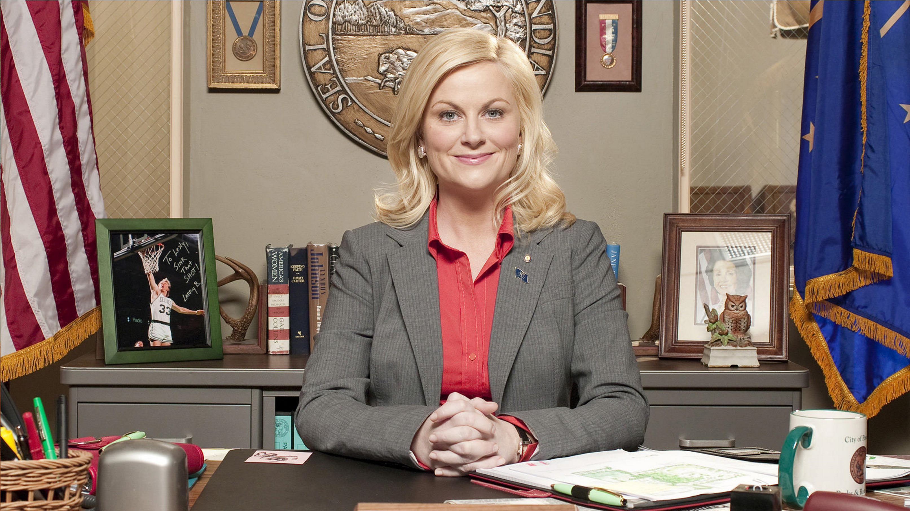
(A) Abigail
The Super User
Controls the “Administrative” functions of the website
Building new users
Controlling the variables and settings
Able to Edit and Publish any content for any Content Groups
Controls Home Page settings and images

Slide 3
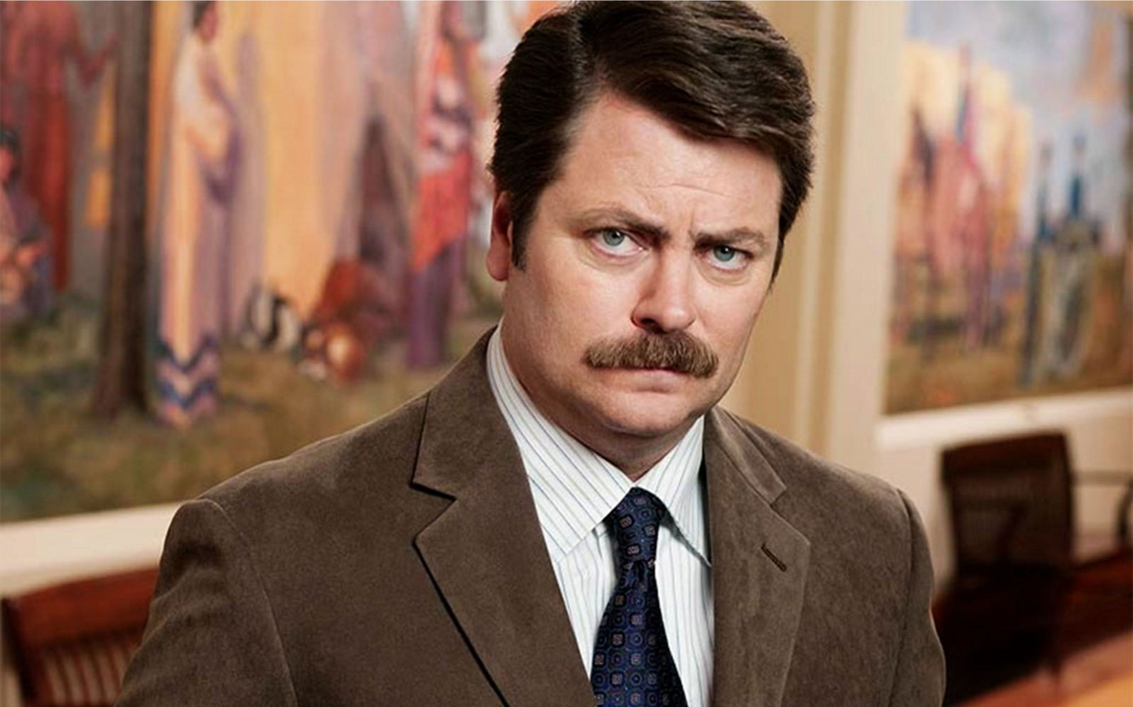
The Basic User
(B) Bruce
*Parks and Rec Dept. Manager
Can only edit and manage content that belongs to the Content Group he belongs to (Parks and Rec)
Bruce has final say over what gets Published for Parks and Rec in a two step Workflow/ Approval Cycle
Other members of his department can work on the web content, but before it goes live Bruce will review then publish

Slide 4
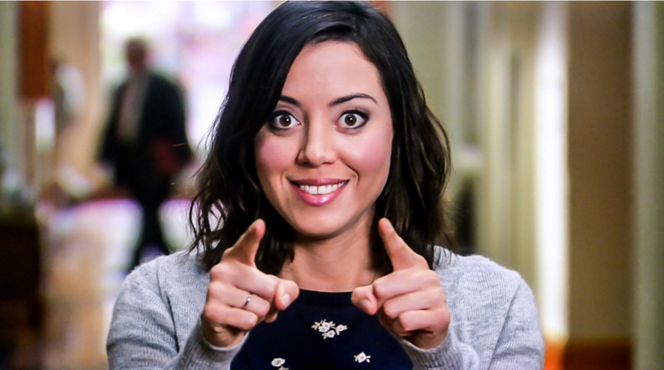
*Parks and Rec Summer Intern
(C) Cassandra
Another Basic User
She can only edit and manage content that belongs to the Content Group she belongs to (Parks and Rec)
What she Edits moves forward to Bruce in a two step Workflow/ Approval Cycle to be Published
She may build, edit and manage lots of content, but Bruce can review

Slide 5
Abigail (A) Bruce (B) and Cassandra (C)
Choose A B or C for you, or the individuals you import in, this will impact what level of access they have for our training site- and may be incorporated into your website

