Slide 1
Oakland County Neighborhood & Housing Development Division
Community Development Block Grant (CDBG)
PY 2024 CDBG Application Workshop
September 6 , 2023

Slide 2
Welcome
HOUSEKEEPING
Please remain on mute until you are called on. This will help to keep the meeting organized and prevent background noise from disrupting the conversation.
If you have a question, please use the chat function. This will allow you to ask your question without interrupting the flow of the meeting. The chat will be monitored by staff.
Thank you for your cooperation. We hope you have a productive meeting.
ATTENDANCE
Attendance is mandatory. Please enter your name, and community in the discussion/chat area to ensure recording of attendance.
If you called into the Webinar, please email CDBG@oakgov.com following the workshop to confirm your attendance.
WORKSHOP MATERIAL AND APPLICATION
The Workshop is being recorded.
Please check your email for links to workshop recording, presentation slide, PY 24 Application, Environmental forms, and maps.
Material for today’s workshop will be made available on/by Friday September 8, 2023.
Applications are DUE by 5pm on Friday December 1, 2023.
Applications MUST be submitted electronically to CDBG@oakgov.com

Slide 3
Welcome
We’re glad you’re here
Oakland County Neighborhood & Housing Development Team
Khadija Walker-Fobbs, Housing Officer
Monique Guerrero, Chief Financial Officer & Deputy Manager
Michael Pucher, Supervisor Contract Compliance
Samantha Ferguson, Grant Compliance Coordinator
Katie Tierney, Sr. Specialist - Environmental Officer
Shelia Leddy, Public Health Resource Coordinator
Simone Craig, Assistant

Slide 4
Welcome
OFFICER ANNOUNCEMENTS
Khadija Walker-Fobbs, Housing Officer
  Introduction of New Staff/Team Member
    Kyle Hines, Housing Trust Fund Manager
    Michele Holmes, Housing Trust Fund Coordinator
  Virtual Office Hours
    Third Tuesday of the Month
    Next Office Hours: September 19, 2023
  Finance Reports
    Available Monthly
  Spending/Timeliness
    Minimum of quarterly draws/reimbursements, monthly recommended
    Timeliness Ration must be below 1.5
    Keep project selection to what can be completed in 18 months
  Funding Updates
    Annual Action Plan submitted to HUD, awaiting approval
    Subrecipient Agreements/Approval to Spend Letters

Slide 5
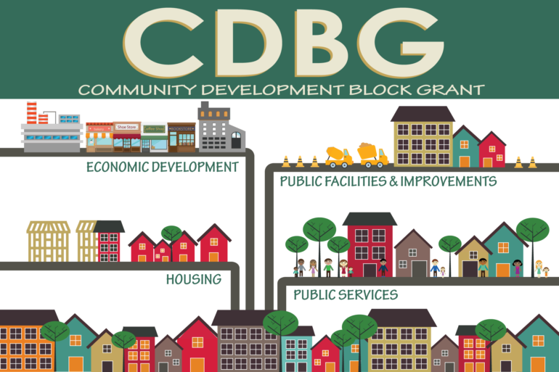

Slide 6
PY 2024 CDBG Application
  CDBG Program Rules & PY 24 Application
  Samantha Ferguson, Grant Compliance Coordinator
    CDBG Program Rules
      PY 2024 Guide & Materials
      Allocations
      Eligible Projects
      Program Rules
    PY 2024 Application Process
      Instructions
      Part 1-5

Slide 7
PY 2024 CDBG Application
POLL QUESTION
What is the first step of the Application Process?
Determine the project budget/allocation
Attending the CDBG Workshop
Determine local needs
Type your response (A, B, or C) in the Chat.

Slide 8
PY 2024 CDBG Application
POLL QUESTION
What is the first step of the Application Process?
Determine the project budget/allocation
Attending the CDBG Workshop
Determine local needs

Slide 9
Application Process
Attend the Application Workshop
Determine Local Needs
Schedule Required Public Hearing
Advertise Public Hearing Notice
Host Public Hearing
Complete Application Materials
Prepare Citizen Participation
Submit Application

Slide 10
PY 2024 Application
ELIGIBLE PROJECTS
The list of eligible projects (and CDBG Matrix Codes begins on page 7 of the Guidebook.
CDBG matrix codes are used to indicate (but do not establish) eligibility. An activity must be eligible in accordance with the regulations (See 24 CFR 570.201-570.207)
ELIGIBLE OR NON-ELIGIBLE?
Using CDBG funds to replace old playground equipment in city-owned park.
Using CDBG funds to resurface gavel parking lot to make ADA compliant and adding additional handicap parking spaces.

Slide 11
CDBG Program Rules
1. Minimum Allocation (Threshold)
$7,000
Allocation Options
  1 PS Project at 100% ($7,000)
  1 Non-PS Project at 100% ($7,000)
  2 Projects at $3,500 each
Minimum Allocation (Non-Threshold)
Formula allocation
Allowed up to 4 CDBG projects per PY
Minimum allocation per project = $3,500
Public Service Cap (Non-Threshold)
15%

Slide 12
PY 2024 Program Rules
Multiple Agency Public Service Contracts
PS contracts of same type not permitted
Public Service Contract Duration
PS contracts maximum 18 month duration
PS contracts start July 1st
Project Service Delivery Costs (PSDC)
Communities may be reimbursed for eligible PSDC
Costs related to delivery of eligible project services
7. Ineligible Uses
Maintenance of public facilities
Items that are not an integral structural fixture

Slide 13
PY 2024 Program Rules
Required Draws
Quarterly. Monthly recommended
Required Expenditures
All funds per year per activity spent in 2 years from Letter to Spend date in IDIS
After 2 years unobligated funds will be evaluated for possible recapture
Micro-Purchase
Goods or services $10,000 or less are considered a micro-purchase and no procurement is required.

Slide 14
PY 2024 Planning Allocations
Exact CDBG funding levels for PY 2024 are not available at this time
Use amount on page 4 (of the Guidebook) to complete application
Once exact amounts are available necessary adjustments will be made
Neighborhood & Housing Development Staff Contacts
See Page 4 for contact information
Monitor assignments, also on page 4 of the Workbook

Slide 15
Application Instructions
Applications MUST be completed and submitted as outlined.
(NO EXCEPTIONS)
  Applications must be completed electronically.
    Use the provided PDF to complete the application
  Applications must be submitted electronically.
    Submit applications as instructed to CDBG@oakgov.com
  Please provide detailed responses.
    Required fields are outlined in red. N/A is an acceptable response.
  Attach ERR and Location and CT/BG Maps

Slide 16
Application Instructions
PY 2024 CDBG Application: Similar Look. Enhanced Functions.
Application includes:
Part 1 - Checklist
Part 2 – Applicant Information
Part 3 - Project Type
Part 4 - Project Overview
Part 5 – Public Hearing/Citizen Participation

Slide 17
PY 2024 Application
PY 2024 CDBG Application Packet
  Available on/by Friday, September 8, 2023
PY 2024 CDBG Application Highlights
  Autofill of Community Name/Allocation Amounts
  Dropdown menus
  Less pages
  And More…
Application Review

Slide 18
Public Hearing
Participating communities required to advertise and conduct a Public Hearing (see examples on Pages 132-134)
Option #1 allows for public hearing notice to appear in a newspaper of general local circulation at least 10 days before the hearing
Option #2 allows for public hearing notice to appear in a posting at the community and on the community website at least 10 days before the hearing unless procedure violates local public hearing notice requirements
    Acceptable only if:
      The community has approved by ordinance/resolution the use of web posting for CDBG Public Hearings and has provided a copy of the ordinance/resolution to OCNHD at the time of application; and
      This procedure does not violate local public hearing notice requirements

Slide 19
Citizen Participation Rules
HUD requires a public hearing in order to receive comments from the public regarding the CDBG application.
Staff presentations and staff or elected official comments must occur before or after the CDBG public hearing.
Comments from the public only must occur once the CDBG public hearing is open and before it is closed.
Option 1: Meeting Minutes
Option 2: Governing Body Resolution

Slide 20
Application Instructions
Applications due by 5:00pm Friday December 1, 2023
No exceptions to due date
Applications received after Tuesday, December 5, will be considered late.
Submit applications electronically (via email) to: CDBG@oakgov.com
Please Do Not Include Unrelated Items

Slide 21
Submission Instructions
You MUST complete the application electronically.
Save the ENTIRE Packet (Filename Outline: CommunityName_Project#)
For communities submitting multiple projects once you complete and save the first project. Open the file and update project information, and “SAVE AS”.
Attach Required and Applicable documentation
Copy of current SAMS
Applicable Environmental Review Requirement forms and documentation.
  Filename Outline: CommunityName_Project#ERR
Notice of Public Hearing (Option 1 or 2)
Public Hearing Minutes (Option 1 or 2)
Submit ALL Application documentation via email to CDBG@oakgov.com.

Slide 22
PY 2024 CDBG Application
  Application Deadline
  5:00 p.m.
  December 1, 2023

Slide 23


Slide 24
Environmental Review Record
  Katie Tierney, Senior Specialist – Environmental Officer

Slide 25
Environmental Review Responsibilities
The Office of Environment and Energy (OEE) manages the environmental review process for HUD
During environmental review, a project is evaluated for potential environmental impacts to determine whether it meets federal, state and local environmental standards

Slide 26
Environmental Review Responsibilities
The environmental review process is required for all HUD-assisted projects to ensure that the proposed project does not negatively impact the surrounding environment and that the property site itself will not have an adverse environmental or health effect on residents and the surrounding community.

Slide 27
Environmental Review NEPA
National Environmental Policy Act (NEPA)
Requires us to integrate environmental values into our decision-making processes by considering the environmental impact of our proposed actions and reasonable alternatives to those actions.

Slide 28
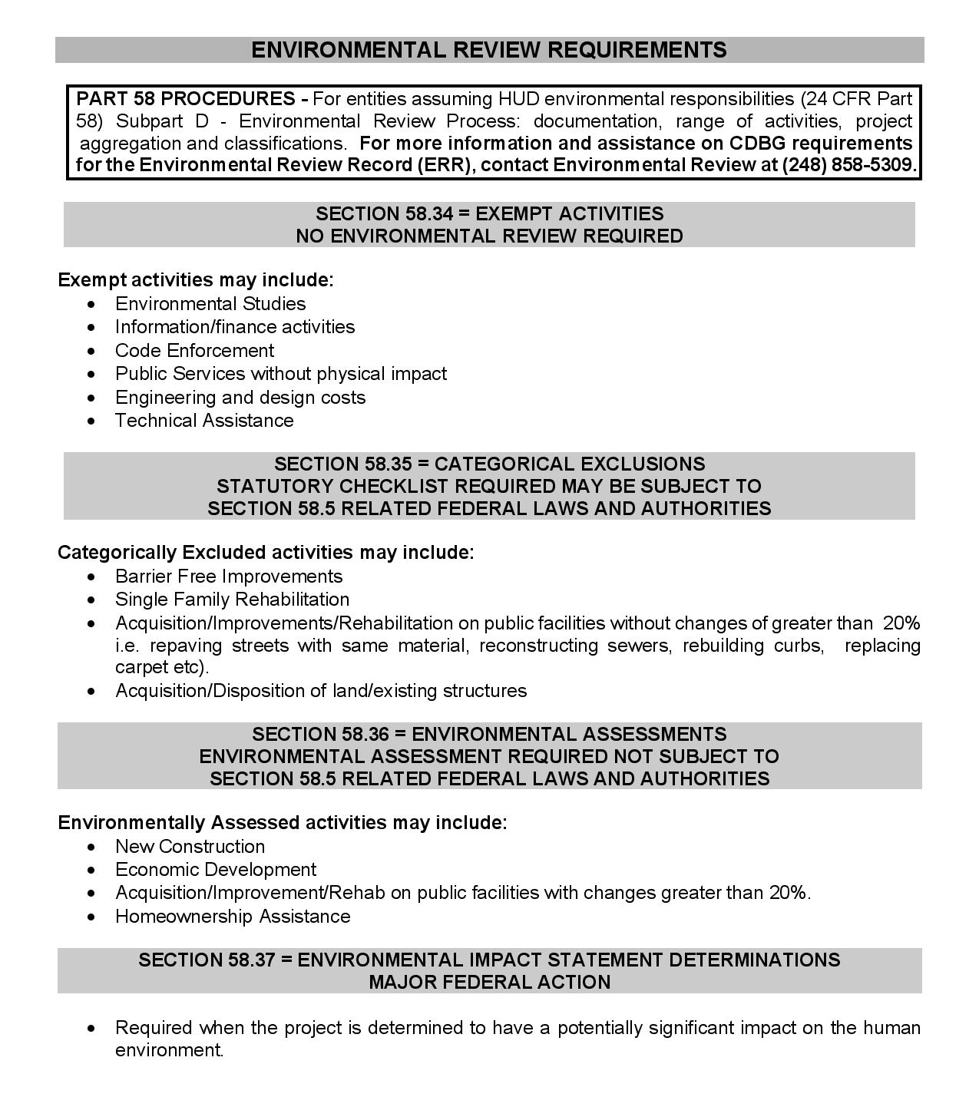
Environmental Review Outline

Slide 29
Environmental Review Requirements
Environmental Review
Required with the Annual Application
Required with all reprogramming requests
One Review Per Project
    If funded in multiple years (must submit each year)

Slide 30
Project Description=Defining the Project
Purpose of the proposed project
Location
Size of the parcel and buildings
Benefits of and impact to the community
Existing conditions
Scope of work to be completed
Number of homes or units (estimate if unknown)
It is estimated that this activity will take up to five years to complete.

Slide 31
Project Description Example
The rehabilitation of Trepanier Hall will include repairs to elevators, replacement of security doors and roof exit doors, the installations of an interior/exterior entry points security system, mechanical updates to the heat system, air recovery system, bathrooms and kitchen, the installation of new sprinkler heads, the replacement of old windows with newer, energy efficient windows, energy efficient LED lights installed throughout the building, covering old worn floors with new flooring, and the addition of wall partitions to better utilize space.
It is estimated that this activity will take up to five years to complete.

Slide 32
Project Description Example
To enhance neighborhoods by removing and replacing existing sidewalk that does not comply with current City safety standards. The sidewalks in noncompliant status create difficult and/or dangerous conditions for pedestrians.
  Concrete flags will be identified for removal and replaced with new concrete sidewalks to proper grade and eliminate trip hazards. The concrete removed shall be disposed of in a manner consistent with all federal, state and local laws and regulations.
  Due to the nature of the proposed sidewalk improvement processes of removing and replacing existing concrete sidewalks, there will be no adverse impact on the environment. It is estimated this project will take up to five years to complete.
  The City had in the specs but not in the ERR there were many locations for tree root removal in addition to sidewalk replacement which would have a need for more invasive foundation groundwork. SHPO and THPO would have needed to have been contacted.

Slide 33
Tree/Bush Removal – Ground Disturbance Endangered Species
We are trying to stay away from any habitat disturbance at this time.
If a tree needs to be taken down, you must contact our office beforehand, and we may need to come out and see it.
Pictures must be taken for the file.
If the work is being done on an already manicured lawn, that is fine, we just needs pictures and document the file stating just that.
Depending on what we find, professional consultation may be needed.
Hazardous tree removal will trigger iPac, but it does get expedited.
  Be sure to let us know if it’s a hazardous tree and if there is going to be ground disturbance.
New iPac system being used with the Fish & Wildlife Service now with endangered species which may trigger a higher level of review.
Ground disturbing activities may trigger THPO consultation.

Slide 34
SHPO/Section 106
THPOs
New guidance on Minor/Mobile Home repair SHPO/Section 106
  Previous exemption form is now obsolete
A memo will be sent to the CVTs who provide this service to their constituents
Memo states any rehabilitation work done must be sent to SHPO for evaluation before the work can be done
  Allow 30 days for SHPO to respond
Any significant ground disturbance, THPOs will need to be contacted (this is done by the County)
  I will send you a copy of the letter, a signed letter must be put in each file
  Must allow 30 days for THPOs to respond
Guidance for Categorizing an Activity as Maintenance for Compliance with HUD Environmental Regulation, 24 CFR Parts 50 and 58; Issued February 8, 2016

Slide 35
Inadvertent Discovery Plan for Human Remains or Cultural Items
This document can be found in the guidebook, and it sets forth the protocol to be followed in the event that human remains, and funerary objects are encountered during ground-disturbing work on a HUD-funded project.
With any ground-disturbing activities, there is the possibility that human remains or artifacts will be encountered.
Any human remains encountered will be treated with care and respect. Work must stop and appropriate agencies must be contacted for direction as listed in the plan.
In the policy a sequence of steps to follow and be implemented in the event of the discovery of human remains during a section 106 project is listed and must be adhered to.

Slide 36
ERR – Exempt: Listed in 24 CFR 58.34(a)
Projects that do not effect environment
(must submit form & colored maps for each project)
Code Enforcement
Technical Assistance
Public Services (no physical impact)
Environmental & other planning studies
Strategic Plans
Engineering or Design Costs
Purchase of tools & insurance

Slide 37
Statutory Checklist
Airport – Must include map(s)
  The City of Berkley is not located within 15,000 feet of a military airport or 3,000 feet of a commercial airport. The nearest airport is Coleman Young International Airport, and it is approximately 11 miles away. The project does not involve the sale or acquisition of developed property.
Coastal Barriers – Must include map
  This project is not located in a CBRS Unit. Therefore, this project has no potential to impact a CBRS Unit and is in compliance with the Coastal Barrier Resources Act. There are no Coastal Barriers in Oakland County.
Flood Insurance –
  The project does not involve mortgage insurance, refinance, acquisition, repairs, rehabilitation, or construction of a structure, mobile home, or insurable personal property and does not require flood insurance. Flood plains will not affect this project.

Slide 38
ERR - Categorically Excluded Subject To: 24 CFR 58.35(a)
Minimal Effect on Environment
Acquisition
Remove Architectural Barriers
Rehabilitation w/out changes of >20%
Surface with same material w/out changes of >20%
Statutory Checklist Required
Colored Maps and Documentation
Notes:
Categorically excluded activities minimally affect the environment.
Replacing like with like
A statutory checklist, floodplain management, and historic clearance is required.

Slide 39
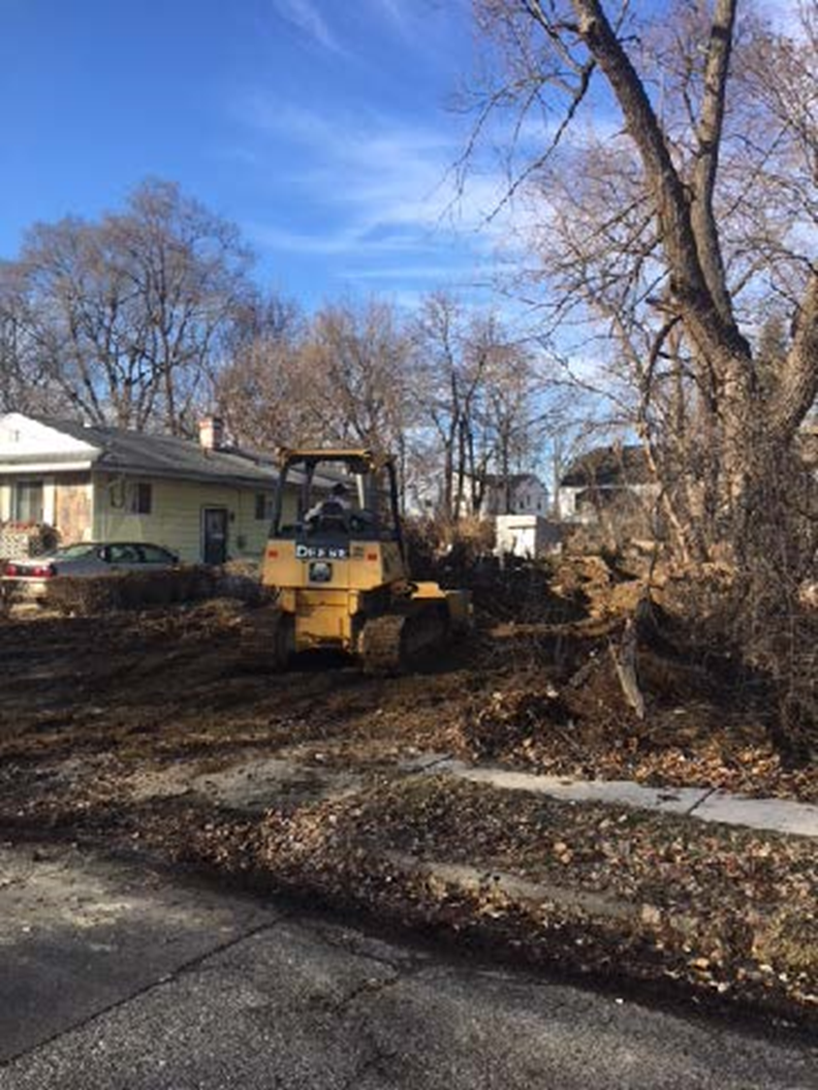

Slide 40
ERR - Environmentally Assessed
  Non Exempt or Categorically Excluded Projects must complete a Full EA – Majority of projects do not fall in this category
May have an effect on the environment
Residential buildings when density is increased
  over 4 units or when land use changed
Water
Sewer
Sidewalks
Major Rehabilitation
Most new construction, reconstruction, or demolition
Whenever no exclusion applies
Statutory Checklist Required
Colored Maps and Documentation

Slide 41
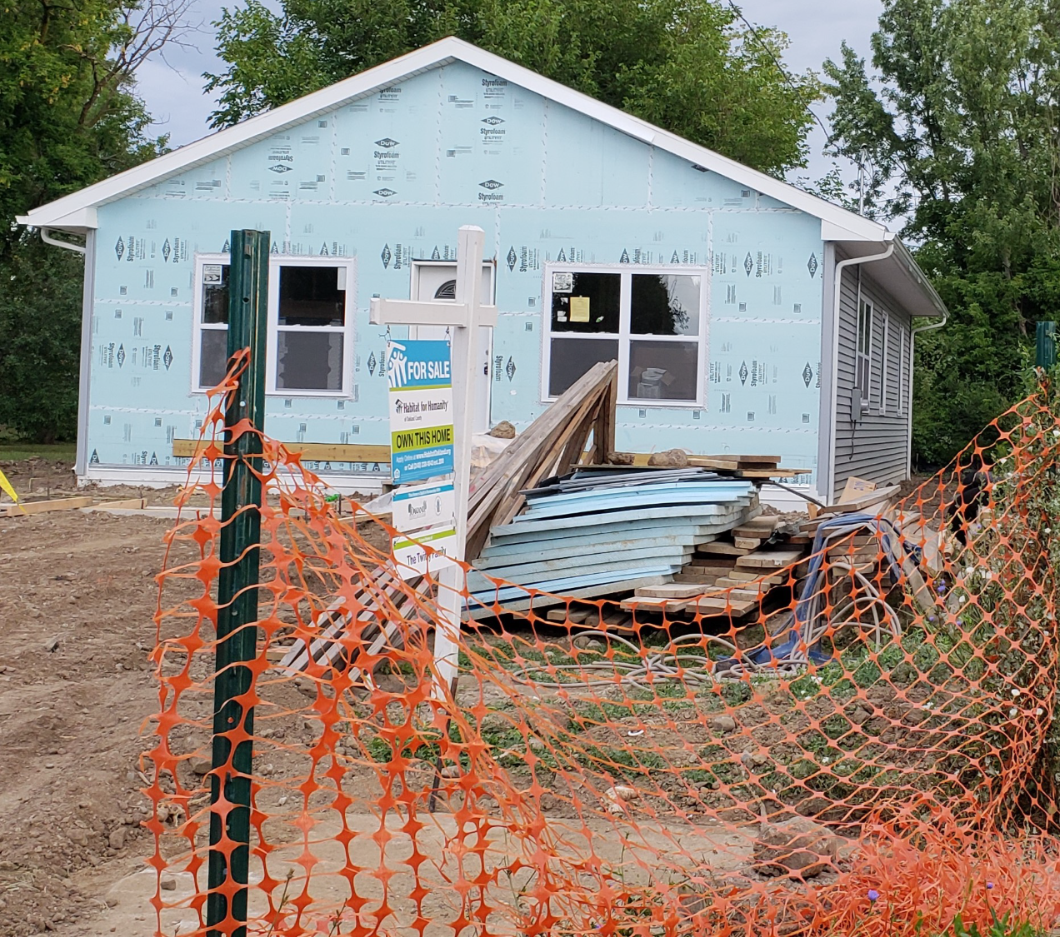

Slide 42
ERR - Source Documentation
Use Federal, State, local oversight agency or recognized authoritative sources and verifiable documentation
  Verifiable: City/county land use plans, FEMA maps, zoning maps, USGS topo maps, historic registers, aerial photos, EPA, Noise Analysis, grading plans, asbestos surveys, wetland delineations, etc.
  Relevant: Field observations, photos, interviews, printed materials, letters, emails, phone logs, reports, studies, etc.
  Do not use the words none, not applicable (N/A) etc.

Slide 43
Credible Websites
EPA NEPAssist – Look for toxic and hazardous locations https://nepassisttool.epa.gov/nepassist/nepamap.aspx
HUD Exchange – Related Federal Laws & Authorities
https://www.hudexchange.info/programs/environmental-review/federal-related-laws-and-authorities/
Endangered Species – Habitat Disturbance https://ipac.ecosphere.fws.gov/
SHPO/Section 106
https://www.miplace.org/historic-preservation/programs-and-services/cultural-resource-management-and-planning/
WISER Training - https://www.hudexchange.info/trainings/wiser/
Must have a HUD login to complete the WISER training

Slide 44
Environmental Review Record
Bidding and construction of a project
May not begin nor funds obligated or expended until the ERR process has been completed and approved - OCNHD will not reimburse
ERR will vary in length and content
Depending upon the level of review required for the activity

Slide 45
Environmental Review Record
ERR is written evidence “administrative record” of review-decision making-action
One per project
Reviewable to public/HUD/OCNHD
Contains evaluations, proper HUD forms, findings, decisions, documentation, maps, resources, notices, permits and approvals
Your proof of procedural compliance with Federal and State environmental laws and your defense against any environmental challenges
File with application or reprogramming

Slide 46
Environmental Review Record
Person(s) completing ERR does not need to be a technical expert - should be credible in case it becomes necessary to defend the ERR and level of clearance
Certifying Officer is Highest Elected Official or board resolution designee at your community
OCNHD Environmental Officer/ Approver is Katie Tierney for Exempt and CEST’s
All Environmental Assessment’s need to be signed by County Executive David Coulter

Slide 47
Contract Compliance
  Mike Pucher, Supervisor Contract Compliance
  Spending Performance
  Environmental / SHPO / THPO
  SAM Registration / Debarment
  Equal Opportunity

Slide 48
Recommend submitting requests monthly!

Slide 49
Spending Performance
More detail on contractor invoices.
Don’t say “services rendered” or “per specifications” be more specific.
For example: (100 lawns mowed @ $25 = $2500 billed)
DBA – Count starts over every July 1 or when account is expended.
DBA – Minor home repair = head of household = 1
Financial reports are being mailed out on a regular basis. Might not be exactly what your reporting because of timing of reimbursement.

Slide 50
Administrative Capacity
Only apply for the number of projects you have capacity to expend within 18 months.
For example: We strongly recommend only applying for two strong projects if that’s what your staff can currently handle.

Slide 51
Reimbursement
To be reimbursed for CDBG activities, the CVT must prepare and submit a request for reimbursement. Use the checklist to help ensure documents are complete and the reimbursement package contains all needed items for timely reimbursements.

Slide 52
Reimbursement Check List
Community Reimbursement Request letter is complete.
On official letterhead
Community abbreviation, date, and total funds requested at the top
  Body of letter includes the total amount of reimbursement requested (this number matches the number on top of the form)
  Table is complete and accurate with the following with each fund, account, and program year on a separate line:
Program Year for funds expended
Account name
Account number
Total amount expended for PY account
Total amount of funds remaining as a result of the request
  Checks payable portion is complete, accurate, and includes the address the check should be sent to
Signature on bottom of letter
Language at bottom of form verifying truth of document

Slide 53
Reimbursement Check List
A complete reimbursement package shall include the following:
Community reimbursement request letter (see above)
Activities must have occurred after the release of funds date for the program year expending
Invoice(s) from vendor or contractor (must be dated before the check)
  Contract amounts over $10,000 must include a completed bid tab form, listing vendor as lowest bidder.
  Detailed invoice should match amount paid and contractor listed on check and bid tab
Copy of the check(s) copy paid to vendor (must be dated after the invoice from vendor)
Additional supporting information:
  Public service activities:
      Direct Benefit Activity (DBA) form (two pages) providing demographic data on the client(s) served

Slide 54
Reimbursement Checklist
Public Service Contract between the community and the agency/vendor/contractor that is signed and covers the date(s) the service was rendered.
Contract Extension when needed.
Extension must be singed.
Extension dates must begin immediately after the contract expired and have a defined end date.
Davis Bacon projects need all documents submitted according to the pre-construction checklist (see attached also found on our website at https://www.oakgov.com/community/neighborhood- housing-development/grants-funding/community- development-block-grants-cdbg-contractors.

Slide 55
Environmental Requirements
  New - More detailed environmental reporting
  Additional SHPO / THPO requirements
  Endangered Species - FWS
  Demolition -new form in SHPO for submittal

Slide 56
SHPO Requirements
  HISTORIC PRESERVATION
  WHAT:
  MI SHPO and THPO consultation, any project that includes rehabilitation level work or demolition should complete consultation prior to beginning work. It does not need to be 50 years old to have historical significance as it could have significance via other means than age (related to a specific famous/significant person, act, etc).
  HUD Notice CPD-16-02 Guidance for Categorizing an Activity as Maintenance for Compliance with HUD Environmental Regulation, 24 CFR Parts 50 and 58; Issued February 8, 2016
  SHPO = State Historic Preservation Office • THPO = Tribal Historic Preservation Office
  ACHP = Advisory Council on Historic Preservation • SOI = Secretary of the Interior

Slide 57
SHPO Requirements
  HISTORIC PRESERVATION
  WHO:
  The use of a professional historical archaeologist/architect/etc. is not required by the ACHP or HUD for submission to the state SHPO.
  HOWEVER, The submittal to the SHPO must be of professional level though. The ACHP has provided the following: “ The Section 106 regulations do not require submissions to be completed by historic preservation professionals who meet the SOI Professional Qualification Standards. This requirement is not stated in the regulations. “ What is required is that the submission itself must meet professional standards; i.e. the Section 106 regulations and related guidance. Documentation must be complete and sufficient to justify the final finding of effect. The SHPO can send back insufficient submittals but should not be rejecting them based upon not have a “professional” prepare them.
  SHPO = State Historic Preservation Office • THPO = Tribal Historic Preservation Office
  ACHP = Advisory Council on Historic Preservation • SOI = Secretary of the Interior

Slide 58
Environmental Requirements
  Rehab vs. Maintenance – see HUD notice CPD-16-02
  Endangered Species - FWS
  Ground Disturbance
  Habitat Destruction
  Tree Removal – Note: If tree is a human hazzard…we can expedite the review through the IPAC system
  Ipac – Fish & Wildlife Services
  There is also a new demolition submittal form online.
  http://www.mi.gov/shposection106

Slide 59
SAM Registration https://sam.gov/content/home
Pre-Federal Award Requirements
Must have correct unique entity ID to receive federal award
All municipalities must register in SAM
SAM registration due with CDBG application

Slide 60
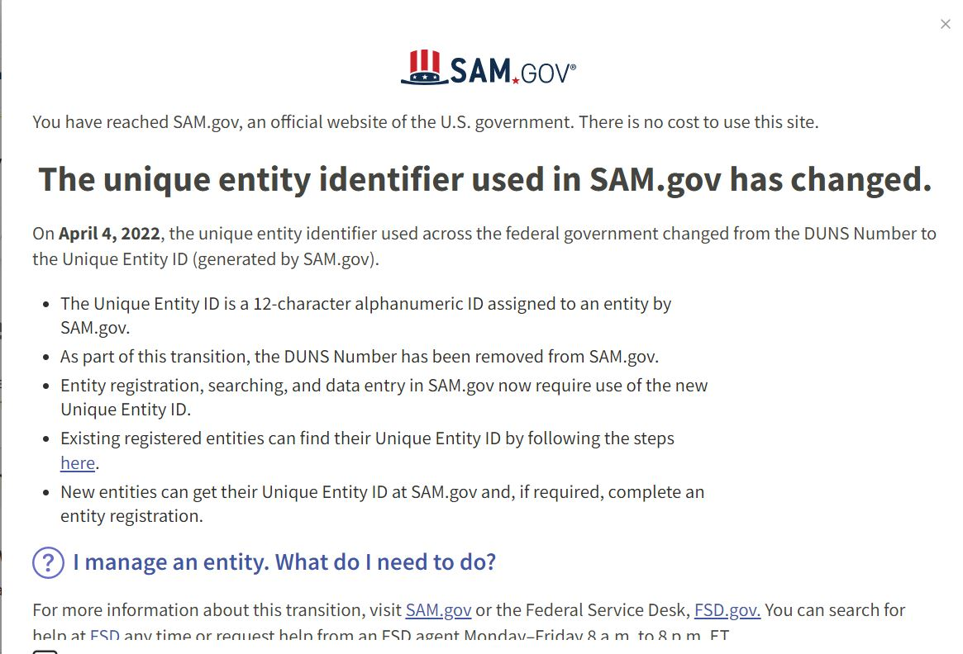

Slide 61
SAM Registration
Submit current SAM registrations with CDBG application
When HUD grant agreements are received Contract Compliance will check debarment status
If a municipality has an expired SAM registration, Contract Compliance will request an update
Your SAM’s registration must be current before CDBG award
Oakland County Fiscal Services may contact you time to time for their own reporting

Slide 62
SAM Contractor Debarment Check
Subpart C - Debarment Verification
All contractors must be checked for debarment PRIOR to award of contract using Federal Funds
SAM = System for Award Management
  https://www.sam.gov/content/home

Slide 63
SAM Debarment https://sam.gov/content/home
Start @ Home Page
Select – “Search”
Select “All Domains” - “Entity Information” – “Exclusions”
Input “Contractor name”
Hit “Enter”
You should see “No matches found” - Print this page
Note: If a contractor with a similar name comes up – print that page to reference this isn’t your contractor.
If you have an Account - Go to “Entity Information” sign in
Search “exclusions”
Note: there is a video tutorial

Slide 64

Equal Opportunity
ALL ADVERTISEMENTS - Equal Opportunity Programs/ Activities
HOUSING PROGRAMS -
ADVERTISEMENT FOR BIDS - This municipality is an equal opportunity employer, businesses owned by women or minorities are strongly encouraged to bid. advantageoakland/resources/Documents/chi_
ADVERTISEMENT_SAMPLE.pdf

Slide 65
Q & A/NEXT STEPS
QUESTIONS?
Please use the chat, unless asked to unmute, for questions.
IMPORTANT DATES TO REMEMBER
MONTHLY OFFICE HOURS
September 19, October 17, & November 21
APPLICATION DUE
Friday, December 1, 2023

Slide 66
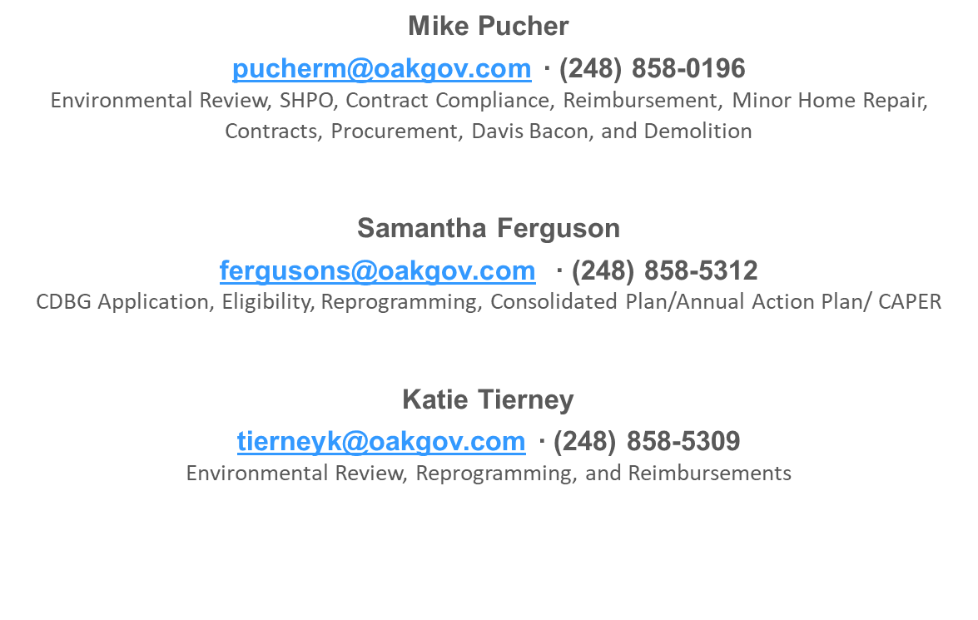
STAFF CONTACT INFORMATION

