Slide 1
Change Management - Workflows
Table of Contents
Introduction
Log into Clarity
Create a New Change Request
Select and Update Change
Begin the Change Workflow Journey
Trigger AIR Workflow - Submit Change Request for Approval
Action Items - Monitor the Change Workflow
AIR Workflow Approvals
Approval – Complete PMO Processes
AIR Workflow Rejection
Restart the Workflow
Change Type Tables
  Baseline - Initial
  Baseline - Planning Next Phase
  Rebaseline
  Project On Hold
  Project Close
  Project Cancel

Slide 2
Change Management - Workflows
Intro
The Change Request Approval Workflow is driven by Change record “Change Type” and Project field data. Change Types include:
  Initial Baseline
    New Projects
    No Baseline Exists
  Replanning Baseline
    Detailing Preliminary (~~~~P)
    Baseline Exists
    Planning Next Phases box is checked
  Rebaseline
    Revised End Date
    Additional Hours are Needed
    Red to Green Plan
  On Hold
  Close Project
  Cancel (Closed)

Slide 3
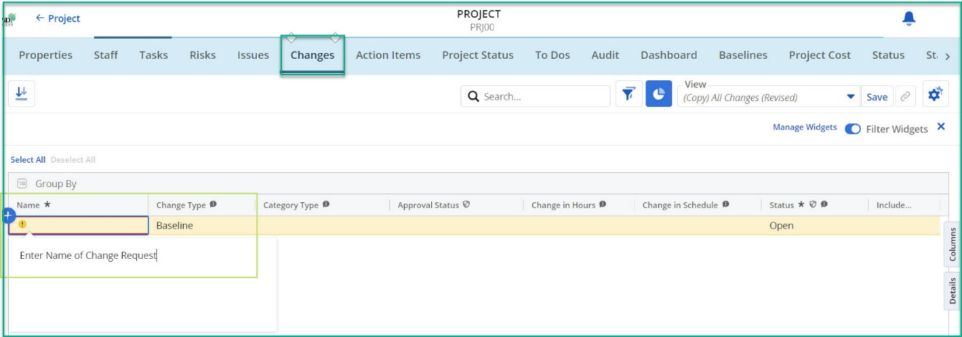
Change Management - Workflows
Log into Clarity
On the left navigation pane, click the Projects module icon.
Projects will be displayed.
Create a New Change Request
Open a Project, click on the Changes tab.
Click Add Row + button.
Fill in the required fields (*) – Name.
  Record is saved when required field(s) are populated.
Notes:
Image 1

Slide 4
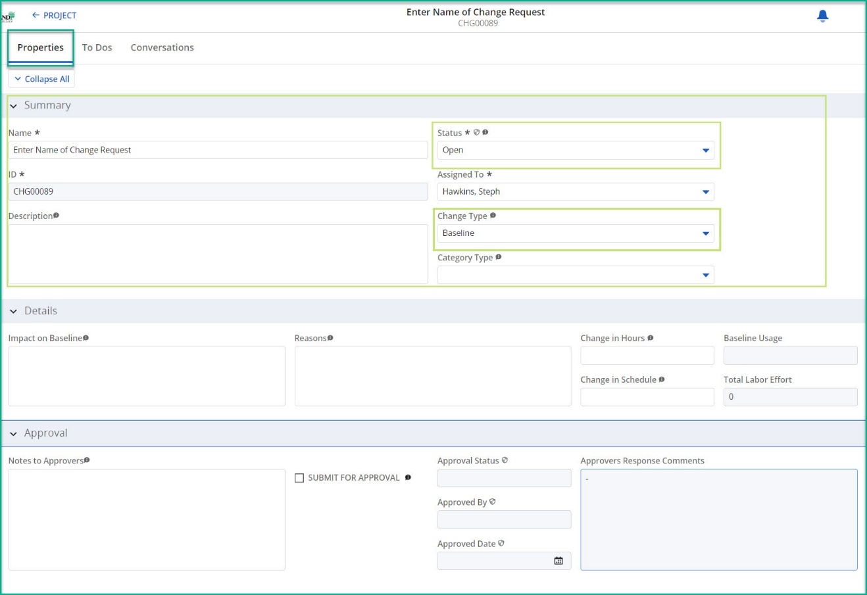
Change Management - Workflows
Select and Update Change
On the new Change record, click Name to open the Properties tab.
Select the Change Type. [Refer to Tables 1- 6]
  Baseline - Initial
  Baseline - Planning Next Phase
  Rebaseline
  Project On Hold
  Project Close
  Project Cancel
Complete the mandatory fields in the Change section(s) for the Change Type:
  Summary: Name, Assigned To, Description, Change Type
Quick Tips:
  Refer to Tables 1-6 throughout the workflow
  Change Status default value is Open. After checking the SUBMIT FOR APPROVAL field, this read-only field will change based on the Approval Status within the workflow.
  Record is automatically saved as fields are populated.
  WARNING: Do not check the SUBMIT FOR APPROVAL field until all mandatory fields are populated in the Project Properties and Change Properties tabs.
Notes:
Image 2

Slide 5
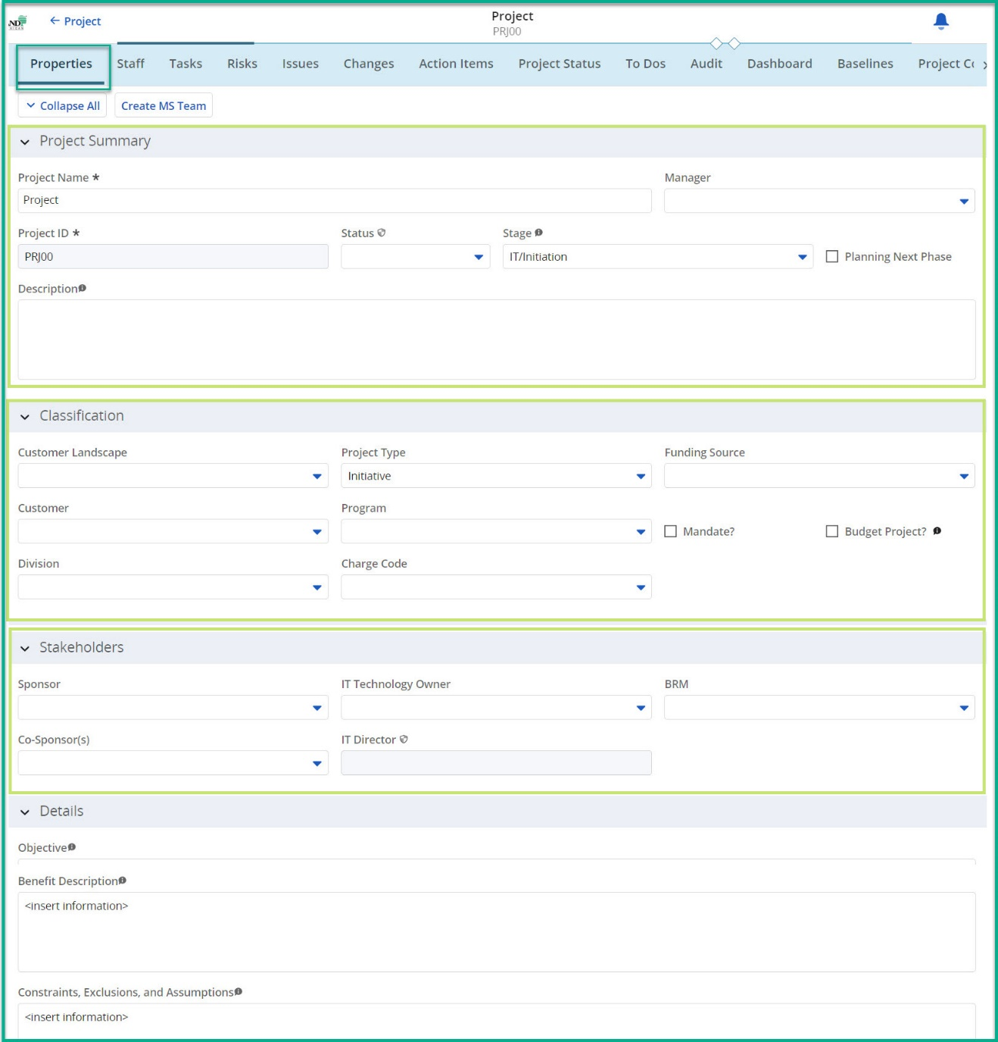
Change Management - Workflows
Begin the Change Workflow Journey
Click on the Project Properties tab.
Review and complete the mandatory fields in the Project Properties section(s):
  Project Summary: Manager
  Classification: Customer Landscape, Customer, Project Type, Funding Source, Charge Code
  Stakeholders: Sponsor, Co-Sponsor(s), IT Technology Owner
Quick Tips:
  Contact the PMO if the IT Director field is empty.
Notes:
Image 3

Slide 6
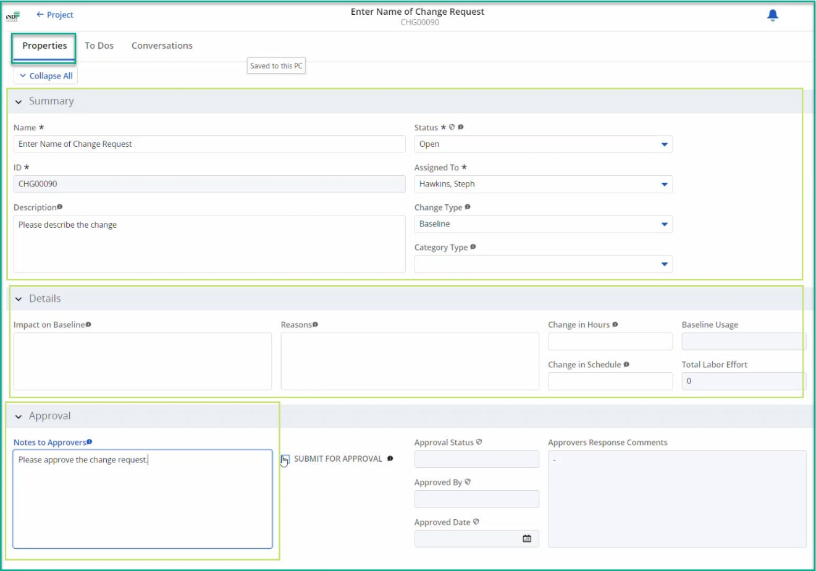
Change Management - Workflows
Begin the Change Workflow Journey (cont.)
Click on the Project Changes Tab.
On the Change record, click Name to open the Change Properties tab.
Review and complete the mandatory fields in the Change section(s) for the Change Type:
  Summary Section: Name, Description, Assigned To, Change Type
Review and complete the Optional fields in the Change section(s) for the Change Type :
  Approval: Notes to Approvers
Quick Tips:
  Notes to Approvers: This message is sent to all Stakeholder(s) to read and action in the approval email.
  Contact the PMO if the IT Director field is empty.
  WARNING: Do not check the SUBMIT FOR APPROVAL field until all mandatory fields are populated in the Project Properties and Change Properties tabs.
Notes:
Image 2.5

Slide 7
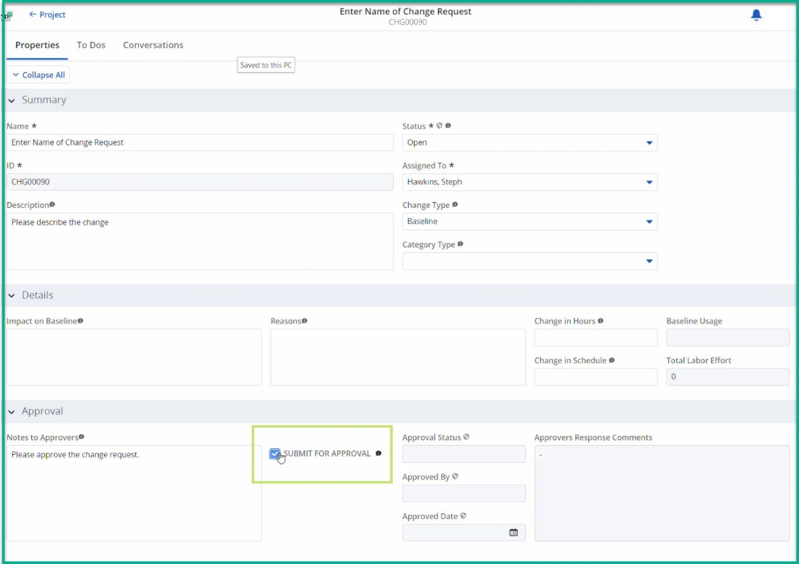
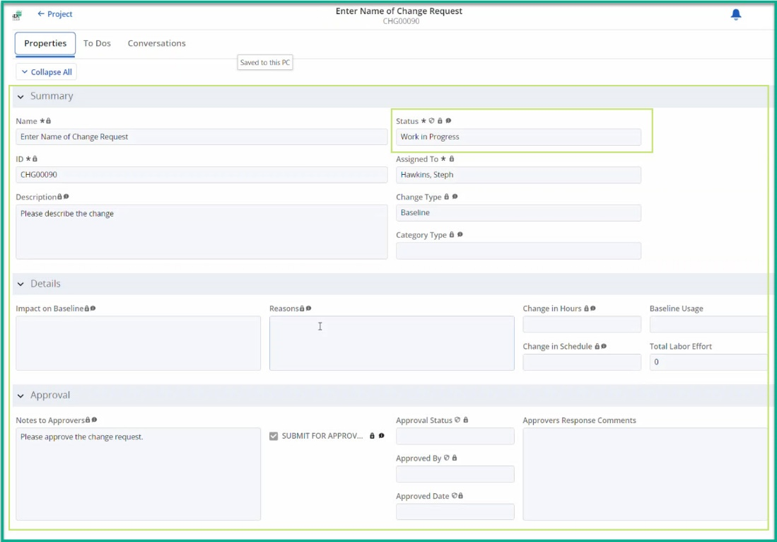
Change Management - Workflows
Trigger AIR Workflow - Submit Change Request for Approval
To trigger the Change Workflow, click the checkbox □ SUBMIT FOR APPROVAL.
In your browser, refresh the page or use the left arrow to exit the Change Request.
  If the Change fields turn light gray and are locked, the workflow is in process.
  If the Change fields do not turn light gray and lock, the submitter should check the mandatory fields in Project Properties and Change Properties and resolve missing data. The submitter will receive a missing data email. The user must re-trigger the Idea Workflow and check the SUBMIT FOR APPROVAL field.
Status will change to Work In Progress
Stakeholder(s) will receive an email based on the Change Status field.
Notes:
IMAGE 4.1 & 4.2

Slide 8
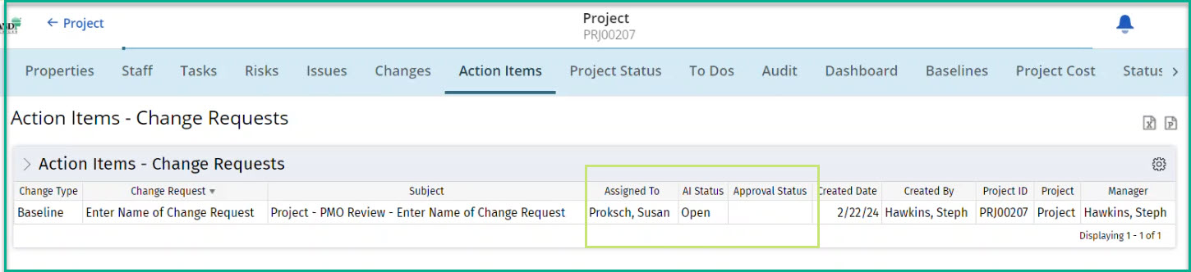
Change Management - Workflows
Action Items - Monitor the Change Workflow
Open a Project, click on Action Items tab.
Review active Action Items – Change Request columns labeled to determine current status:
  AI Status: This provides open/closed status of workflow for Stakeholder
  Approval Status: This provides approval decision:
    Approved = Stakeholder Approved
    Rejected = Stakeholder Rejected
    Null = Stakeholder decision not provided or processed
Quick Tips:
  Action Item Responder (AIR) is being used to Automate Workflow Processes and Approvals.
    Emails route to IT Management and Sponsors.
    AIR processes execute every 15 minutes. Contact PMO if a Change Request is urgent.
  Action Items tab:
    Utilize tab to understand the status of emails sent and the recipients.
    Click > Action Items – Change Request to filter and rerun report for inactive change Request to view history.
Notes:
IMAGE 10.1

Slide 9
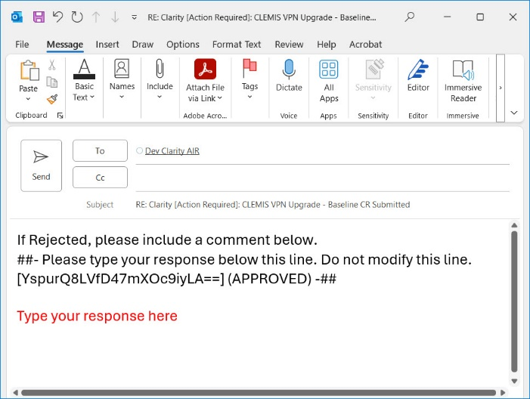
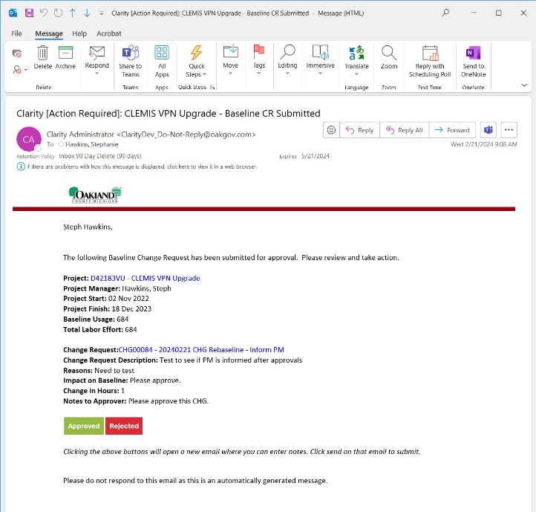
Change Management - Workflows
AIR Workflow Approvals
Stakeholder(s) will receive an email with a call to action in the Subject Line:
  Clarity [Action Required]: <Name of Project> - <Status Information>
Stakeholder(s) will review the information and decide by clicking on a button:
  Approved (green)
  Rejected (red)
After clicking a button, a new email will open. The email body will contain the following language:
  If Rejected, please include a comment below.
  ##- Please type your response below this line. Do not modify this line. [bd6V6mRDmZ8FS2MI4PalQw==] (APPROVE) -##
  Warning: Stakeholders will need to CLICK BELOW this information in the email body to enter their response, as applicable.
Stakeholder will click the Send button when completed.
Notes:
IMAGE 5
IMAGE 6

Slide 10
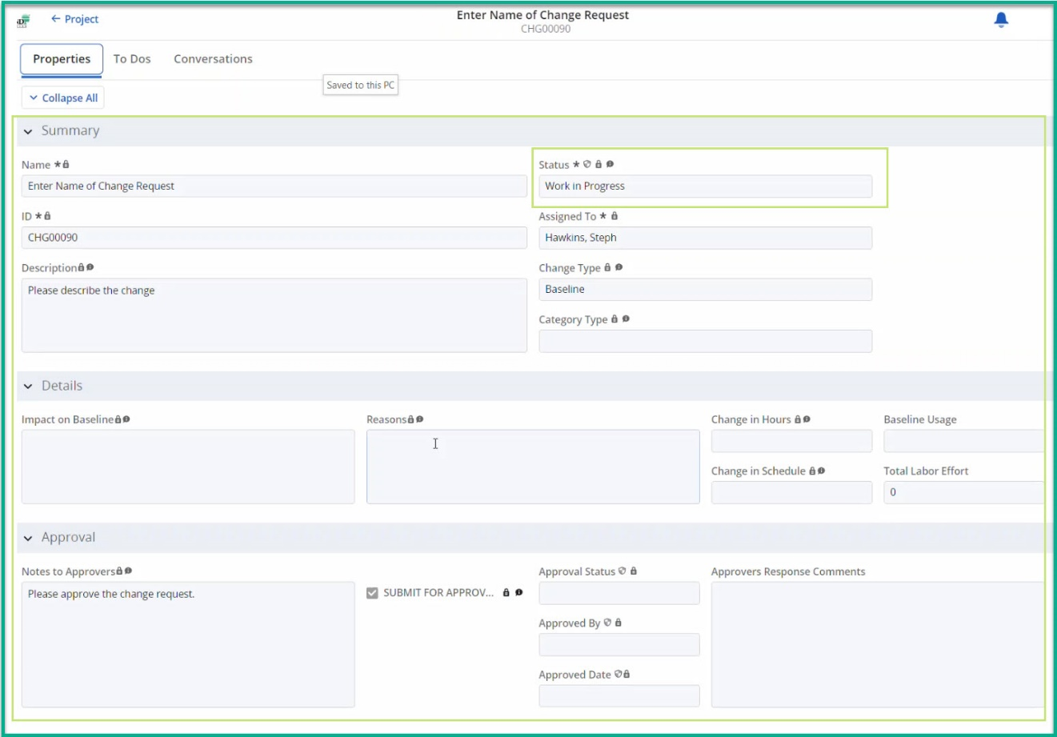
Change Management - Workflows
AIR Workflow Approvals (cont.)
Approved: AIR processes the stakeholders' email responses and updates the Approvers Section fields.
  In the Change Summary section, Status will remain Work In Progress until all Stakeholder(s) approve.
  In the Change Approval Section:
    Approval Status will be updated based on the progression of workflow.
    Approved By and Approved Date will update after processing Sponsor approval.
    Approvers Responses Comments will update throughout the workflow after processing Stakeholder emails.
  Stakeholder(s) will receive an email based on the Status field.
  In the Change Summary section:
    Status will then change to Approved after processing all Stakeholder approvals.
Notes:
IMAGE 8 4.2

Slide 11
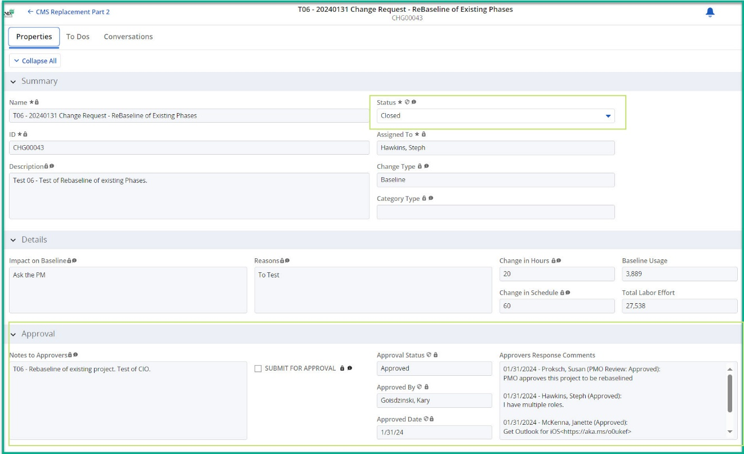
Change Management - Workflows
Approval – Complete PMO Processes
  Baseline:
    PMO is notified the Change is approved and to begin the ‘Baseline Process’.
      PMO will contact the Project Manager if there are questions.
    PMO completes the ‘Baseline Process’.
    Stakeholder(s) will receive an email based on the Status field.
  Automated PMO Process:
    Process runs automatically after AIR processes all Stakeholder approval(s) for:
      ‘Project on Hold’ Process
      ‘Close Project’ Process
      ‘Cancel Project’ Process
    In the Change Summary section:
      Status will then change to Closed.
    Stakeholder(s) will receive an email based on the Status field.
Notes:
IMAGE 8

Slide 12
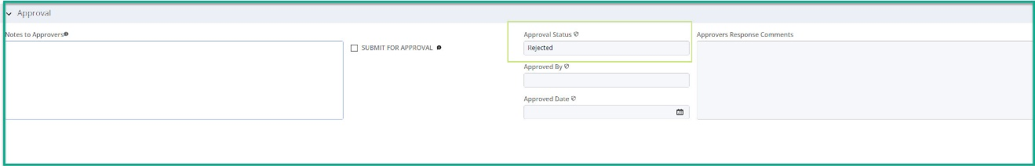
Change Management - Workflows
AIR Workflow Rejection
Rejected: AIR processes the stakeholders' email responses and updates the Approvers Section's Idea Approvers Response Comments field.
  In the Change Summary section, the Status will change to Closed if any Stakeholder(s) rejects.
  In the Change Approval Section:
    Approval Status will be updated based on the progression of workflow.
    Approvers Responses Comments will update throughout the workflow after processing Stakeholder emails.
  Stakeholders will receive an email based on the Status field.
  The workflow ends and will need to be restarted.
Restart the Workflow
Resolve the reason for the Change Request rejection.
Click on the Changes Tab.
On the Change record, click Name to open the Change Properties tab.
  To trigger the Change Workflow, click the checkbox □ SUBMIT FOR APPROVAL
  In your browser, refresh the page or use the left arrow to exit the Change Request.
    If the Change fields turn light gray and are locked, the workflow is in process.
    If the Change fields do not turn light gray and lock, the submitter should check the mandatory fields in Project Properties and Change Properties and resolve missing data. The submitter will receive a missing data email. The user must re-trigger the Idea Workflow and check the SUBMIT FOR APPROVAL field.
  Status will change to Work In Progress.
  Stakeholders will receive an email based on the Change Status field.
Notes:
IMAGE 9

Slide 13
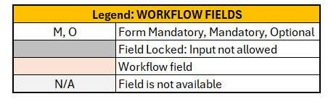
[TABLE 1] Change Management Workflow and Fields: Project - Initial Baseline
WORKFLOW: Project - Initial Baseline
Change Type | Open | Work In Progress | Sub Type: Submit for PMO Review | Sub Type: Submit for Approval | Sub Type: Approved | Sub Type: Reject | Approved | Closed
Stakeholder
Project Manager | □ Submit for Approval |  |  | Inform |  | Inform | Inform | Inform
PMO |  | Inform | Decision | AIR |  |  | Inform | 'Baseline' Process
Director |  |  |  |  | Decision
Sponsor / Co-Sponsor |  |  |  |  | Decision
IT Technology Owner |  |  |  |  | Decision |  |  | Inform
WORKFLOW FIELDS: Project - Initial Baseline
Project Fields |  |  | Change Workflow “Status”
Tab | Section | Field Name | Open | Work In Progress | Closed
Properties | Project Summary | Manager | M | M | M
Properties | Classification | Customer Landscape | M | M | M
Properties | Classification | Customer | M | M | M
Properties | Classification | Division
Properties | Classification | Project Type | M | M | M
Properties | Classification | Funding Source | M | M | M
Properties | Classification | Charge Code | M | M | M
Properties | Stakeholders | Sponsor | M | M | M
Properties | Stakeholders | Co-Sponsor(s)
Properties | Stakeholders | IT Technology Owner | M | M | M
Changes | Summary | Name * | M | M | M
Changes | Summary | Status * | M | M | M
Changes | Summary | ID * | M | M | M
Changes | Summary | Assigned To * | M | M | M
Changes | Summary | Description | M | M | M
Changes | Summary | Change Type | M | M | M
Changes | Summary | Category Type
Changes | Details | Impact on Baseline | N/A | N/A | N/A
Changes | Details | Reasons | N/A | N/A | N/A
Changes | Details | Change in Hours | N/A | N/A | N/A
Changes | Details | Change in Schedule | N/A | N/A | N/A
Changes | Details | Baseline Usage | N/A | N/A | N/A
Changes | Details | Total Labor Effort | M | M | M
Changes | Approval | Notes to Approvers
Changes | Approval | SUBMIT FOR APPROVAL | □ Trigger | N/A | N/A
Changes | Approval | Approval Status | N/A | M | M
Changes | Approval | Approved By | N/A | M | M
Changes | Approval | Approved Date | N/A | M | M
Changes | Approval | Approvers Response Comments | N/A | M | M
Notes:
Change Request defaults “Change Type” to baseline
Initial Baseline:
No baseline exists
CIO will not receive Decision email

Slide 14
[TABLE 2] Change Management Workflow and Fields: Project - Planning Next Phase
WORKFLOW: Project - Planning Next Phase
Change Type | Open | Work In Progress | Sub Type: Submit for PMO Review | Sub Type: Submit for Approval | Sub Type: Approved | Sub Type: Reject | Approved | Closed
Stakeholder
Project Manager | □ Submit for Approval |  |  | Inform |  | Inform | Inform | Inform
PMO |  | Inform | Decision | AIR |  |  | Inform | 'Baseline' Process
Director |  |  |  |  | Decision
Sponsor / Co-Sponsor |  |  |  |  | Decision
IT Technology Owner |  |  |  |  | Decision |  |  | Inform
WORKFLOW FIELDS: Project - Planning Next Phase
Project Fields |  |  | Change Workflow “Status”
Tab | Section | Field Name | Open | Work In Progress | Closed
Properties | Project Summary | Manager | M | M | M
Properties | Project Summary | Planning Next Phase | M | M | M
Properties | Classification | Customer Landscape | M | M | M
Properties | Classification | Customer | M | M | M
Properties | Classification | Division
Properties | Classification | Project Type | M | M | M
Properties | Classification | Funding Source | M | M | M
Properties | Classification | Charge Code | M | M | M
Properties | Stakeholders | Sponsor | M | M | M
Properties | Stakeholders | Co-Sponsor(s)
Properties | Stakeholders | IT Technology Owner | M | M | M
Changes | Summary | Name * | M | M | M
Changes | Summary | Status * | M | M | M
Changes | Summary | ID * | M | M | M
Changes | Summary | Assigned To * | M | M | M
Changes | Summary | Description | M | M | M
Changes | Summary | Change Type | M | M | M
Changes | Summary | Category Type | N/A | N/A | N/A
Changes | Details | Impact on Baseline | N/A | N/A | N/A
Changes | Details | Reasons | N/A | N/A | N/A
Changes | Details | Change in Hours | N/A | N/A | N/A
Changes | Details | Change in Schedule | N/A | N/A | N/A
Changes | Details | Baseline Usage | M | M | M
Changes | Details | Total Labor Effort | M | M | M
Changes | Approval | Notes to Approvers
Changes | Approval | SUBMIT FOR APPROVAL | □ Trigger | N/A | N/A
Changes | Approval | Approval Status | N/A | M | M
Changes | Approval | Approved By | N/A | M | M
Changes | Approval | Approved Date | N/A | M | M
Changes | Approval | Approvers Response Comments | N/A | M | M
Notes:
Change Request defaults “Change Type” to baseline
Planning Next Phase Baseline:
Baseline exists
Planning Next Phase is checked on Properties pages
CIO will not receive Decision email

Slide 15
[TABLE 3] Change Management Workflow and Fields: Project - Rebaseline
WORKFLOW: Project - Rebaseline
Change Type | Open | Work In Progress | Sub Type: Submit for PMO Review | Sub Type: Submit for Approval | Sub Type: Approved | Sub Type: Reject | Approved | Closed
Stakeholder
Project Manager | □ Submit for Approval |  |  | Inform |  | Inform | Inform | Inform
PMO |  | Inform | Decision | AIR |  |  | Inform | 'Baseline' Process
CIO |  |  |  |  | Decision
Director |  |  |  |  | Decision
Sponsor / Co-Sponsor |  |  |  |  | Decision
IT Technology Owner |  |  |  |  | Decision |  |  | Inform
WORKFLOW FIELDS: Project - Rebaseline
Project Fields |  |  | Change Workflow “Status”
Tab | Section | Field Name | Open | Work In Progress | Closed
Properties | Project Summary | Manager | M | M | M
Properties | Classification | Customer Landscape | M | M | M
Properties | Classification | Customer | M | M | M
Properties | Classification | Division
Properties | Classification | Project Type | M | M | M
Properties | Classification | Funding Source | M | M | M
Properties | Classification | Charge Code | M | M | M
Properties | Stakeholders | Sponsor | M | M | M
Properties | Stakeholders | Co-Sponsor(s)
Properties | Stakeholders | IT Technology Owner | M | M | M
Changes | Summary | Name * | M | M | M
Changes | Summary | Status * | M | M | M
Changes | Summary | ID * | M | M | M
Changes | Summary | Assigned To * | M | M | M
Changes | Summary | Description | M | M | M
Changes | Summary | Change Type | M | M | M
Changes | Summary | Category Type | M | M | M
Changes | Details | Impact on Baseline | M | M | M
Changes | Details | Reasons | M | M | M
Changes | Details | Change in Hours | M | M | M
Changes | Details | Change in Schedule | M | M | M
Changes | Details | Baseline Usage | M | M | M
Changes | Details | Total Labor Effort | M | M | M
Changes | Approval | Notes to Approvers
Changes | Approval | SUBMIT FOR APPROVAL | □ Trigger | N/A | N/A
Changes | Approval | Approval Status | N/A | M | M
Changes | Approval | Approved By | N/A | M | M
Changes | Approval | Approved Date | N/A | M | M
Changes | Approval | Approvers Response Comments | N/A | M | M
Notes:
Change Request defaults “Change Type” to baseline
Rebaseline:
Baseline exists
Planning Next Phase is NOT checked on Properties pages
CIO will receive Decision email

Slide 16
[TABLE 4] Change Management Workflow and Fields: Project On Hold
WORKFLOW: Project On Hold
Change Type | Open | Work In Progress | Sub Type: Submit for PMO Review | Sub Type: Submit for Approval | Sub Type: Approved | Sub Type: Reject | Approved | Closed
Stakeholder
Project Manager | □ Submit for Approval |  |  | AIR |  | Inform |  | Inform
Sponsor / Co-Sponsor |  |  |  |  | Decision
IT Technology Owner |  |  |  |  | Decision
Director |  |  |  |  |  |  |  | Inform
PMO |  |  |  |  |  |  | ‘On Hold’ Process | Inform
WORKFLOW FIELDS: Project On Hold
Project Fields |  |  | Change Workflow “Status”
Tab | Section | Field Name | Open | Work In Progress | Closed
Properties | Project Summary | Manager | M | M | M
Properties | Classification | Customer Landscape | M | M | M
Properties | Classification | Customer | M | M | M
Properties | Classification | Division
Properties | Classification | Project Type | M | M | M
Properties | Classification | Funding Source | M | M | M
Properties | Classification | Charge Code | M | M | M
Properties | Stakeholders | Sponsor | M | M | M
Properties | Stakeholders | Co-Sponsor(s)
Properties | Stakeholders | IT Technology Owner | M | M | M
Changes | Summary | Name * | M | M | M
Changes | Summary | Status * | M | M | M
Changes | Summary | ID * | M | M | M
Changes | Summary | Assigned To * | M | M | M
Changes | Summary | Description | M | M | M
Changes | Summary | Change Type | M | M | M
Changes | Summary | Category Type
Changes | Details | Impact on Baseline | N/A | N/A | N/A
Changes | Details | Reasons | N/A | N/A | N/A
Changes | Details | Change in Hours | N/A | N/A | N/A
Changes | Details | Change in Schedule | N/A | N/A | N/A
Changes | Details | Baseline Usage | M | M | M
Changes | Details | Total Labor Effort | M | M | M
Changes | Approval | Notes to Approvers
Changes | Approval | SUBMIT FOR APPROVAL | □ Trigger | N/A | N/A
Changes | Approval | Approval Status | N/A | M | M
Changes | Approval | Approved By | N/A | M | M
Changes | Approval | Approved Date | N/A | M | M
Changes | Approval | Approvers Response Comments | N/A | M | M
Notes:
Change Request defaults to baseline – Need to update “Change Type” to On Hold

Slide 17
[TABLE 5] Change Management Workflow and Fields: Close Project
WORKFLOW: Close Project
Change Type | Open | Work In Progress | Sub Type: Submit for PMO Review | Sub Type: Submit for Approval | Sub Type: Approved | Sub Type: Reject | Approved | Closed
Stakeholder
Project Manager | □ Submit for Approval |  |  | AIR |  | Inform |  | Inform
Sponsor / Co-Sponsor |  |  |  |  | Decision
IT Technology Owner |  |  |  |  |  |  |  | Inform
Director |  |  |  |  |  |  |  | Inform
PMO |  |  |  |  |  |  | ‘Close Project’ Process | Inform
WORKFLOW FIELDS: Close Project
Project Fields |  |  | Change Workflow “Status”
Tab | Section | Field Name | Open | Work In Progress | Closed
Properties | Project Summary | Manager | M | M | M
Properties | Classification | Customer Landscape | M | M | M
Properties | Classification | Customer | M | M | M
Properties | Classification | Division
Properties | Classification | Project Type | M | M | M
Properties | Classification | Funding Source | M | M | M
Properties | Classification | Charge Code | M | M | M
Properties | Stakeholders | Sponsor | M | M | M
Properties | Stakeholders | Co-Sponsor(s)
Properties | Stakeholders | IT Technology Owner
Changes | Summary | Name * | M | M | M
Changes | Summary | Status * | M | M | M
Changes | Summary | ID * | M | M | M
Changes | Summary | Assigned To * | M | M | M
Changes | Summary | Description | M | M | M
Changes | Summary | Change Type | M | M | M
Changes | Summary | Category Type | N/A | N/A | N/A
Changes | Details | Impact on Baseline | N/A | N/A | N/A
Changes | Details | Reasons | N/A | N/A | N/A
Changes | Details | Change in Hours | N/A | N/A | N/A
Changes | Details | Change in Schedule | N/A | N/A | N/A
Changes | Details | Baseline Usage | M | M | M
Changes | Details | Total Labor Effort | M | M | M
Changes | Approval | Notes to Approvers
Changes | Approval | SUBMIT FOR APPROVAL | □ Trigger | N/A | N/A
Changes | Approval | Approval Status | N/A | M | M
Changes | Approval | Approved By | N/A | M | M
Changes | Approval | Approved Date | N/A | M | M
Changes | Approval | Approvers Response Comments | N/A | M | M
Notes:
Change Request defaults to baseline – Need to update “Change Type” to Complete (Close)

Slide 18
[TABLE 6] Change Management Workflow and Fields: Cancel (Closed) Project
WORKFLOW: Cancel (Closed) Project
Change Type | Open | Work In Progress | Sub Type: Submit for PMO Review | Sub Type: Submit for Approval | Sub Type: Approved | Sub Type: Reject | Approved | Closed
Stakeholder
Project Manager | □ Submit for Approval |  |  | AIR |  | Inform |  | Inform
Sponsor / Co-Sponsor |  |  |  |  | Decision
IT Technology Owner |  |  |  |  | Decision |  |  | Inform
Director |  |  |  |  |  |  |  | Inform
PMO |  |  |  |  |  |  | ‘Cancel Project’ Process | Inform
WORKFLOW FIELDS: Cancel (Closed) Project
Project Fields |  |  | Change Workflow “Status”
Tab | Section | Field Name | Open | Work In Progress | Closed
Properties | Project Summary | Manager | M | M | M
Properties | Classification | Customer Landscape | M | M | M
Properties | Classification | Customer | M | M | M
Properties | Classification | Division
Properties | Classification | Project Type | M | M | M
Properties | Classification | Funding Source | M | M | M
Properties | Classification | Charge Code | M | M | M
Properties | Stakeholders | Sponsor | M | M | M
Properties | Stakeholders | Co-Sponsor(s)
Properties | Stakeholders | IT Technology Owner | M | M | M
Changes | Summary | Name * | M | M | M
Changes | Summary | Status * | M | M | M
Changes | Summary | ID * | M | M | M
Changes | Summary | Assigned To * | M | M | M
Changes | Summary | Description | M | M | M
Changes | Summary | Change Type | M | M | M
Changes | Summary | Category Type | M | M | M
Changes | Details | Impact on Baseline | N/A | N/A | N/A
Changes | Details | Reasons | N/A | N/A | N/A
Changes | Details | Change in Hours | N/A | N/A | N/A
Changes | Details | Change in Schedule | N/A | N/A | N/A
Changes | Details | Baseline Usage
Changes | Details | Total Labor Effort | M | M | M
Changes | Approval | Notes to Approvers
Changes | Approval | SUBMIT FOR APPROVAL | □ Trigger | N/A | N/A
Changes | Approval | Approval Status | N/A | M | M
Changes | Approval | Approved By | N/A | M | M
Changes | Approval | Approved Date | N/A | M | M
Changes | Approval | Approvers Response Comments | N/A | M | M
Notes:
Change Request defaults to baseline – Need to update “Change Type” to Cancelled

