Slide 1
Idea Demand Management - Workflows
Table of Contents
Introduction
Log into Clarity
Create a New Idea
Select and Update Idea
Begin the Idea Workflow Journey
Continue the Idea Workflow Journey - Initiative
Trigger AIR Workflow - Submit Idea for Approval
Action Items - Monitor the Idea Workflow
AIR Workflow Approvals
Convert Idea to a Project – Initiative
Convert Idea to a Task - Enhancement
AIR Workflow Rejection
Restart the Idea Workflow Journey
Cancel the Idea Workflow Journey
Idea Type Tables
  WORKFLOW: Idea - Initiative
  WORKFLOW: Idea - Enhancement
  T Shirt Sizing

Slide 2
Idea Demand Management - Workflows
Intro
The Idea Demand Management Approval Workflow is driven by Idea Management “Idea Type”, “Work Status”, and “Estimated Hours” data. Idea Types include:
  Initiative: Convert to Project or Task over 200 Hours
    Idea Type:
      Initiative
      Planned Maintenance & Upgrades
      Support/Maintenance
      Non-Project
    Sizing budget: Select a Sizing Project for automated creation of Sizing Task
      Task created in a Sizing Project
  Enhancement: Task under 200 Hours
    Idea Type:
      Enhancement
      Planned Maintenance & Upgrades
    Estimated Hours: Input Hours and select Enhancement Project(s) for automated creation of Enhancement Task(s)

Slide 3
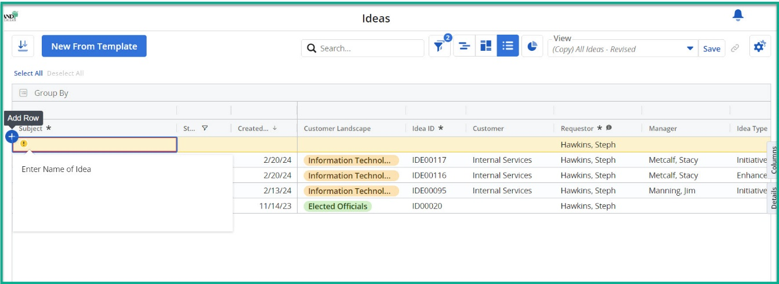
Idea Demand Management - Workflows
Log into Clarity
On the left navigation pane, click the Ideas module icon.
Ideas will be displayed.
Create a New Idea
Click Add Row + button.
Fill in the required fields (*) – Subject.
  Record is saved when required field(s) are populated.
Notes:
Image 24

Slide 4
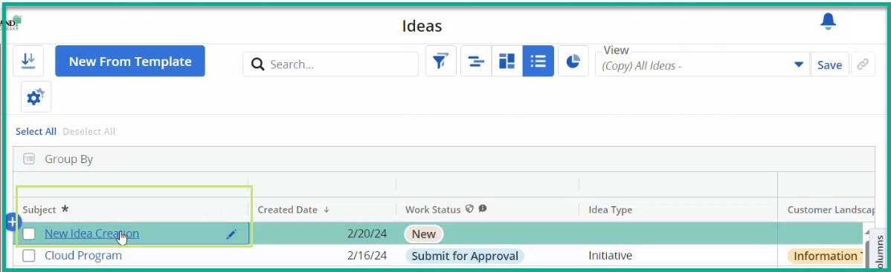
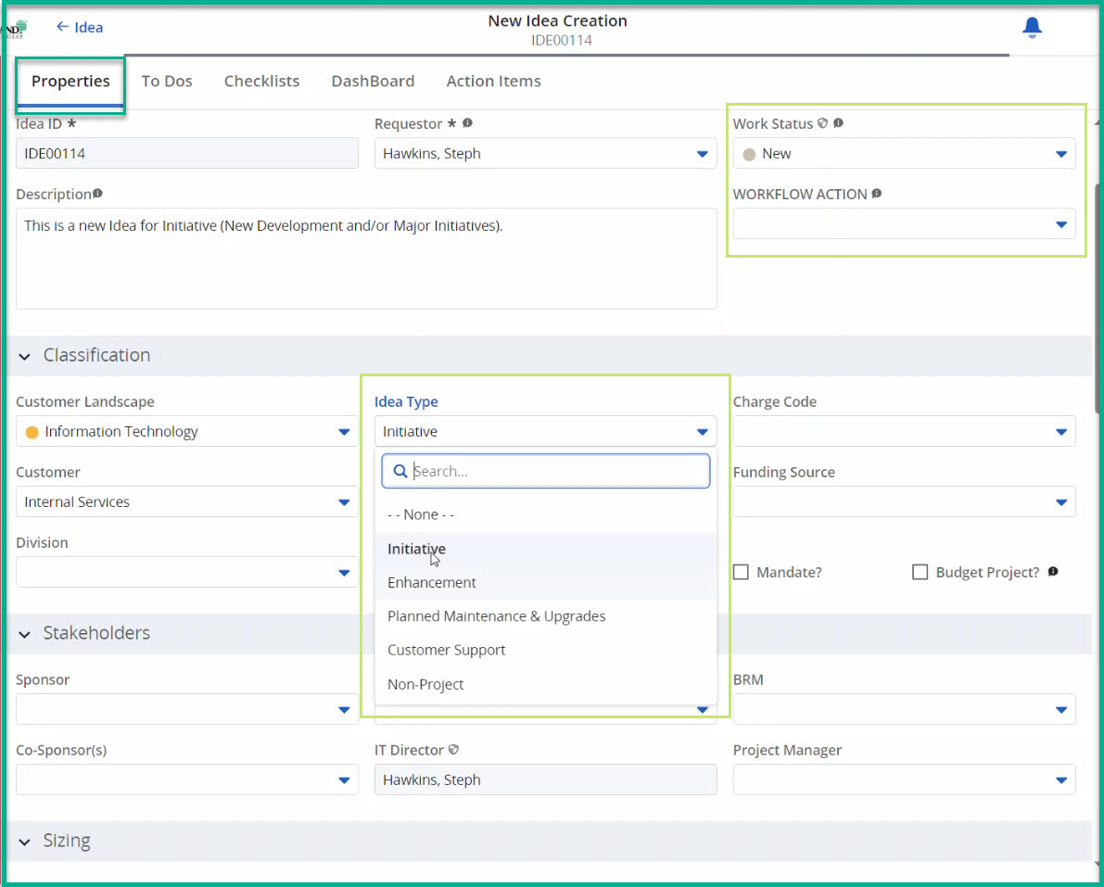
Idea Demand Management - Workflows
Select and Update Idea
On the new Idea record, click Subject to open the Properties tab.
Select the Idea Type. [Refer to Tables 1- 2]
  Initiative
  Enhancement
Complete the mandatory fields in the Idea section(s) for the Idea type, including:
  Idea Summary: Subject, Requestor, Manager, Description
  Classification: Customer Landscape, Customer, Idea Type
  Stakeholders: Sponsor, IT Technology Owner
Based on the Idea Type selected, the WORKFLOW ACTION field will show the applicable workflow steps based on the Work Status field.
Quick Tips:
  Refer to Tables 1-3 throughout the workflow.
  Work Status default value is New. This read-only field will change based on user selection in the WORKFLOW ACTION field.
  The Idea Type is a key field. The Idea Properties tab fields will change based on the selection.
  Record is automatically saved as fields are populated.
  WARNING: Do not select Submit for Approval until all mandatory fields in Idea are populated.
Notes:
Image 25
Image 26.1

Slide 5
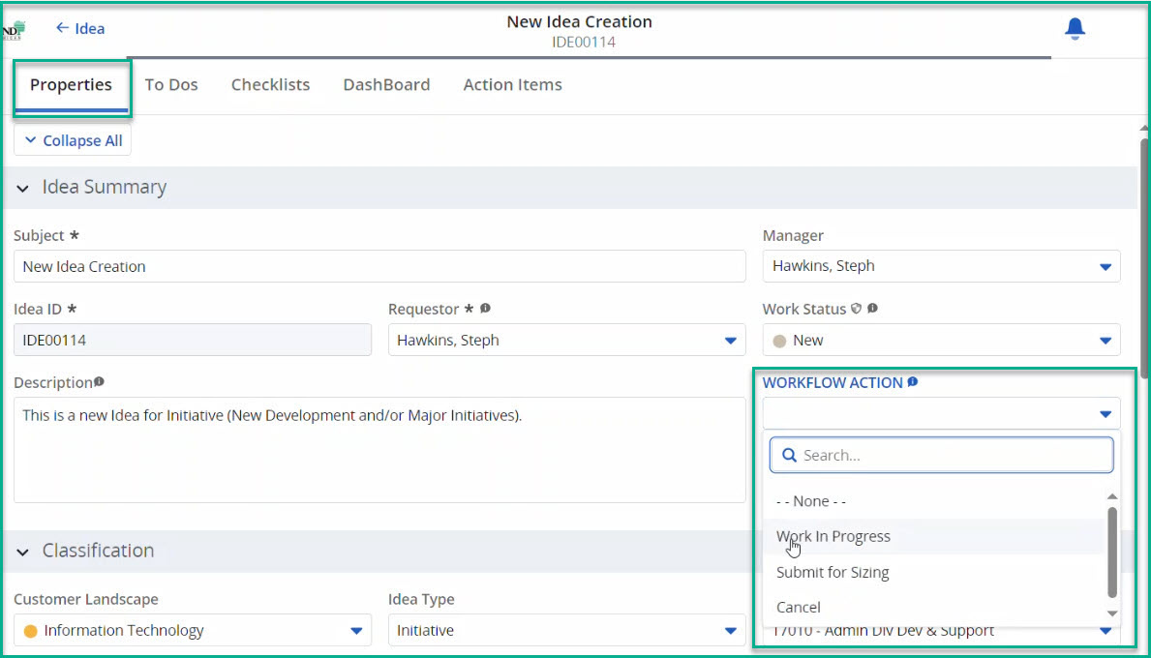
Idea Demand Management - Workflows
Begin the Idea Workflow Journey
Select an Idea record, then click Subject to open the Properties tab.
Review and complete the mandatory fields in the Idea section(s) for the Idea type:
  Idea Summary: Subject, Requestor, Manager, Description
  Classification: Customer Landscape, Customer, Idea Type
  Stakeholders: Sponsor, IT Technology Owner
In the Idea Summary, click the WORKFLOW ACTION field right drop-down arrow to show applicable workflow steps based on the Work Status field.
  For example, if Work Status = New, select Work in Progress.
  In your browser, refresh the page.
  Work Status will change to Work In Progress.
Quick Tips:
  Contact the PMO if the IT Director field is empty.
  WARNING: Do not select Submit for Approval until all mandatory fields in Idea are populated.
Notes:
Image 27

Slide 6
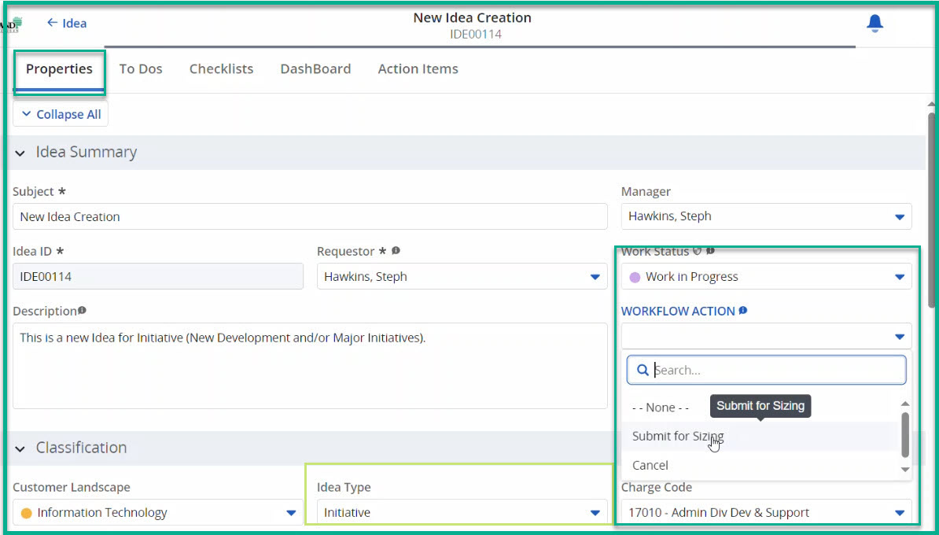
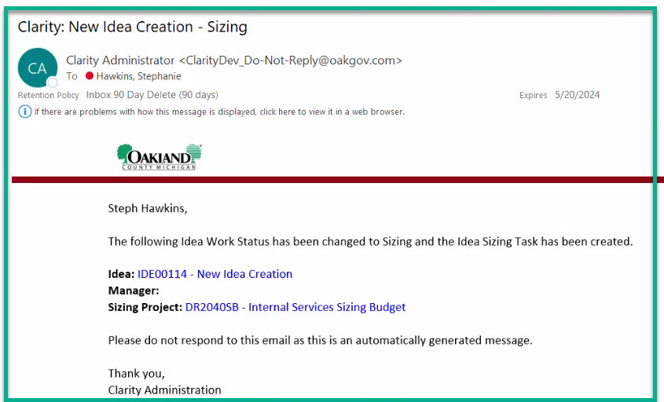
Idea Demand Management - Workflows
Continue the Idea Workflow Journey - Initiative
The following workflow steps pertain to Idea Type = Initiative
Review and complete the mandatory fields in the Idea section(s) for the Idea type selected.
In the Idea Summary, click the WORKFLOW ACTION field right drop-down arrow to show applicable workflow steps based on the Work Status field.
  Select Submit for Sizing.
  In your browser, refresh the page.
  Work Status will change to Sizing.
A Sizing Task will automatically be added to the selected Sizing Project. The sizing task is placed at the bottom of Tasks and will require updates (hours, resources, etc.).
Stakeholder(s) will receive an email based on the Work Status field with links to Idea, Sizing Project, and Sizing Task.
Quick Tips:
  Refer to T-Shirt Sizing Table 3
Notes:
Image 28
Image 29

Slide 7
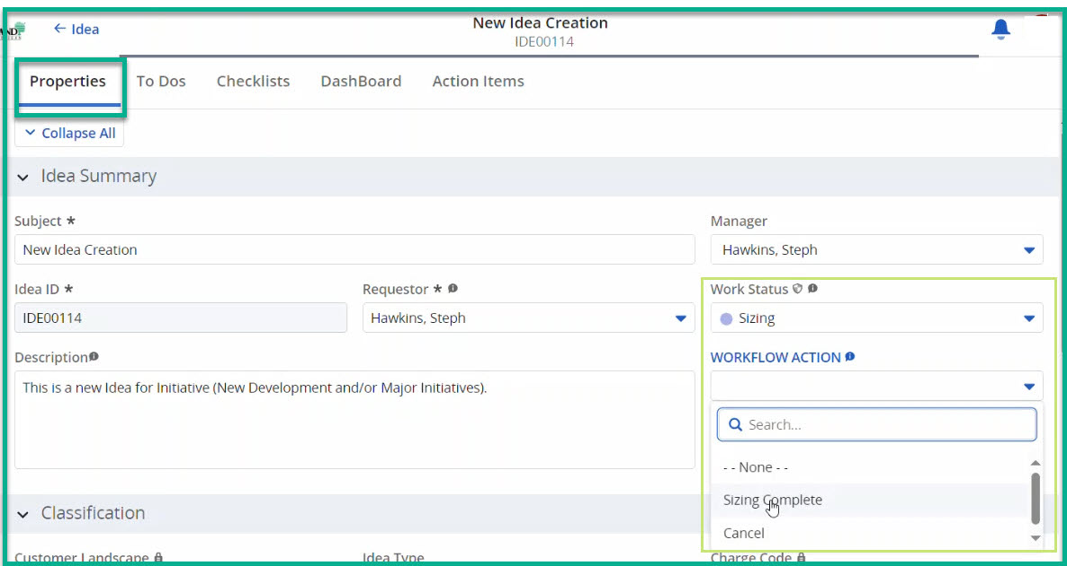
Idea Demand Management - Workflows
Continue the Idea Workflow Journey - Initiative (cont.)
The following workflow steps pertain to Idea Type = Initiative.
Review and complete the mandatory fields in the Idea Properties section(s), including:
  Classification: Charge Code, Funding Type
  Stakeholders: BRM
  Sizing: T-Shirt Size IT Labor Hours, T-Shirt Size Non-Labor Cost
  Details: Objective, Benefit Description, Constraints, Exclusions, and Assumptions, Attachment
In the Idea Summary, click the WORKFLOW ACTION field right drop-down arrow to show applicable workflow steps based on the Work Status field.
  Select Sizing Complete.
  In your browser, refresh the page.
  Work Status will change to Sizing Complete.
Stakeholder(s) will receive email based on the Work Status field.
Quick Tips:
  WARNING: Do not select Submit for Approval until all mandatory fields in Idea are populated.
Notes:
Image 29.1

Slide 8
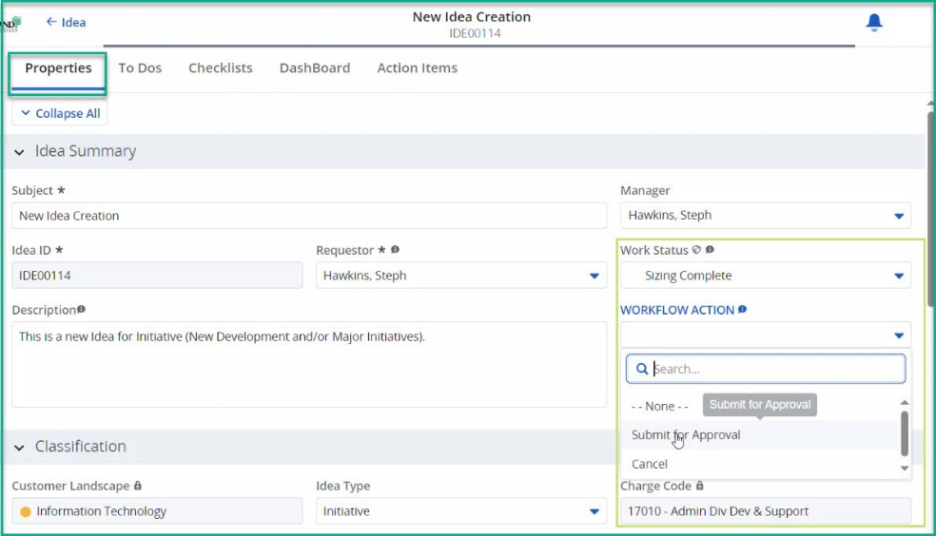
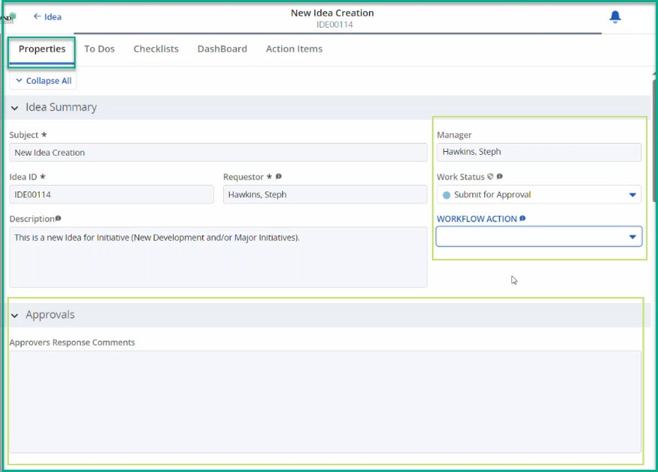
Idea Demand Management - Workflows
Trigger AIR Workflow - Submit Idea for Approval
Review and complete the mandatory fields in the Idea section(s) for the Idea type:
In the Idea Summary, click the WORKFLOW ACTION field right drop-down arrow to show applicable workflow steps based on the Work Status field.
  Select Submit for Approval.
  In your browser, refresh the page.
  Work Status will change to Submit for Approval.
    If the Idea fields turn light gray and are locked, the workflow is in process.
    If the Idea fields do not turn light gray and lock, the submitter should check the mandatory fields in Idea Properties and resolve missing data. The submitter will receive a missing data email. The user must re-trigger the Idea Workflow using the above steps.
Status will change to Submit for Approval
  The section Approvals will now display in the Idea. The Approvers Response Comments will update based on the processing of AIR Approval emails from Stakeholders.
Stakeholder(s) will receive email based on the Work Status field.
Notes:
Image 30
Image 31

Slide 9
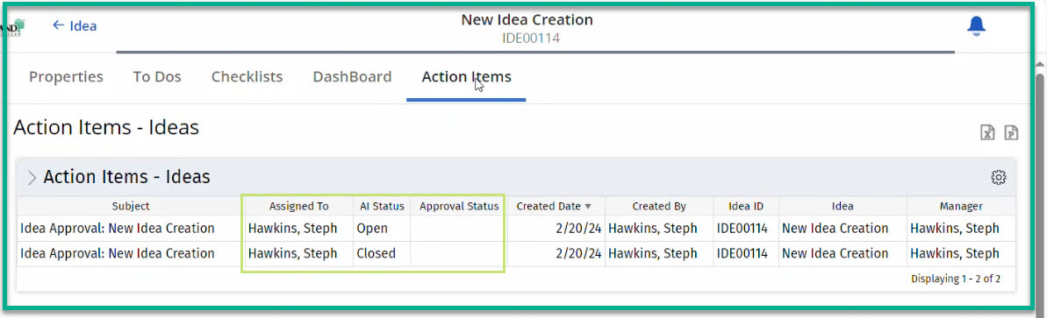
Idea Demand Management - Workflows
Action Items - Monitor the Workflow
Select an Idea record, then click Subject to open the Properties tab.
Click on Action Items tab.
Review active Action Items – Ideas columns labeled to determine current status:
  AI Status: This provides open/closed status of workflow for Stakeholder
  Approval Status: This provides approval decision:
    Approved = Stakeholder Approved
    Rejected = Stakeholder Rejected
    Null = Stakeholder decision not provided or processed
Quick Tips:
  Action Item Responder (AIR) is being used to Automate Workflow Processes and Approvals.
    Emails route to IT Management and Sponsors
    AIR processes execute every 15 minutes. Contact PMO if an Idea is urgent.
  Action Items tab:
    Utilize tab to understand the status of emails sent and the recipients.
    Click > Action Items – Idea to filter and rerun report for inactive change Request to view history
Notes:
Image 35

Slide 10
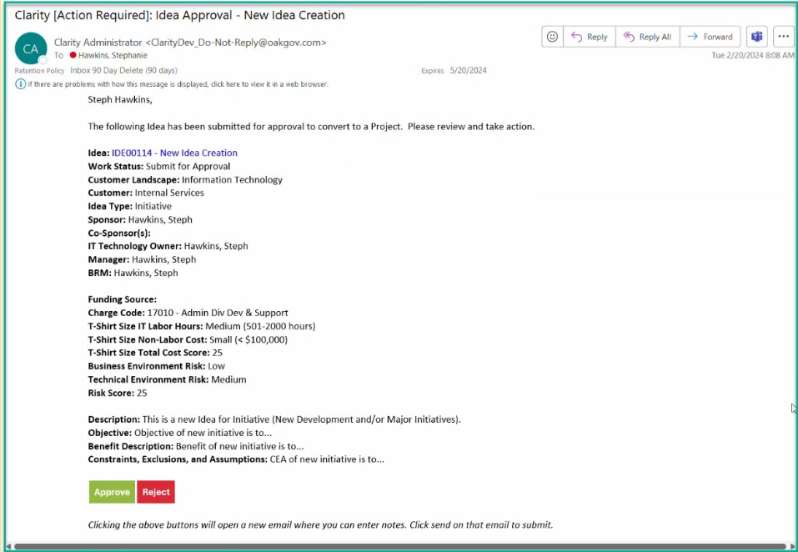
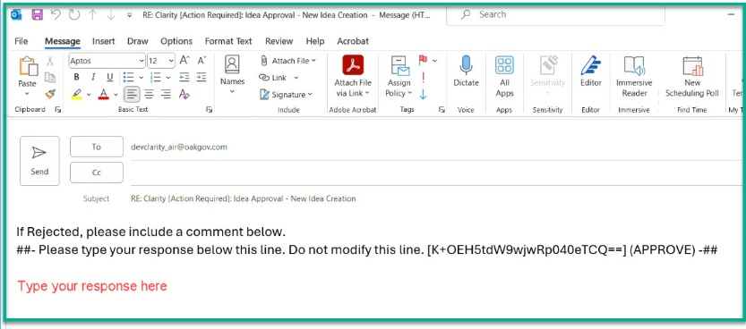
Idea Demand Management - Workflows
AIR Idea Workflow Approvals
Stakeholder(s) will receive an email with a call to action in the Subject Line:
  Clarity [Action Required]: Idea Approval - <Name of Idea>
Stakeholder(s) will review the information and decide by clicking on a button:
  Approved (green)
  Rejected (red)
After clicking a button, a new email will open. The email body will contain the following language:
  If Rejected, please include a comment below.
  ##- Please type your response below this line. Do not modify this line. [bd6V6mRDmZ8FS2MI4PalQw==] (APPROVE) -##
  Warning: Stakeholders will need to CLICK BELOW this information in the email body to enter their response, as applicable.
Stakeholder will click the Send button when completed.
Notes:
Image 32
Image 33

Slide 11
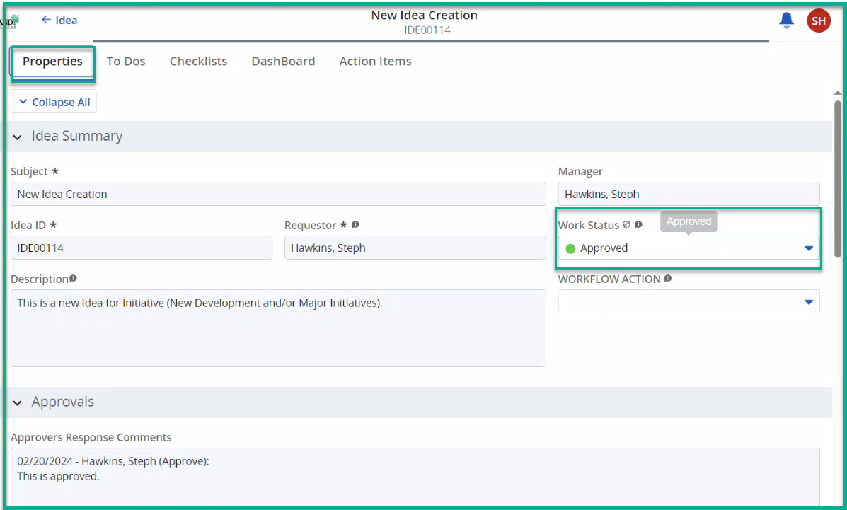
Idea Demand Management - Workflows
AIR Idea Workflow Approvals (cont.)
Approved: AIR processes the stakeholders' email responses and updates Approvers Section's Idea Approvers Response Comments field.
  Work Status will remain Submit for Approval until all Stakeholder(s) approve.
  Work Status will change to Approved after processing all Stakeholder approvals.
Stakeholders will receive an email based on the Work Status field.
Notes:
Image 34

Slide 12
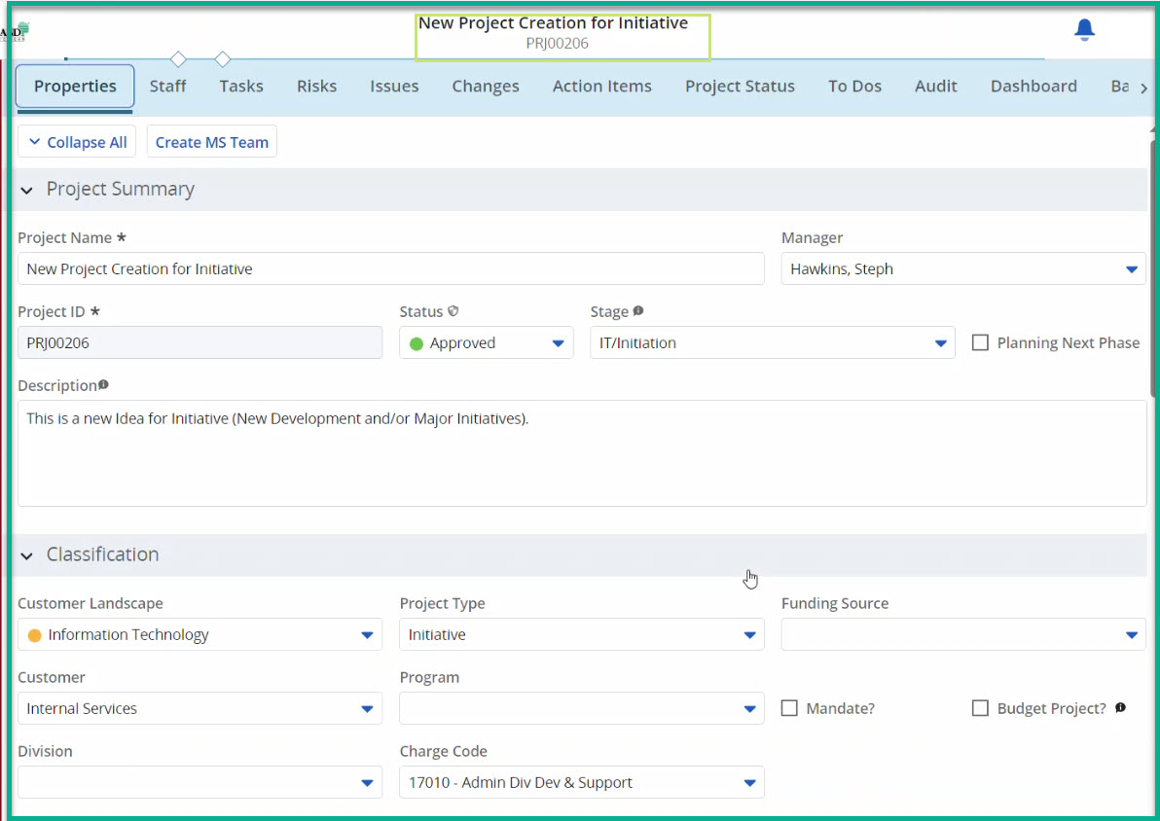
Idea Demand Management - Workflows
Convert Idea to a Project - Initiative
The following workflow steps pertain to Idea Type = Initiative
In the Idea Summary, click the WORKFLOW ACTION field right drop-down arrow to show applicable workflow steps based on the Work Status field.
  Select Submit for Conversion.
  In your browser, refresh the page.
  Work Status will remain Approved until Idea is converted to a Project.
Stakeholder(s) will receive email based on the Work Status field.
PMO will receive an email based on the Work Status field.
  PMO will contact PM regarding any questions about the project setup.
  PMO will convert the idea to a Project.
  Work Status will change to Converted.
Stakeholder(s) will receive email based on the Work Status field.
Notes:
Image 37

Slide 13
Idea Demand Management - Workflows
Convert Idea to a Task - Enhancement
The following workflow steps pertain to Idea Type = Enhancement
Approved: AIR processes the stakeholders' email responses and updates Approvers Section's Idea Approvers Response Comments field.
  Work Status will remain Submit for Approval until all Stakeholder(s) approve.
  Work Status will change to Approved after processing all Stakeholder approvals.
  An Enhancement Task will automatically be added to the Estimation selected Project. The enhancement task is placed at the bottom of Tasks and will require updates (hours, resources, etc.)
  Stakeholders will receive an email based on the Work Status field.

Slide 14
Idea Demand Management - Workflows
AIR Idea Workflow Rejection
Rejected: AIR processes the stakeholders' email responses and updates Approvers Section's Idea Approvers Response Comments field.
  Work Status will change to Rejected if any Stakeholder(s) rejects.
  Approvers Responses Comments will update throughout the workflow after processing Stakeholder emails.
  Stakeholders will receive an email based on the Work Status field.
  The workflow ends and will need to be restarted.
Restart the Idea Workflow Journey
Resolve the reason for the Idea rejection.
Select an Idea record, then click Subject to open the Properties tab
In the Idea Summary, click the WORKFLOW ACTION field right drop-down arrow to show applicable workflow steps based on the Work Status field.
  For example, if Work Status = Rejected, select Work in Progress.
  In your browser, refresh the page.
  Work Status will change to Work in Progress.
Stakeholder(s) will receive email based on the Work Status field.
Cancel the Idea Workflow Journey
During the Workflow Journey, an Idea may need to be cancelled.
Select an Idea record, then click Subject to open the Properties tab
In the Idea Summary, click the WORKFLOW ACTION field right drop-down arrow to show applicable workflow steps based on the Work Status field.
  Select Cancel.
  In your browser, refresh the page.
  Work Status will change to Cancelled.
Stakeholder(s) will receive email based on the Work Status field.
The workflow ends and will need to be restarted to resume pursuit of the Idea.

Slide 15
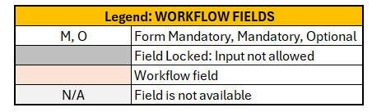
[TABLE 1] Idea Fields: Workflow – Initiative
WORKFLOW: Idea - Initiative
Work Status | New | Work In Progress | Submit for Sizing | Sizing | Sizing Complete | Submit for Approval | Approved | Submit for Conversion | Converted | Rejected | Cancelled
Stakeholder
Manager (Owner) | WORKFLOW ACTION  |  |  |  | Inform |  | Inform |  | Inform | Inform | Inform
IT Technology Owner |  |  |  | Inform |  |  | Inform |  | Inform | Inform | Inform
BRM |  |  |  |  | Inform |  | Inform |  | Inform |  | Inform
CIO |  |  |  |  |  | *Decision
Director |  |  |  |  |  | Decision |  |  |  | Inform
Sponsor / Co-Sponsor |  |  |  |  |  | Decision |  |  |  | Inform
PMO |  |  | Auto Create Sizing Task |  |  |  | Inform | Inform | ‘Convert’ Process
Project Manager |  |  |  |  |  |  |  |  | Inform
WORKFLOW FIELDS: Idea - Initiative
Idea Properties tab |  | Idea “ Work Status”
Section | Field Name | New | Work In Progress | Sizing | Sizing Complete | Submit for Approval | Approved | Submit for Conversion | Converted
Idea Summary | Subject * | M | M | M | M | M | M | M | M
Idea Summary | Idea ID * | M | M | M | M | M | M | M | M
Idea Summary | Requestor * | M | M | M | M | M | M | M | M
Idea Summary | Manager | M | M | M | M | M | M | M | M
Idea Summary | Work Status * | M | M | M | M | M | M | M | M
Idea Summary | WORKFLOW ACTION | Trigger |  |  |  |  |  |  | M
Idea Summary | Description | M | M | M | M | M | M | M | M
Approvals | Approvers Response Comments | N/A | N/A | N/A | N/A | N/A | M | M | M
Classification | Customer Landscape | M | M | M | M | M | M | M | M
Classification | Customer | M | M | M | M | M | M | M | M
Classification | Idea Type | M | M | M | M | M | M | M | M
Classification | Charge Code |  |  | M | M | M | M | M | M
Classification | Funding Source |  |  | M | M | M | M | M | M
Stakeholders | Sponsor | M | M | M | M | M | M | M | M
Stakeholders | Co-Sponsor(s)
Stakeholders | IT Technology Owner | M | M | M | M | M | M | M | M
Stakeholders | IT Director | M | M | M | M | M | M | M | M
Stakeholders | BRM |  |  | M | M | M | M | M | M
Stakeholders | Project Manager
Sizing | T-Shirt Size IT Labor Hours |  |  |  | M | M | M | M | M
Sizing | T-Shirt Size Non-Labor Cost |  |  |  | M | M | M | M | M
Sizing | T-Shirt Size Total Cost |  |  |  | M | M | M | M | M
Sizing | Sizing Project |  | M | M | M | M | M | M | M
Risk | Business Environment Risk |  |  |  | M | M | M | M | M
Risk | Technical Risk |  |  |  | M | M | M | M | M
Risk | Risk Score |  |  |  | M | M | M | M | M
Details | Objective |  |  |  | M | M | M | M | M
Details | Benefit Description |  |  |  | M | M | M | M | M
Details | Constraints, Exclusions, and Assumptions |  |  |  | M | M | M | M | M
Details | Attachment |  |  |  | M | M | M | M | M
Notes | Notes

Slide 16
[TABLE 2] Idea Fields: Workflow – Enhancement
WORKFLOW: Idea - Enhancement
Work Status | New | Work In Progress | Submit for Approval | Approved | Submit for Conversion | Converted | Rejected | Cancelled
Stakeholder
Manager (Owner) | WORKFLOW ACTION  |  |  | Inform |  |  | Inform
Sponsor / Co-Sponsor |  |  | Decision
IT Technology Owner |  |  | Decision | Inform
PMO |  |  |  |  | Auto create EB Task
Project Manager |  |  |  |  |  | Inform
WORKFLOW FIELDS: Idea - Enhancements
Idea Properties tab |  | Idea “ Work Status”
Section | Field Name | New | Work In Progress | Submit for Approval | Approved | Submit for Conversion | Converted
Idea Summary | Subject * | M | M | M | M | M | M
Idea Summary | Idea ID * | M | M | M | M | M | M
Idea Summary | Requestor * | M | M | M | M | M | M
Idea Summary | Manager | M | M | M | M | M | M
Idea Summary | Work Status * | M | M | M | M | M | M
Idea Summary | WORKFLOW ACTION | Trigger |  |  |  |  | M
Idea Summary | Description | M | M | M | M | M | M
Approvals | Approvers Response Comments | N/A | N/A | N/A | M | M | M
Classification | Customer Landscape | M | M | M | M | M | M
Classification | Customer | M | M | M | M | M | M
Classification | Division
Classification | Idea Type | M | M | M | M | M | M
Classification | Program
Classification | Charge Code |  |  | M | M | M | M
Classification | Funding Source |  |  | M | M | M | M
Classification | Mandate
Classification | Budget Project
Stakeholders | Sponsor | M | M | M | M | M | M
Stakeholders | Co-Sponsor(s)
Stakeholders | IT Technology Owner | M | M | M | M | M | M
Stakeholders | IT Director | M | M | M | M | M | M
Stakeholders | BRM
Stakeholders | Project Manager
Estimation | Estimated Hours |  | M | M | M | M | M
Estimation | Selected Project |  | M | M | M | M | M
Notes | Notes

Slide 17
TABLE 3] Idea T Shirt Sizing
T-Shirt Sizes IT Labor Hours
Small (201-500 hours)
Medium (501-2000 hours)
Large (2001+ hours)
T-Shirt Sizes Non-Labor Cost
Small (<$100,000)
Medium ($100,001 - $300,000)
Large ($300,000+)
WORKFLOW FIELDS: Idea - Initiative
Value | T-Shirt Size IT Labor Hours | T- Shirt Size Non- Labor Cost | T-Shirt Size Total Cost
Small | 201-500 | < $100,000 | Calculated
Medium | 501-2000 | $100,001 - $300,000 | Calculated
Large | 2001+ | $300,001+ | Calculated
Calculations
Calculations | T-Shirt Size IT Labor Hours | T- Shirt Size Non- Labor Cost | T-Shirt Size Total Cost
 | Small | Small | Small
 | Small | Medium | Small
 | Small | Large | Medium
 | Medium | Small | Small
 | Medium | Medium | Medium
 | Medium | Large | Large
 | Large | Small | Medium
 | Large | Medium | Large
 | Large | Large | Large

