Slide 1
Clarity SharePoint
Intro
The Clarity SharePoint is used to stores project artifacts. The SharePoint Clarity functionality utilizes MS Teams with a SharePoint backbone.
Log into Clarity
Projects will be displayed based on the filter.
Click on Project Name to select and open your project.
Create MS Team
Clarity: Create MS Team – SharePoint
Clarity: Access Project SharePoint Tab
Clarity: Access Project SharePoint Tab
Sync MS Team Permissions
Clarity: Sync MS Team – Permissions

Slide 2
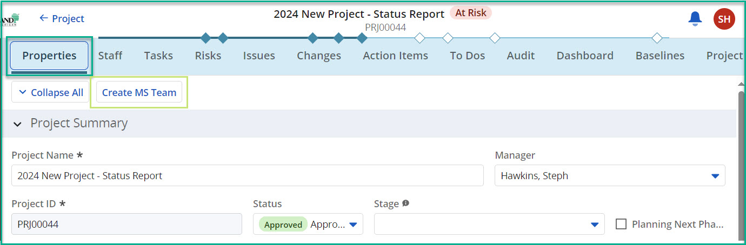
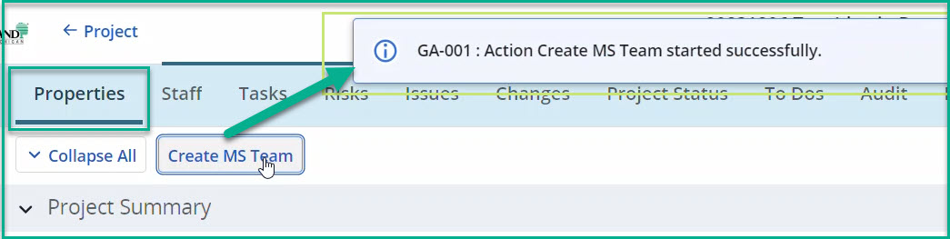
Clarity: Create MS Team – SharePoint
Create MS Team
Open a Project and click on the Properties tab.
Click the Create MS Team button.
The MS Team creates project initiates, begins creating MS Teams – SharePoint, and adds the resources on the Staffing tab with MS Team / SharePoint.
A message will appear to indicate the creation process has started.
  Please be patient. The process may take 1-3 minutes to complete.
Quick Tips:
  The user’s browser must allow for pop-ups.
Notes:
Image: 01 - SharePoint Create MS Team
Image: 02 - SharePoint Create MS Team Message

Slide 3
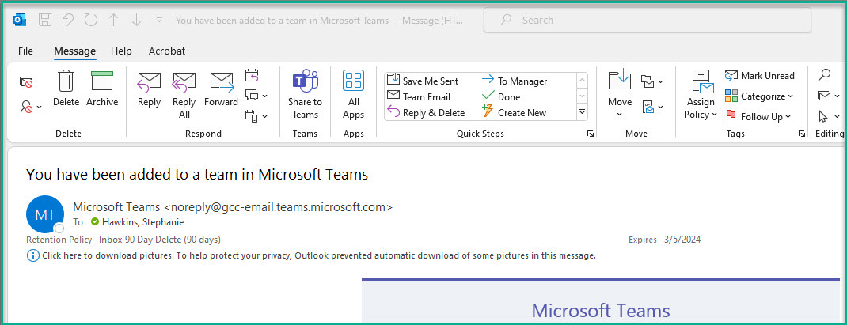
Clarity: Create MS Team – SharePoint
Create MS Team (cont.)
The project team is granted access to the MS Team Channel for the Project.
Open Outlook or other email client.
User(s) will receive an email with Subject, “You have been added to a team in Microsoft Teams.”
  Email contains a link to MS Teams ‘Team Channel.
  MS Teams ‘Team’ is created with General Channel. General Channel allows users to access SharePoint.
Quick Tips:
  You can directly access project via MS Team Channel.
Notes:
Image: 03 - SharePoint MS Team Email Message

Slide 4
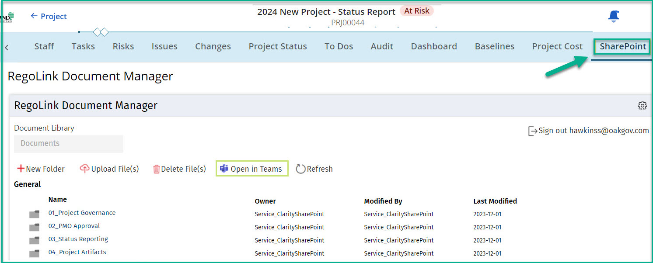
Clarity: Access Project SharePoint Tab
Access Clarity Project SharePoint
Open a Project and click on the SharePoint tab.
The RegoLink Document Manger View displays.
  The default folder structure is available for usage.
  This is a virtualized view of files in MS Team / SharePoint.
  Any changes in Clarity will be reflected in MS Team / SharePoint.
From this View, users can:
  Add New Folder
  Upload File(s)
  Delete File(s)
  Refresh
  Access Clarity Project SharePoint
Click the Open In Teams button to open the MS Teams Channel.
Quick Tips:
  Users must have a Microsoft license to allow access to MS Teams.
Notes:
Image: 04 - Project SharePoint tab

Slide 5
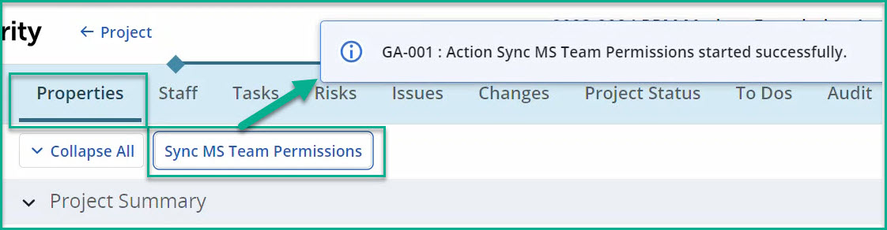
Clarity: Sync MS Team – Permissions
Sync MS Team Permissions
Open a Project and click on the Properties tab.
Click the Sync MS Team Permissions button.
The Sync MS Team Permissions syncs resources on the Staffing tab with MS Teams – SharePoint.
A message will appear to indicate the sync process has started.
  Please be patient. The process may take 1-3 minutes to complete.
  This is a one-way sync from Clarity to MS Teams – SharePoint. Change in MS Teams – SharePoint does not write back to Clarity.
Quick Tips:
  The user’s browser must allow for pop-ups.
  MS Teams – SharePoint permissions are managed from SharePoint following OakGov standard procedures.
Notes:
Image: 05 - SharePoint Sync MS Team

