Slide 1
Status Reporting
Table of Contents
Introduction
Prepare Your Status Report
Project Status Report – Add or Update Risks
Project Status Report – Add or Update Issues
Project Status Report – Include Changes
Project Status Report – Prepare Status Report
Project Status Report – Preview Status Report
Project Status Report – Publish Status Report
Project Status Report – Access Status Reports: Latest Final and Draft
Status Reporting - Self-Service: Project Tiles
Status Reporting - Self-Service: Project List
Status Reporting - Self-Service: Portfolio Dashboard Status Reports
Status Reporting - Self-Service: Late Status Reports
Status Reporting - Self-Service: Overall Status = Red

Slide 2
Status Reporting
Intro
The Project Status Report must be completed on a weekly basis for every project.
To prepare a project status report
Follow the Weekly Tracking and Reporting Process.
Log into Clarity
Projects will be displayed based on the filter.
Click on Project Name to select and open your project.
Prepare A Project Status Report
Add or Update Risk(s) Quick Link to QRG - Project: Risks
Add or Update Issues Quick Link to QRG - Project: Issues
Include Changes Quick Link to QRG – Project Change Requests Approval Workflow
Prepare Status Report
Preview Status Report
Publish Status Report
Access Status Reports: Latest Final and Draft
Portfolio Status Reporting - Self-Service
Project Tiles
Project List
Portfolio Dashboard Status Reports
Late Status Reports
Overall Status = Red

Slide 3
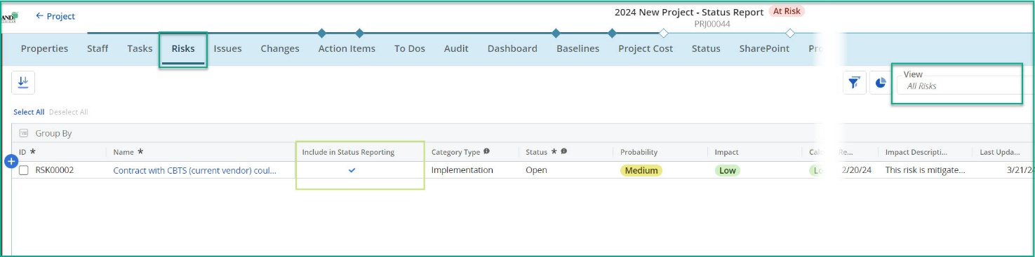
Project Status Report – Add or Update Risks
Quick Link to Project: Risks QRG
To Prepare Your Status Report – Risks
Follow the Tracking and Reporting Processes.
Add a Risk
Open a Project and click on the Risks tab.
Click Add Row + button.
Confirm the All Risks View displays.
Fill in the required fields (*) – Name.
  Record is saved when required field(s) are populated.
  Update a Risk
Click on Name to open the Properties tab.
Review and update fields using the form.
Click the ☑ Include in Status Report checkbox to display your Status Report.
Click the <- Project Name link in the upper left to close the Properties tab and return to the project.
  Include Risk(s) on your draft Status Report
On the All Risks View or the Risks Properties tab.
Click the ☑ Include in Status Report checkbox to display the Risk(s) on your Status Report. Or click to □ uncheck and remove from draft Status Report.
Notes:
Image: 01 - Risks

Slide 4
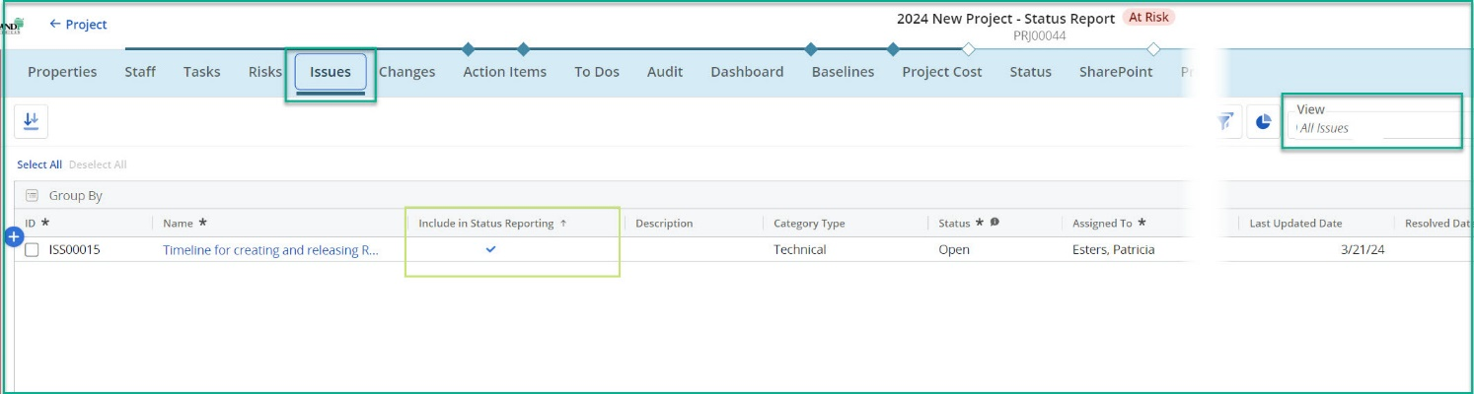
Project Status Report – Add or Update Issues
Quick Link to QRG - Project: Issues
To Prepare Your Status Report – Issues
Follow the Tracking and Reporting Processes.
Add an Issue
Open a Project and click on the Issues tab.
Click Add Row + button.
Confirm the All Issues View displays.
Fill in the required fields (*) – Name.
  Record is saved when required field(s) are populated.
  Update an Issue
Click on Name to open the Properties tab.
Review and update fields using the form.
Click the ☑ Include in Status Report checkbox to display your Status Report.
Click the <- Project Name link in the upper left to close the Properties tab and return to the project.
  Include Issues on your draft Status Report
On the All Issues View or the Issues Properties tab.
Click the ☑ Include in Status Report checkbox to display the Issues on your Status Report. Or click to □ uncheck and remove from draft Status Report.
Notes:
Image: 02 - Issues

Slide 5
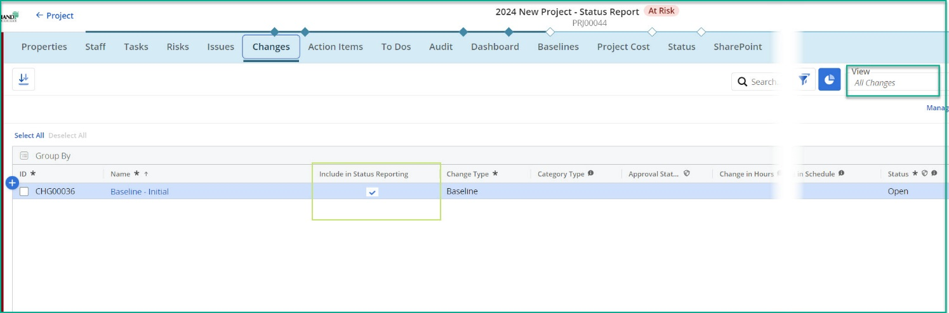
Project Status Report – Include Changes
To Prepare Your Status Report – Changes
Follow the Tracking and Reporting Processes.
  Review Change Request(s)
Open a Project and click on the Changes tab.
Confirm the All Changes View displays.
Review Change Requests and determine whether to include them on the draft Status Report.
  Include Change Request(s) on your draft Status Report
On the All Changes View or the Changes Properties tab.
Click the ☑ Include in Status Report checkbox to display the Change(s) on your Status Report. Or click to □ uncheck and remove from draft Status Report.
Notes:
Image: 03 - Changes

Slide 6
Project Status Report – Prepare Status Report
To Prepare Your Status Report – Data Entry
Follow the Tracking and Reporting Processes.
  Create Status Report
Open a Project and click on the Status tab.
Confirm the Project Dashboard View displays.
Fill in the required fields (*) – refer to the Status Report Fields table.
  Record is saved when field(s) are populated.
Quick Tips:
  The Risks, Issues, and Changes with a checked ☑ Include in Status Report will display on your draft Status Report. To add or remove, click the appropriate tab and update the Include in Status Report checkbox.
STATUS REPORT FIELDS
Project Fields
Tab | Section | Field Name | Manual Data Entry | Field Entry Details
Properties | Project Summary | Project Name | Auto
 |  | Report Date * (1) | User | Defaults to current date; select the appropriate Report Date (i.e. prior Friday)
 |  | Overall Status | Calculated | Based on user selection for Cost and Effort Status & Schedule Status
 |  | Cost and Effort Status * (2) | User
 |  | Schedule Status * (3) | User
 |  | Current Phase * (4) | User | Selection based on WBS
Properties | Schedule | Go-Live Date | Auto
Dashboard |  | Baseline Usage | Auto
 |  | Status Report Update * (5) | User
Dashboard |  | Effort Metrics | Auto
 |  | Key Accomplishments * (6) | User
 |  | Upcoming Activities * (7) | User
 |  | Items for Management Attention (8) | User
Tasks |  | Phases | Auto
Issues |  | Issues | Auto
Risks |  | Risks | Auto
Changes |  | Changes | Auto

Slide 7
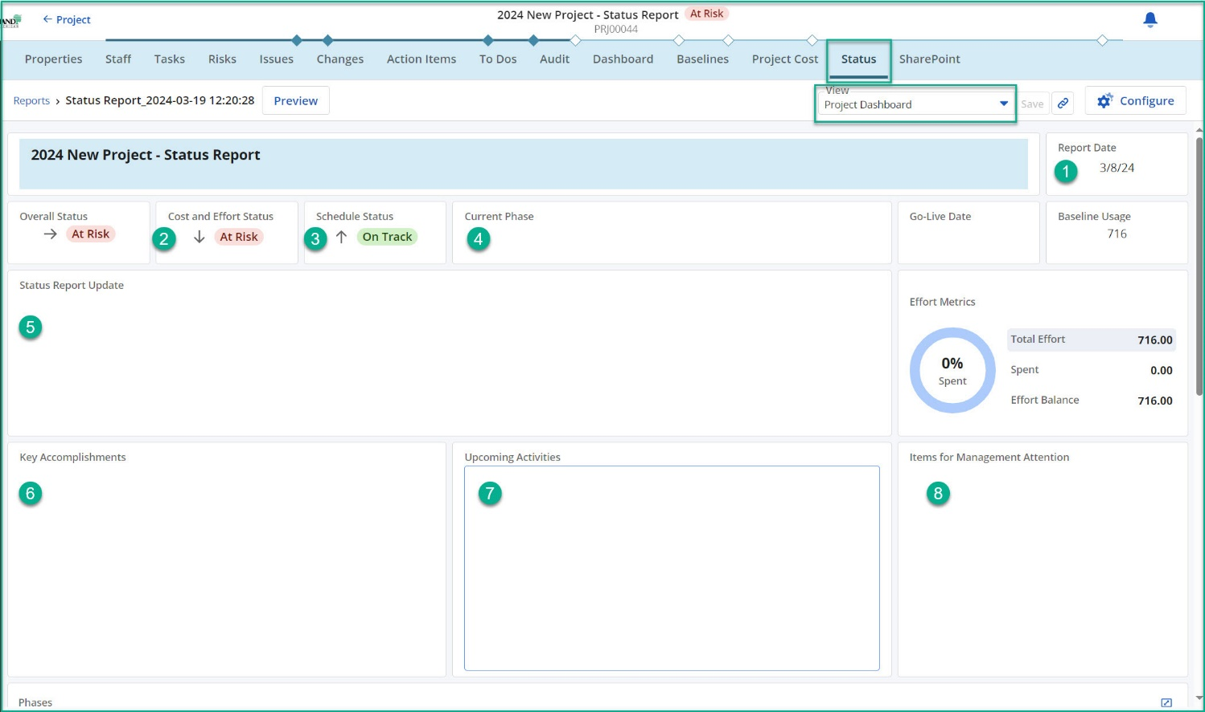
Project Status Report – Prepare Status Report
To Prepare Your Status Report – Data Entry (cont.)
Follow the Tracking and Reporting Processes.
  Create Status Report
Open a Project and click on the Status tab.
Confirm the Project Dashboard View displays.
Fill in the required fields (*) – refer to the Status Report Fields table.
  Record is saved when field(s) are populated.
Notes:
Image: 04 - Status Report Data Entry

Slide 8
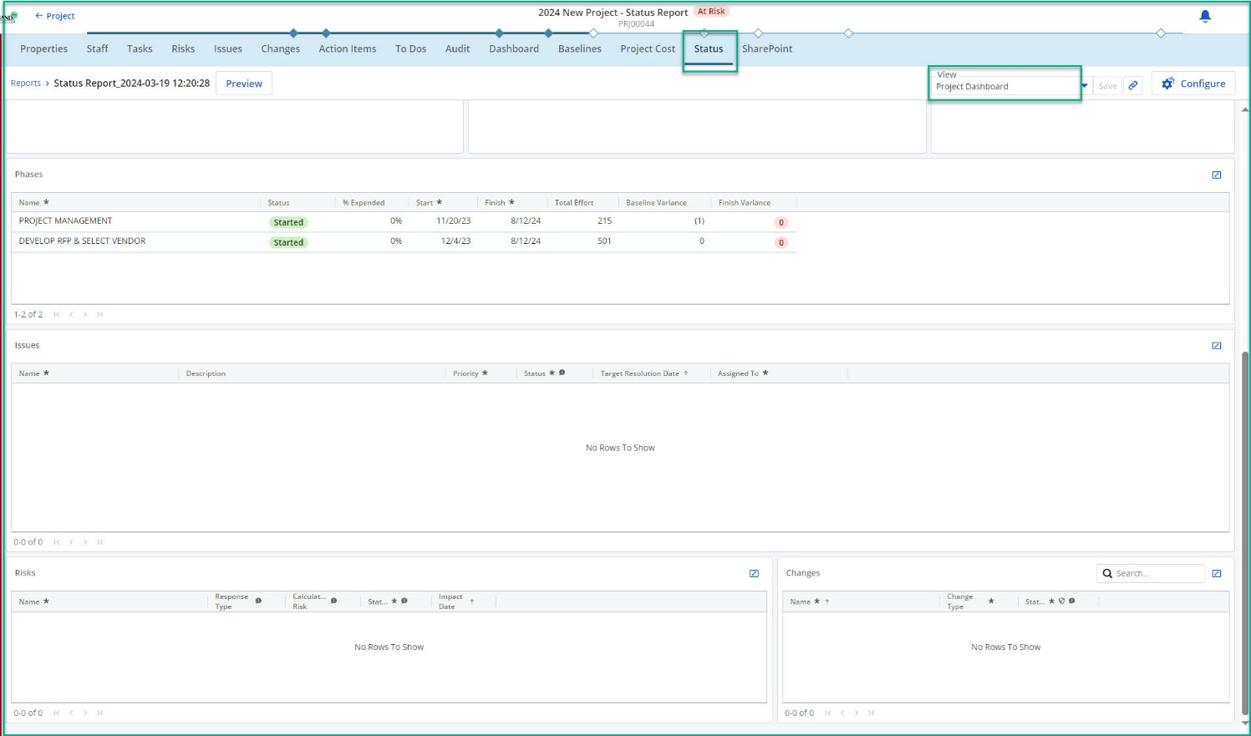
Project Status Report – Prepare Status Report
To Prepare Your Status Report – Data Entry (cont.)
Follow the Tracking and Reporting Processes.
  Create Status Report
Open a Project and click on the Status tab.
Confirm the Project Dashboard View displays.
Fill in the required fields (*) – refer to the Status Report Fields table.
  Record is saved when field(s) are populated.
Notes:
Image: 05 - Status Report Data Entry

Slide 9
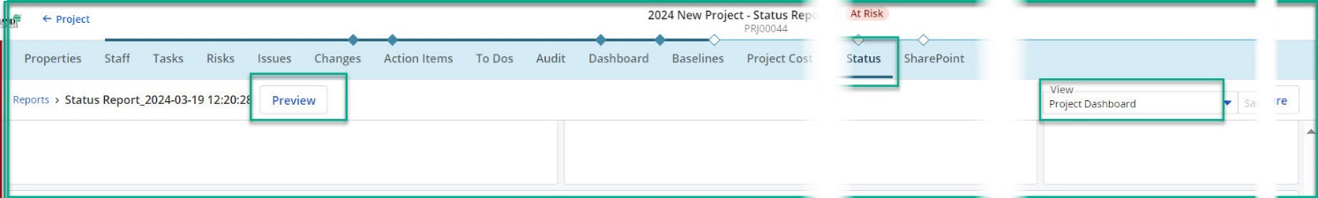
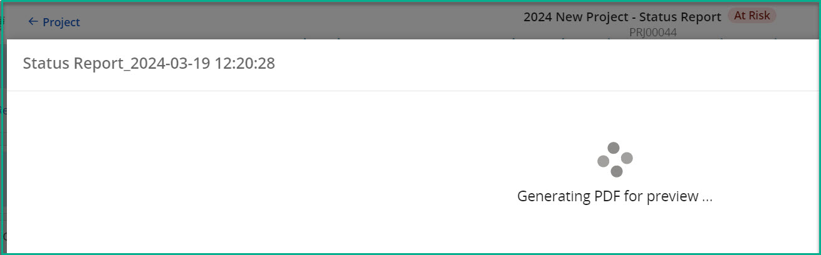
Project Status Report – Preview Status Report
To Preview Your Status Report
Follow the Tracking and Reporting Processes.
  Preview Status Report
Open a Project and click on the Status tab.
Confirm the Project Dashboard View displays.
Fill in the required fields (*) – refer to the Status Report Fields table.
  Record is saved when field(s) are populated.
Click the Preview button and wait for the draft status report to render.
Review the draft status report and determine if the report is ready to publish.
Update Status Report
If there are updates to the draft Status Report, click the Close button and return to Project Dashboard View.
Make the appropriate update and click on the Preview button when ready.
Notes:
Image: 06 - Status Report Preview
Image: 07 - Status Report Preview

Slide 10
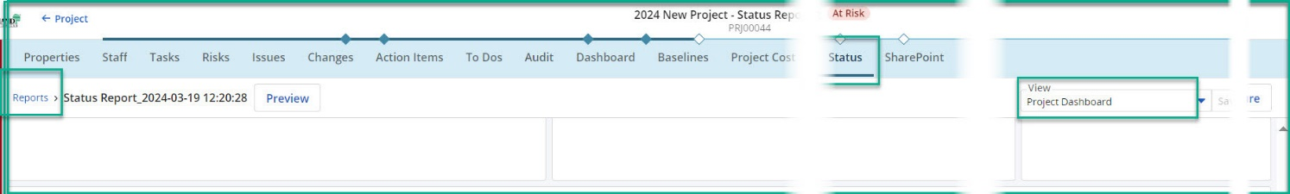
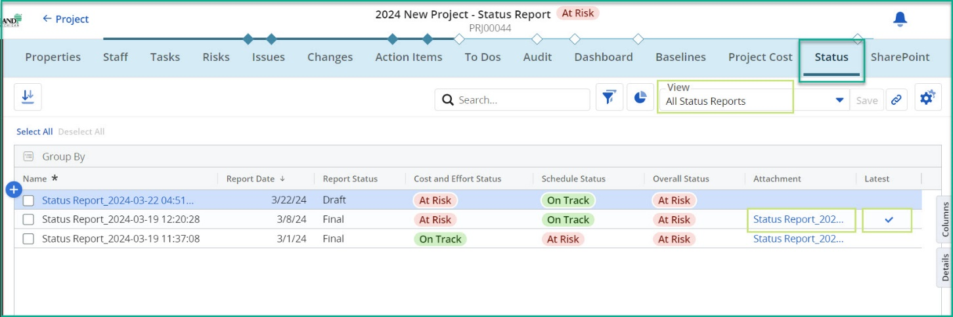
Project Status Report – Access Status Reports: Latest Final and Draft
To View Your Status Report
Follow the Tracking and Reporting Processes.
Access Status Reports – Draft and Final
Open a Project and click on the Status tab.
Confirm the Project Dashboard View displays.
Click the Reports link.
Confirm All Status Reports View displays. Key fields include:
  Report Date: Field user entered as Status Report Date
  Report Status: Draft and Final (published)
  Attachment: Link to open PDF
  Latest: Checkmark for most recent published Status Report
Download Latest Final Status Report
Locate the Status Report with the checked field ☑ Latest.
Click on the Attachment to download the Status Report PDF.
Preview Draft Status Report
Click on Name to open the draft Status Report tab.
Refer to the section Prepare Status Report for details on updating and publishing the draft Status Report.
Notes:
Image: 09 - Status Report Access
Image: 10 - Status Report Access

Slide 11
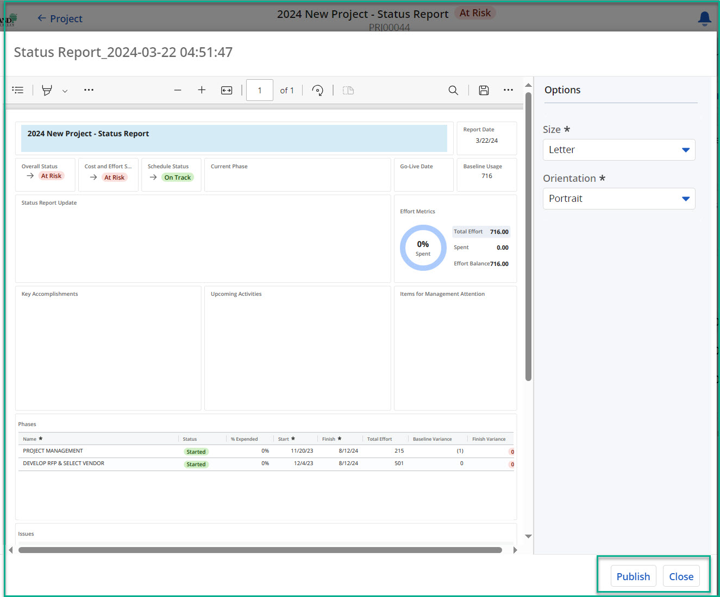
Project Status Report – Publish Status Report
To Publish Your Status Report
Follow the Tracking and Reporting Processes.
  Publish Status Report
Open a Project and click on the Status tab.
Confirm the Project Dashboard View displays.
Fill in the required fields (*) – refer to the Status Report Fields table.
  Record is saved when field(s) are populated.
Click the Preview button and wait for the draft status report to render.
Click the Publish button to publish a final version of the status report.
Click the Close button and return to Project Dashboard View.
Notes:
Image: 08 - Status Report Publish

Slide 12
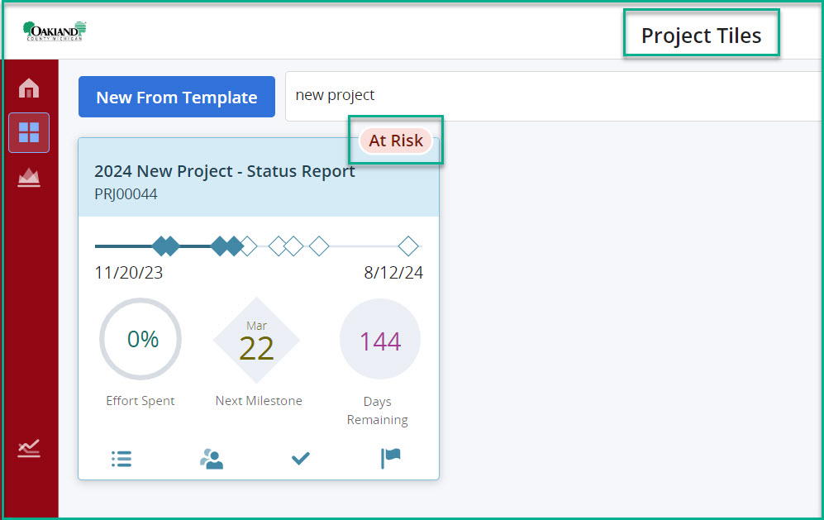
Status Reporting - Self-Service: Project Tiles
Quick Link to Project: General Navigation
To View Your Status Report
Follow the Tracking and Reporting Processes.
Log into Clarity
Projects will be displayed based on the filter.
Click on the Project Tiles module on the left navigation.
Filter or search to display your project(s).
Project Tiles – Overall Status Indicators
The project tile will display the Overall Status indicator bubble from the Latest Status Report published.
Notes:
Image: 11 - Status Report Access

Slide 13
Status Reporting - Self-Service: Project List
Quick Link to Project: General Navigation
To View Your Status Report
Follow the Tracking and Reporting Processes.
Log into Clarity
Projects will be displayed based on the filter.
Click on the Projects module on the left navigation.
Confirm the Project Status: Portfolio Dashboard View displays.
Filter or search to display your project(s).
Project List – View Status Updates
The project grid will display the Overall Status indicator and other status fields from project data and the published latest status report.
Key fields include:
  Overall Status: Indicator bubble from the Latest Status Report published
  Report Date: Field user entered as Status Report Date
  Status Report Update: Field user entered as Status Update
  Attachment: Link to open PDF
Notes:
Image:

Slide 14
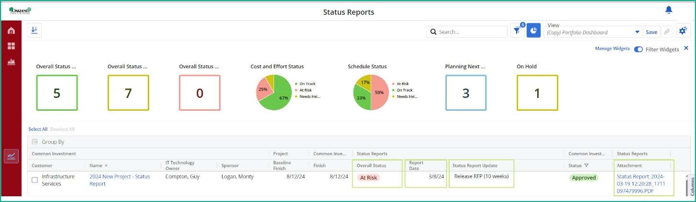
Status Reporting - Self-Service: Portfolio Dashboard Status Reports
Quick Link to Project: General Navigation
To View Your Status Report
Follow the Tracking and Reporting Processes.
Log into Clarity
Projects will be displayed based on the filter.
Click on the Status Reports module on the left navigation.
Click on View and confirm the Portfolio Dashboard View displays.
Filter or search to display your project(s).
Status Reports Module – View Status Updates
The project grid will display the widgets and other status fields from project data and the published latest status report.
Key fields include:
  Overall Status: Indicator bubble from the Latest Status Report published
  Report Date: Field user entered as Status Report Date
  Status Report Update: Field user entered as Status Update
  Attachment: Link to open PDF
Download Latest Final Status Report
Filter or search to display your project(s).
Click on the Attachment to download the Latest Status Report PDF that has been published.
Notes:
Image: 13 - Status Report Module - Portfolio Dashboard

Slide 15
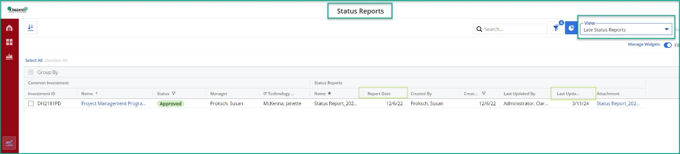
Status Reporting - Self-Service: Late Status Reports
Quick Link to Project: General Navigation
To View Your Status Report
Follow the Tracking and Reporting Processes.
Log into Clarity
Projects will be displayed based on the filter.
Click on the Status Reports module on the left navigation.
Click on View and confirm the Late Status Reports View displays.
Filter or search to display your project(s).
Status Reports Module – View Late Status Reports
The project grid will display the Status Report(s) created/published at least 14 days from current date.
Key fields include:
  Report Date: Field user entered as Status Report Date
  Last Updated Date: Final (published)
  Attachment: Link to open PDF
Download Latest Final Status Report
Filter or search to display your project(s).
Click on the Attachment to download the Latest Status Report PDF that has been published.
Notes:
Image: 14 - Status Report Module - Last Status Reports

Slide 16
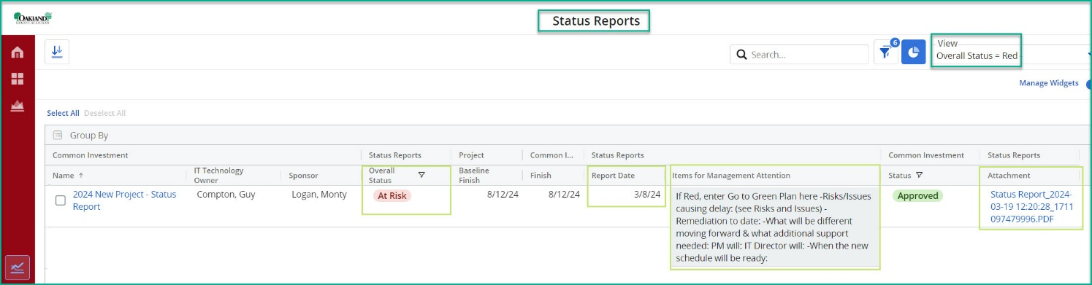
Status Reporting - Self-Service: Overall Status = Red
Quick Link to Project: General Navigation
To View Your Status Report
Follow the Tracking and Reporting Processes.
Log into Clarity
Projects will be displayed based on the filter.
Click on the Status Reports module on the left navigation.
Click on View and confirm the Overall Status = Red View displays.
Filter or search to display your project(s).
Status Reports Module – View Late Status Reports
The project grid will display the Status Report(s) with a Red Status.
Key fields include:
  Overall Status: Indicator bubble from the Latest Status Report published
  Report Date: Field user entered as Status Report Date
  Items for Management Attention:
  Attachment: Link to open PDF
Download Latest Final Status Report
Filter or search to display your project(s).
Click on the Attachment to download the Latest Status Report PDF that has been published.
Notes:
Image: 15 - Status Report Module - Overall Status Red

