Slide 1

Oakland County Neighborhood & Housing Development Division Blueprint to End Homelessness Update, May 1, 2024

Slide 2

Purpose
Oakland County, Michigan is committed to ending homelessness through prevention, housing with services, reforming the system of care, and engaging the community.
With the collaboration of providers across Oakland County’s homelessness service system contributing to the development, the Blueprint outlines how Oakland County will prioritize actions towards eliminating homelessness.

Slide 3
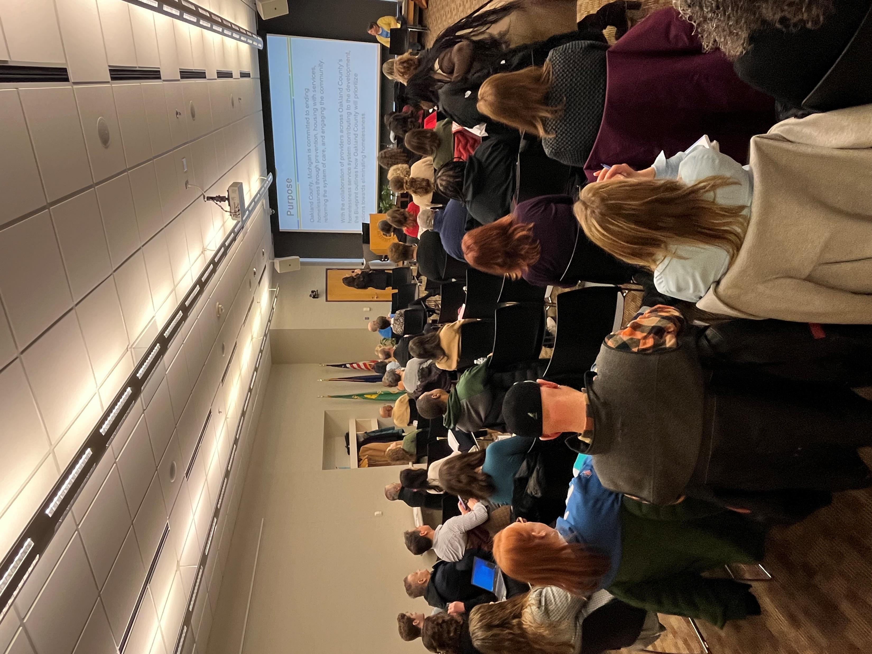
Vision Statement
People at risk or experiencing homelessness in Oakland County will have timely, equitable access to shelter, and affordable, quality housing in the communities of their choice through organizations working together seamlessly to navigate a holistic range of supportive services.

Slide 4
Timeline
In 2019, Sen. Rosemary Bayer secured a grant for the Blueprint to End Homelessness.
In 2020, Oakland County Neighborhood & Housing Development engaged staff from the Michigan Public Health Institute (MPHI) to help develop the Blueprint.
In October 2023, Neighborhood & Housing Development Division Officer, Khadija Walker-Fobbs, collaborated with Alliance for Housing and other key stakeholders to undertake putting the plan into action
In November 2023, the first Blueprint to End Homelessness meeting was held with 60+ stakeholders in attendance.
  Five work-groups were formed, each with their own goals and objectives to achieve
In January 2024, the work-groups prioritized an objective to undertake.
On April 25, 2024, a quarterly meeting was had with all stakeholders to provide an update on their selected objective progress.

Slide 5
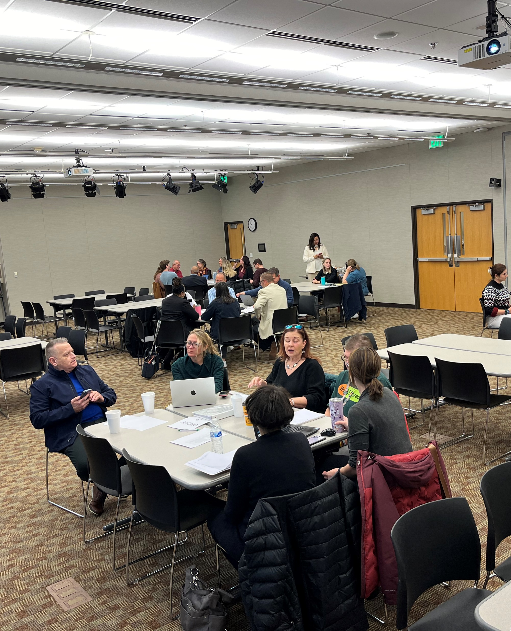
Goal #1: Prevent Root Cause of Homelessness
Objective: Develop an advocacy plan to address root causes of homelessness.
Group Update:
Expand Project Clean Slate outreach efforts.
Distribute survey to identify community resources.
Joined Regional Housing Plan (RHP) Group.

Slide 6
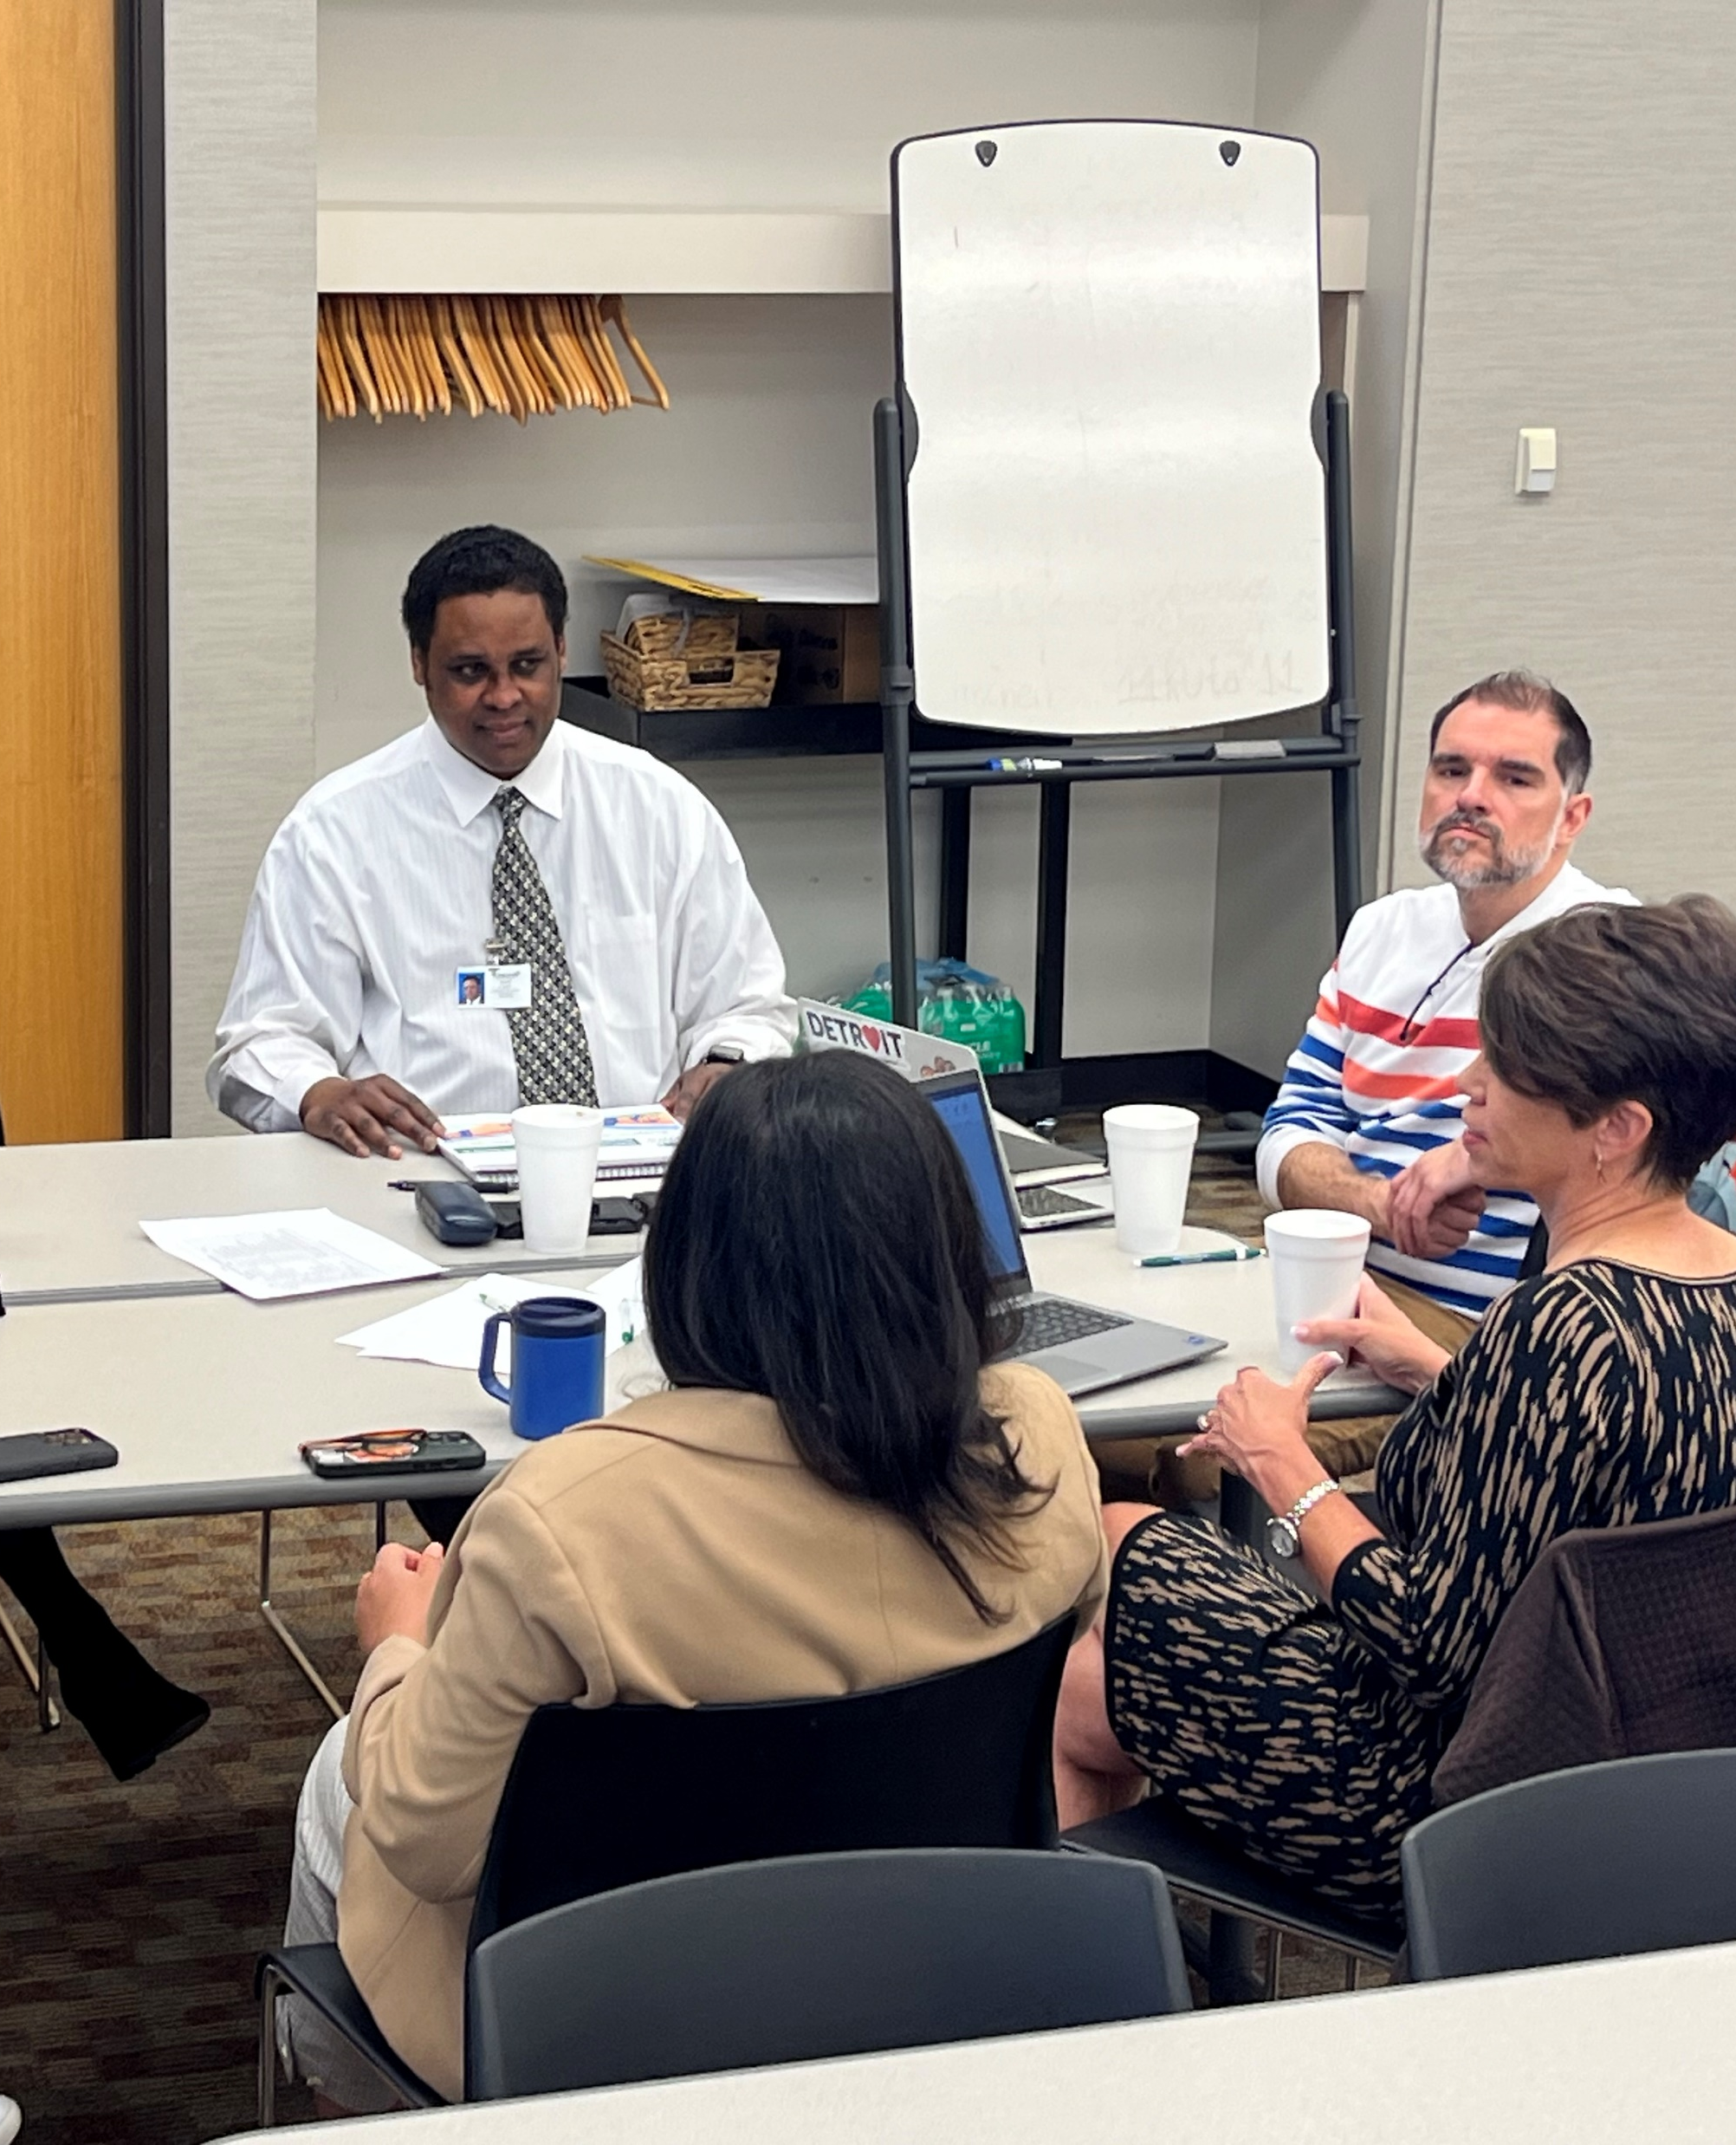
Goal #2: Increased Affordable, Quality Housing
Objective:
Identify and develop at least one program to preserve existing and increase new affordable housing units.
Group Update:
Discussing the potential to increase affordable housing stock by leveraging the expertise.
Reduce stigmas of affordable housing by creating marketing materials that help inform the community.

Slide 7
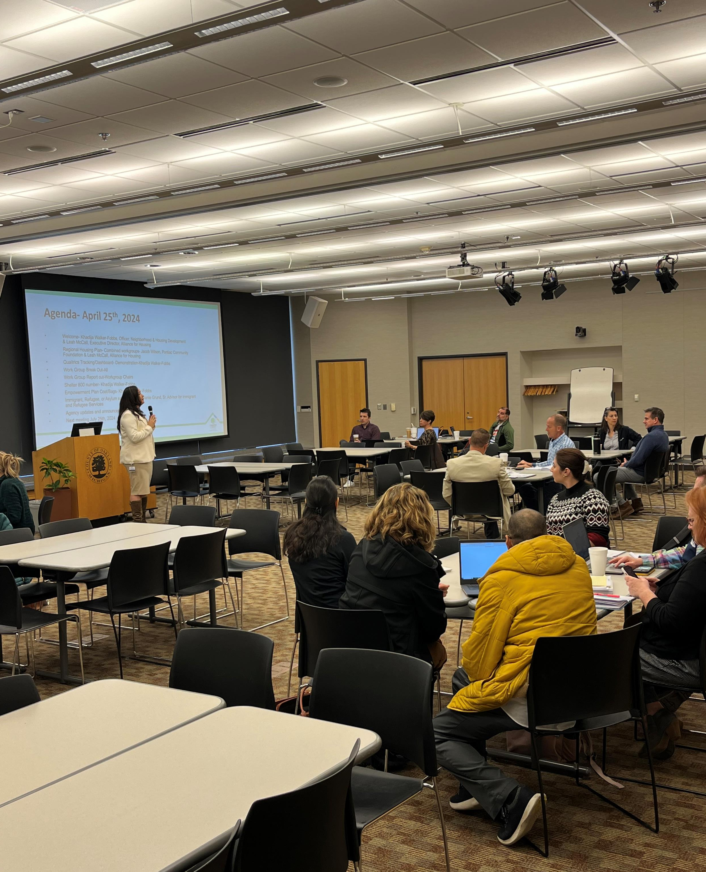
Goal #3: Ensure equitable access to shelter
Objective:
Establish a centralized repository of shelter bed availability to improve system navigation.
Group Update:
Single point of entry/800 number – live answering service to connect individuals to resources and prioritize sheltering (in development)
Deepen engagement with Common Ground
Continue to research best practices in other communities to help strengthen our own system

Slide 8
Goal #4: Improve Continuum of Care Outreach and Education
Objective:
Implement an outreach plan to effectively get information about services and resources to individuals and families at risk or experiencing homelessness in Oakland County.
Group Update:
Working on centralized center for press releases, as well as an alternative center when necessary, combined with Regional Housing Plan Group

Slide 9
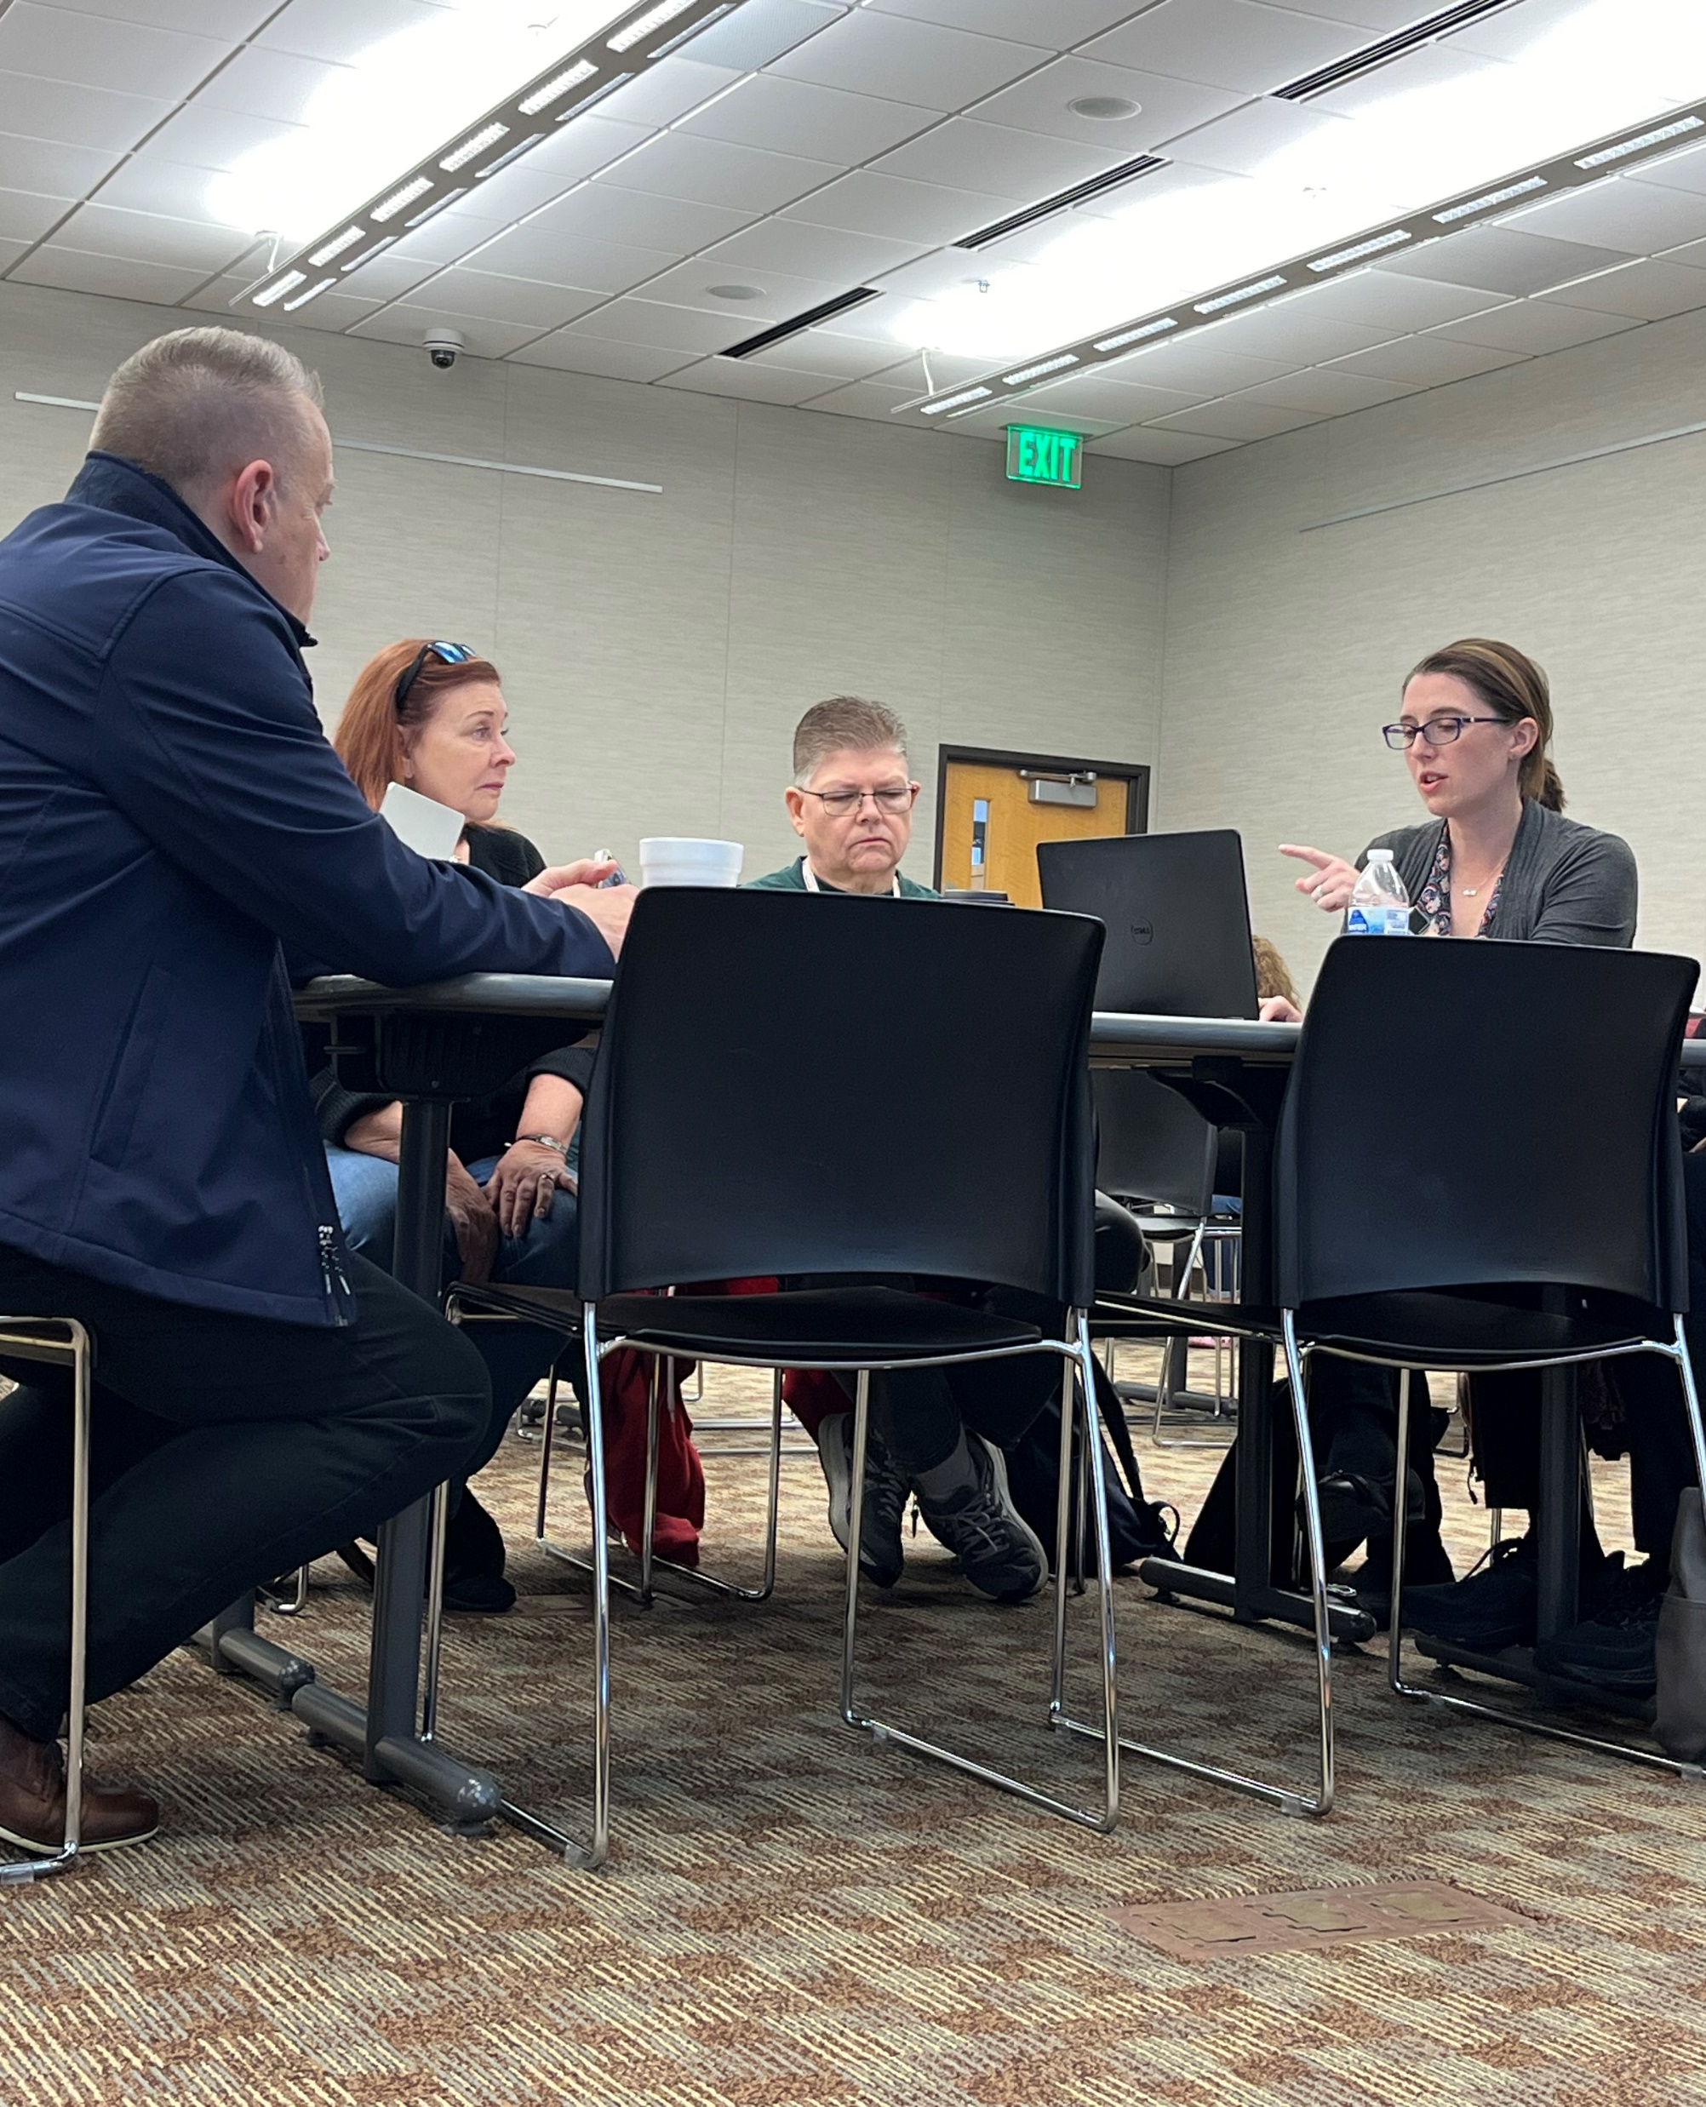
Goal #5: Support Organizations and Improve Collaboration
Objectives:
Provide training materials to support agency staff knowledge of the available homelessness services in Oakland County, improve well-being of service providers, and increase cultural competence of providers.
Group Update:
Collaborate with State & County to create human centered communications.
Model the application process developed by Civilla (Project Re:form) to design a streamlined process to access services.

Slide 10
Blueprint Co-Chairs
Khadija Walker-Fobbs, Officer
Oakland County Neighborhood & Housing Development
Leah McCall, Executive Director
Alliance for Housing, Oakland County Michigan’s Continuum of Care

Slide 11


