Slide 1
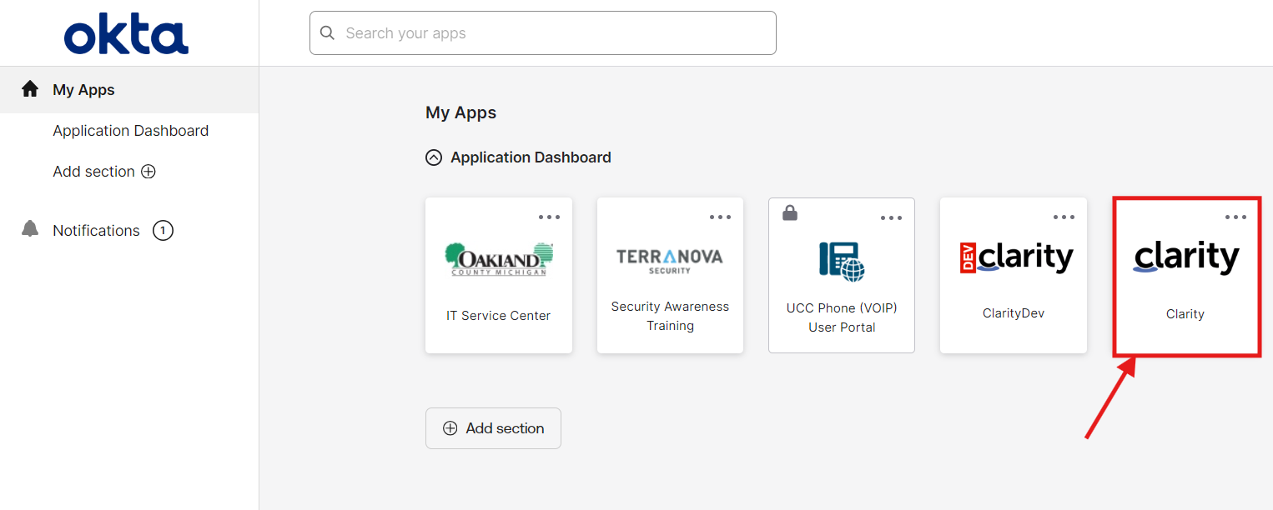
My Timesheet – Add & Select Tasks Job Aid
My Timesheet
Add and Select tasks to enter and track time within Clarity
Access Clarity
Navigate to Oakland County okta
Click on the Clarity icon
Enter your okta verify when requested
Clarity will open and display a module based on your user group

Slide 2
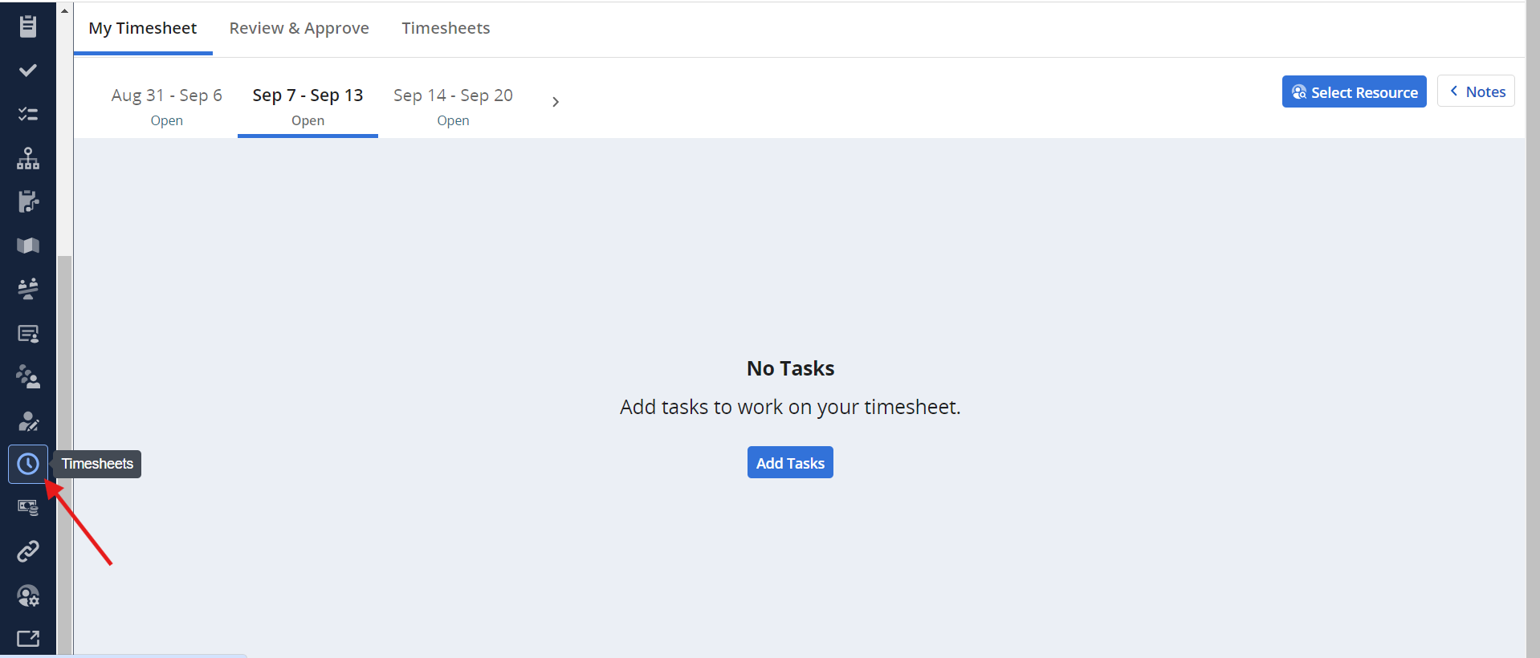
My Timesheet – Add & Select Tasks Job Aid
Accessing My Timesheet within Clarity
On left navigation pane within Clarity, click on Timesheets
My Timesheet will display

Slide 3
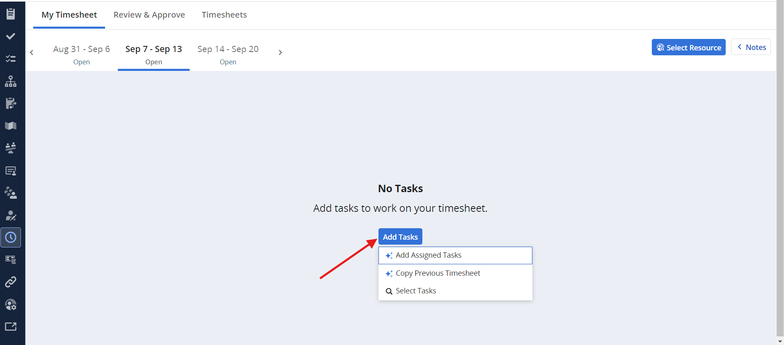
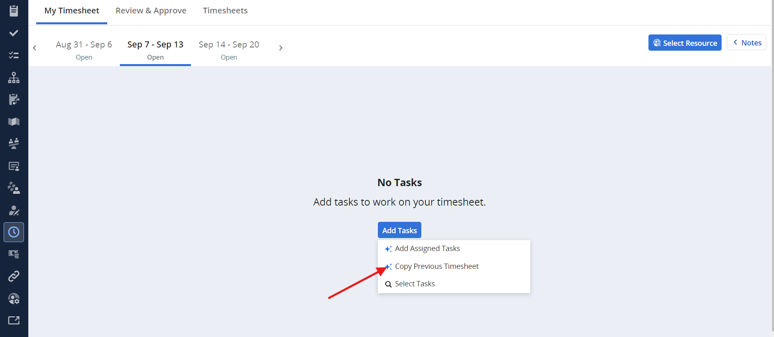
My Timesheet – Add & Select Tasks Job Aid
Copy Previous Timesheet
Select “Add Tasks” Icon
Select “Copy Previous Timesheet” from drop down list
Tasks from previous timesheet will be displayed
1 Week Exception: Do not perform “Copy Previous Timesheet” during the first week of new Fiscal Year (October)
1 Week Exception: Do not perform “Copy Previous Timesheet” during the first week of new Fiscal Year (October)

Slide 4
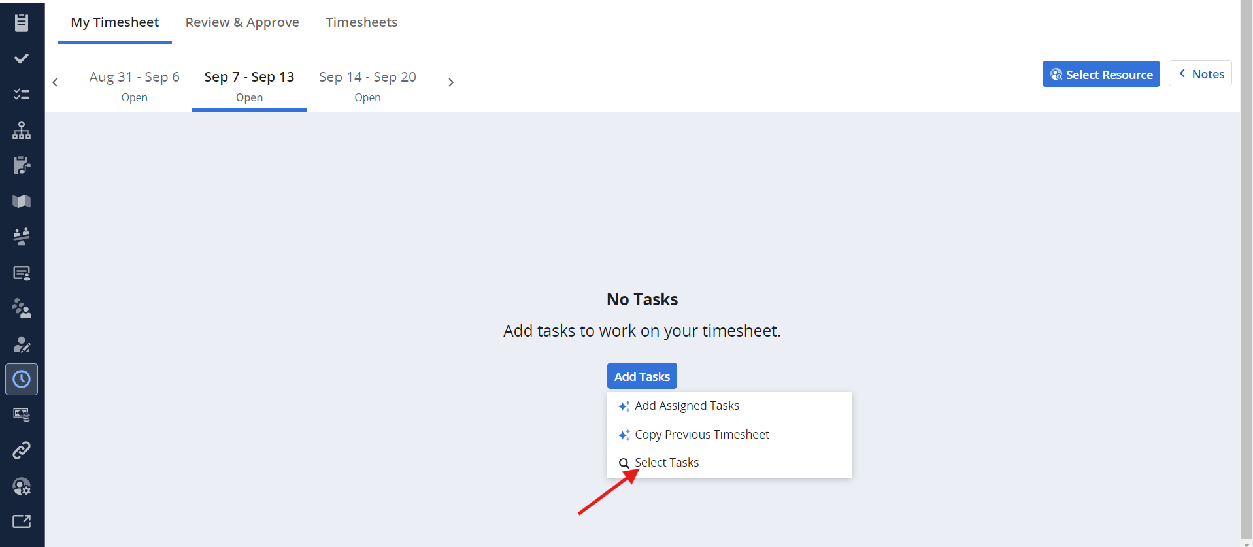
My Timesheet – Add & Select Tasks Job Aid
Select Tasks to be added to My Timesheet
Select “Add Tasks” Icon
Select “Select Tasks” from drop down list

Slide 5
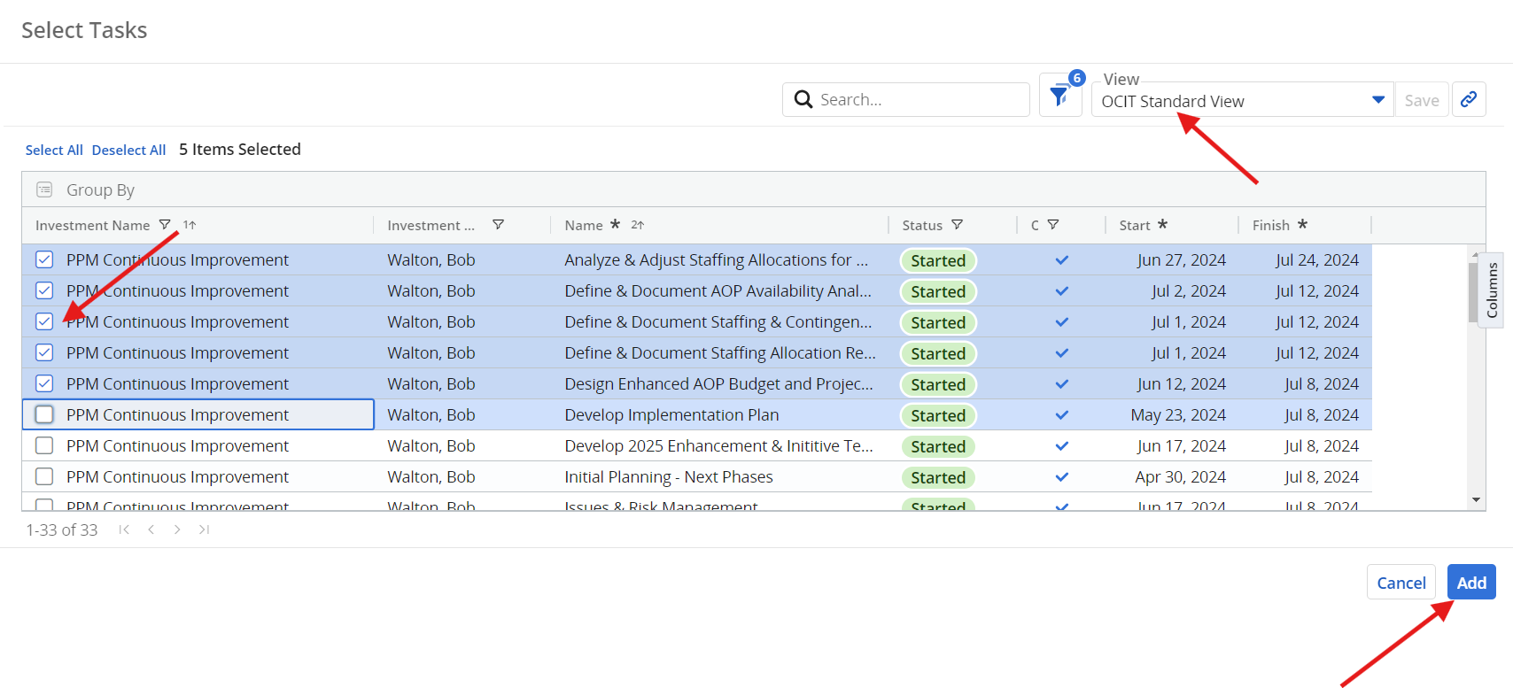
My Timesheet – Add & Select Tasks Job Aid
Use the following views/filters to help find and add tasks to your timesheet:
Use the OCIT Standard View to retrieve a listing of Assigned Tasks
Select/Check the tasks you want to be added to My Timesheet
Click the Add button
2
1
3

Slide 6
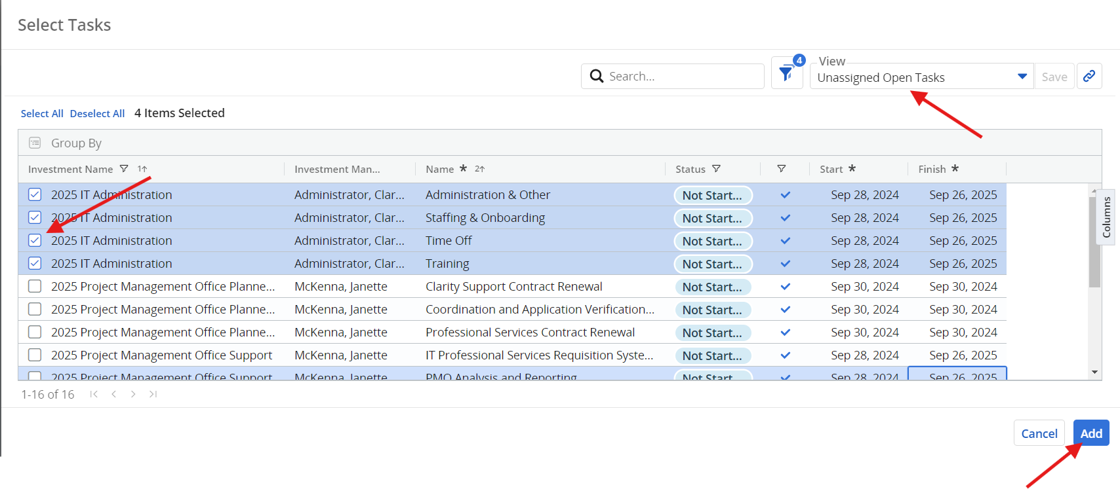
My Timesheet – Add & Select Tasks Job Aid
Use the following views/filters to help find and add tasks to your timesheet:
Use the Unassigned Open Tasks view to retrieve a listing of All Open Tasks available on a project that you have been staffed to.
Select/Check the tasks you want to be added to My Timesheet
Click the Add button
2
1
3

Slide 7
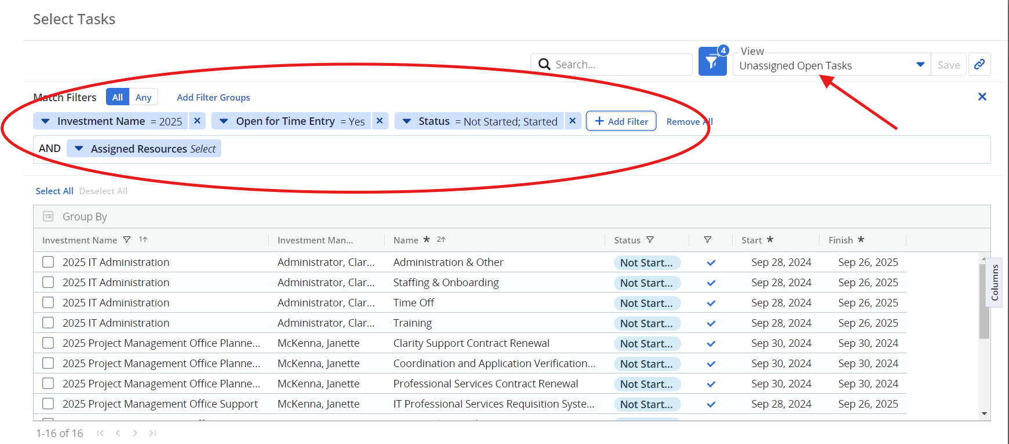
My Timesheet – Add & Select Tasks Job Aid
Important: The Unassigned Open Tasks view must have the following filter settings:
  Investment Name: Contains “2025” or current Fiscal Year
  Open for Time: Is Equal to “Yes”
  Status: Is equal to “Not Started” or “Started”
  Assigned Resources: Do not select

Slide 8
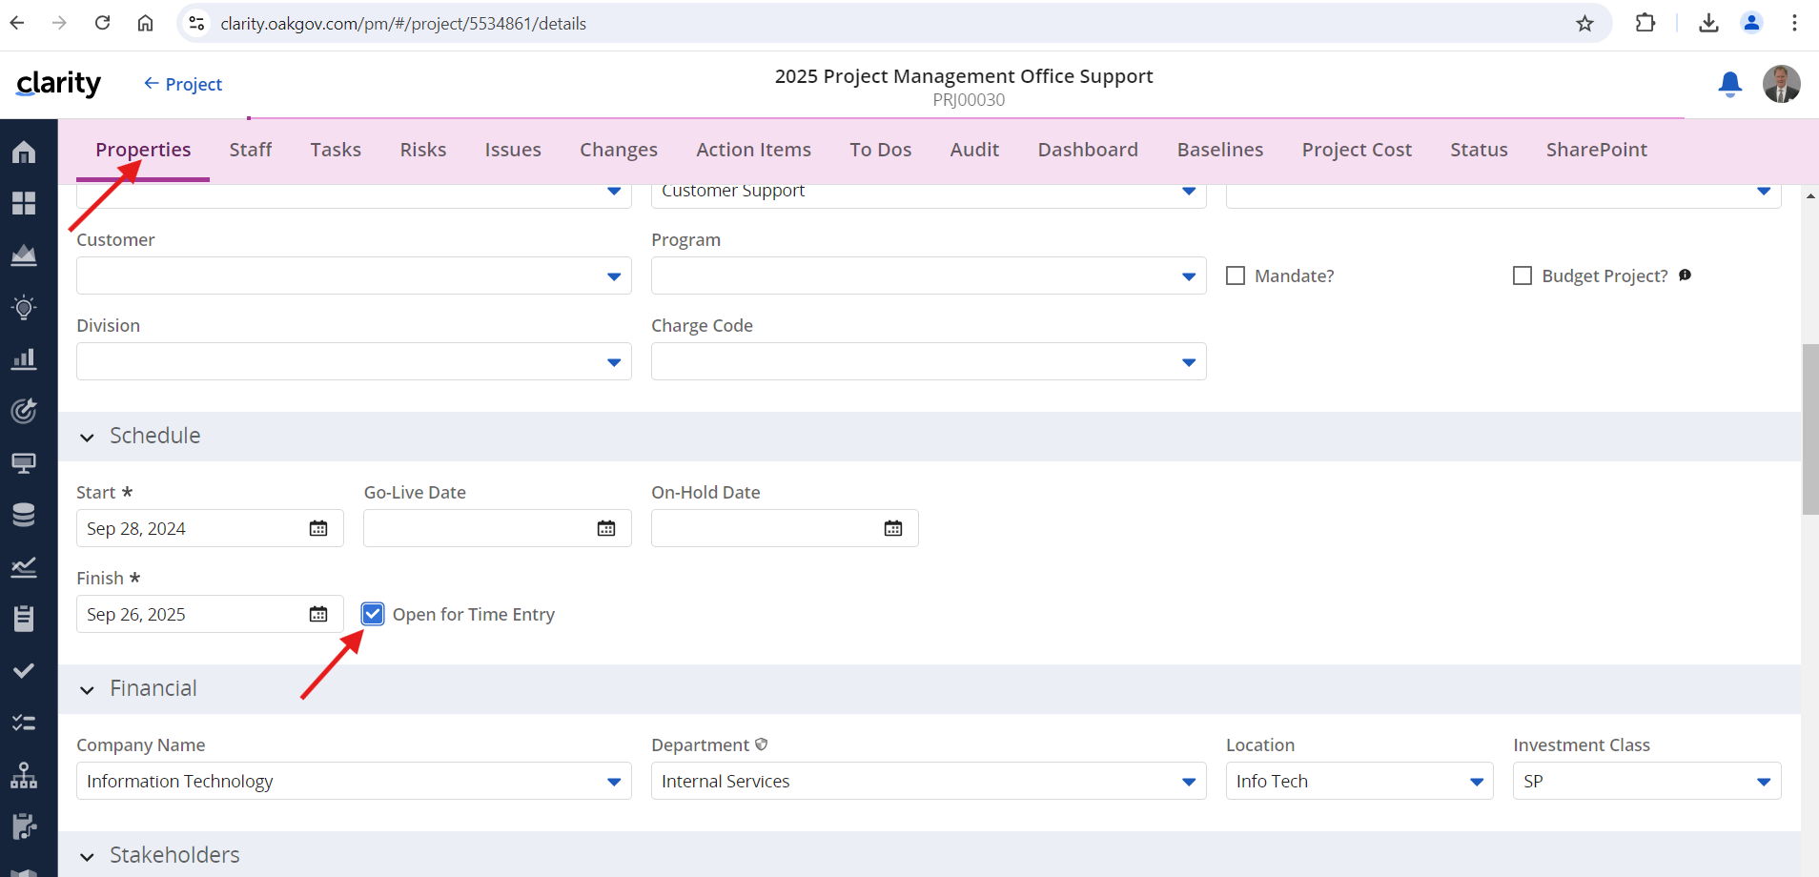
My Timesheet – Add & Select Tasks Job Aid
Note for Supervisor/Project Manager: Open for Time Entry must be applied at the Project, Staff and Task levels to support the Timesheet views above. See details below:
Project Level - Project Properties within Clarity must have “Open for Time Entry” checked.

Slide 9
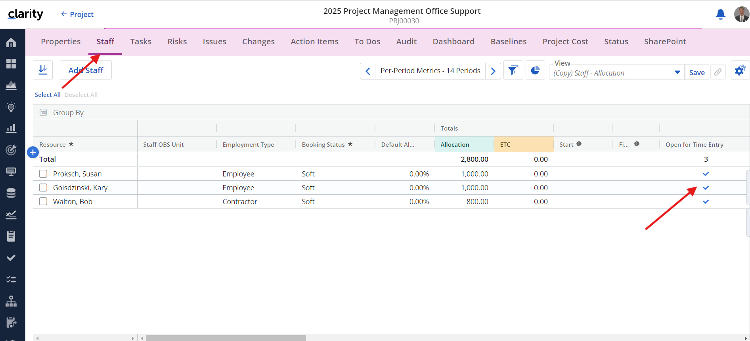
My Timesheet – Add & Select Tasks Job Aid
Note for Supervisor/Project Manager: Open for Time Entry must be applied at the Project, Staff and Task levels to support the Timesheet views above.
Staff Level – Project must be staffed within Clarity with Open for Time Entry checked for every resource added to the project.

Slide 10
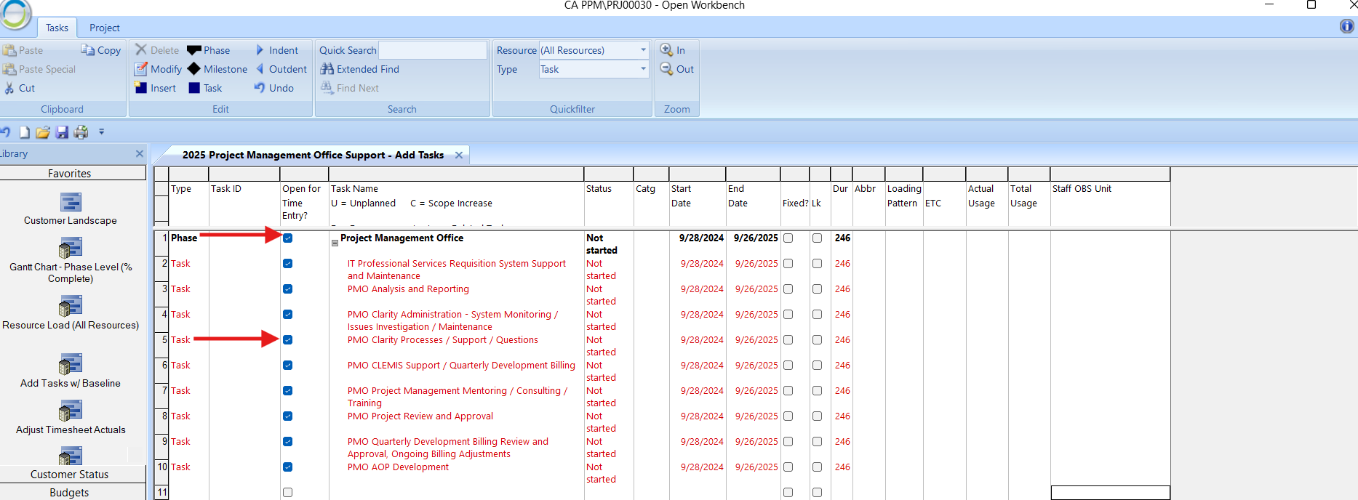
My Timesheet – Add & Select Tasks Job Aid
Note for Supervisor/Project Manager: Open for Time Entry must be applied at the Project, Staff and Task levels to support the Timesheet views above.
Task Level – Project plan must have Open for Time Entry checked for every task and corresponding phase/activity that needs to be accessible on the Timesheet.

