Slide 1

School & Childcare Disease Reporting
Oakland County Health Division
Communicable Disease Unit
248-858-1286
cd@oakgov.com

Slide 2

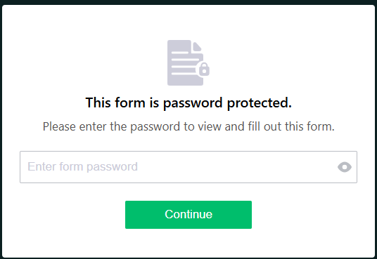
Directions
https://forms.people.health/250264763247964 (Bookmark this site!)
Enter password provided by Oakland County Health Division (OCHD) - email cd@oakgov.com to register

Slide 3
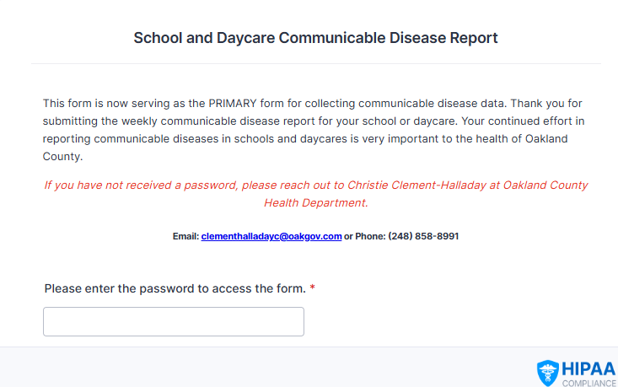
Directions
Re-enter password to access the reporting form:

Slide 4
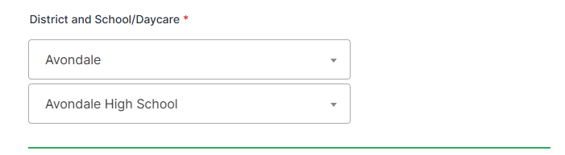
Directions
Choose district and building from drop down menus. If you do not see your building in the dropdown, contact OCHD at cd@oakgov.com or 248-858-1286.
*For private schools, choose N/A for district

Slide 5
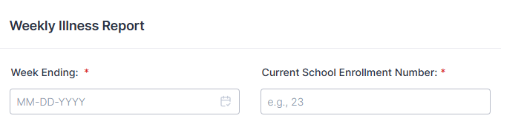
Directions
Click ‘Week Ending’ date you are reporting for (will always be a Saturday)
Enter total ‘Current School Enrollment Number’

Slide 6
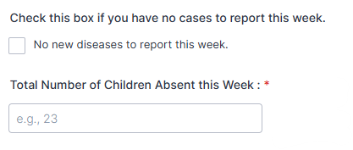
Directions
If there were no students out ill for the week you are reporting, click ‘No new diseases to report this week’.
Fill in ‘total number of absences this week’ – this is a total of ALL absences, not only illnesses. If a child was out more than one day, count each day as a separate absence.

Slide 7
Directions
For the next section, fill in number of students reported absent for each illness, as reported by parent/guardian. Please contact the OCHD Communicable Disease (CD) unit if you are unsure how to classify an illness/symptom.
Here are some examples:
Gastro-Intestinal (stomach) – nausea, vomiting, diarrhea, upset stomach, stomachache, “food poisoning” with no specified organism, “stomach flu”
Strep throat, Influenza, COVID19, RSV, Pneumonia are specific diagnoses that a parent/guardian may report
Flu-like/Other respiratory illness – cough, sore throat, stuffy nose, nasal congestion, sneezing – with no specific disease/pathogen reported
Rash Illnesses – any rash with no specific disease/pathogen
Other Illnesses – fever, headache, muscle ache, tired, general “doesn’t feel good”, any symptom that does not fit in one of the categories above

Slide 8
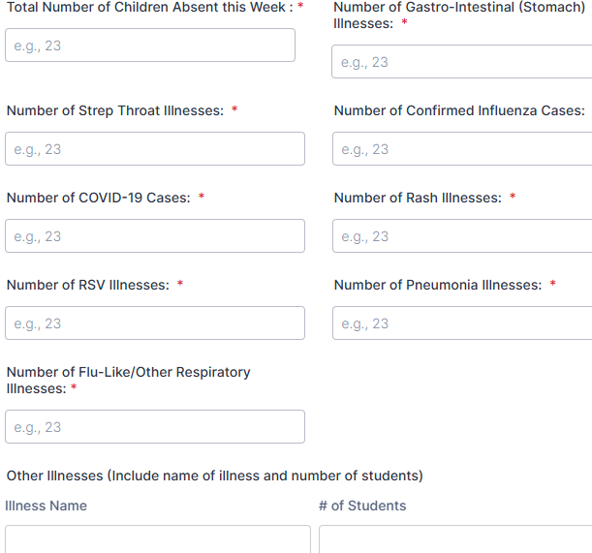
Directions
Notes:
Here are some examples:
Gastro-Intestinal (stomach) – nausea, vomiting, diarrhea, upset stomach, stomachache, “food poisoning” with no specified organism, “stomach flu”
Strep throat, Influenza, COVID19, RSV, Pneumonia are specific diagnoses that a parent/guardian may report
Flu-like/Other respiratory illness – cough, sore throat, stuffy nose, nasal congestion, sneezing – with no specific disease/pathogen reported
Rash Illnesses – any rash with no specific disease/pathogen
Other Illnesses – fever, headache, muscle ache, tired, general “doesn’t feel good”, any symptom that does not fit in one of the categories above

Slide 9

Directions
OCHD does not generally make the decision to close a school outside of an official Public Health Order, however we are happy to consult regarding infection control measures when there is widespread illness.

Slide 10
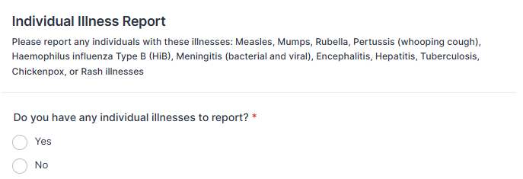
Directions
Please include all requested information so OCHD CD unit can follow up with parent/guardian and provider (see next slide):
  Disease (drop down menu): measles, mumps, rubella, pertussis, HiB, meningitis, encephalitis, hepatitis, tuberculosis, chickenpox
  Student name, date of birth, name of disease, address, parent/guardian name/phone
It is helpful also to give us a call so we can respond quickly, especially in cases where contact tracing, post-exposure medications/vaccines, and/or school exclusions may be recommended.

Slide 11
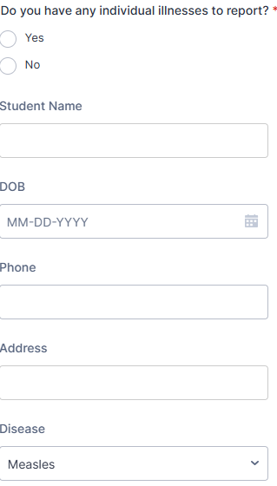
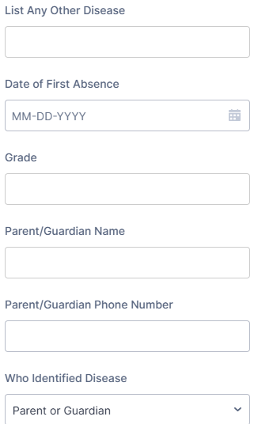

Directions
Notes:
It is helpful also to give us a call so we can respond quickly, especially in cases where contact tracing, post-exposure medications/vaccines, and/or school exclusions may be recommended.

Slide 12
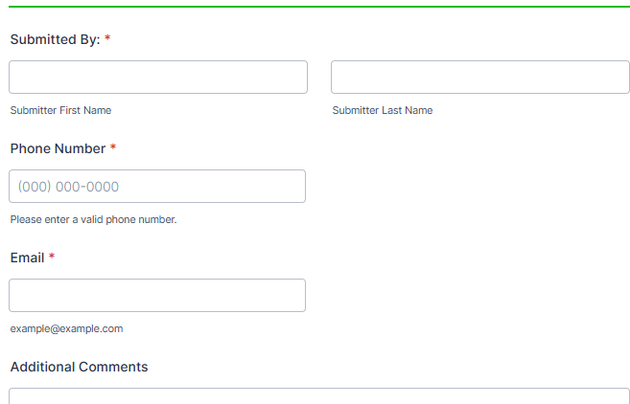
Directions
Your name and contact information:

Slide 13


